Slide 1


Slide 2
GP and patient’s alliance
For the elimination of modifiable risk factors

Slide 3
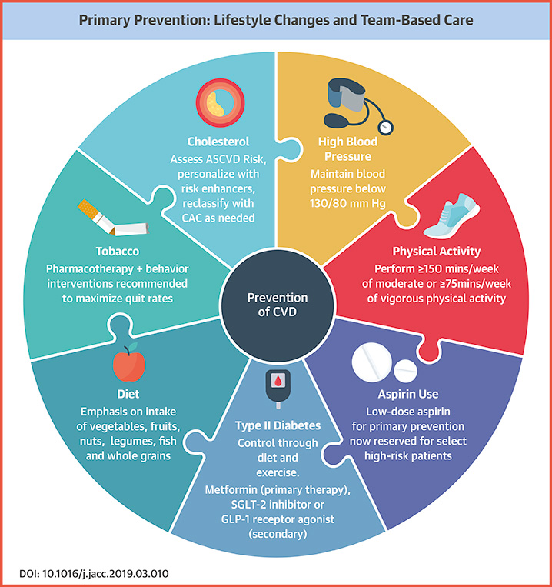
Our goal
Our goal is to minimize the CV risk
Risk factor goals:
  No smoking
  Balanced diet
  Adequate physical activity (> 150 minutes/week)
  Adequate body weight (BMI 20-25 kg/m²)
  Blood pressure control (<140/90 mmHg but depending on individuals)
  LDL, HDL cholesterol and triglycerides depending on risk levels
  Diabetes control

Slide 4
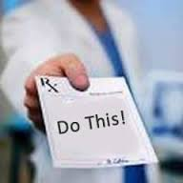
What is Our real goal?
If we just prescribe drugs, actions, initiatives to people, do we really reach our goal?
We might be wrong in many aspects:
  Interference with a person’s autonomy
  Decisions are not shared
  Decisions may not be fully understood
  Unable to define if a person can correctly apply our directives

Slide 5

In the end, this might happen
Anna: My asthma… They said they’d fix it, but it didn’t make any difference at all
House: Well, sometimes doctors make mistakes, Anna, and we have to try twice as hard to fix them… Are you using your inhaler?
Anna: All the time. I go through one a week.
House: Are you sure you're using it right?
Anna: Do I look like an idiot?
House: Nope... Why don't you show me how your inhaler works.
https://www.youtube.com/watch?v=zSSoYmQS6Ng

Slide 6
Data about compliance: how adherent are patients?

Slide 7

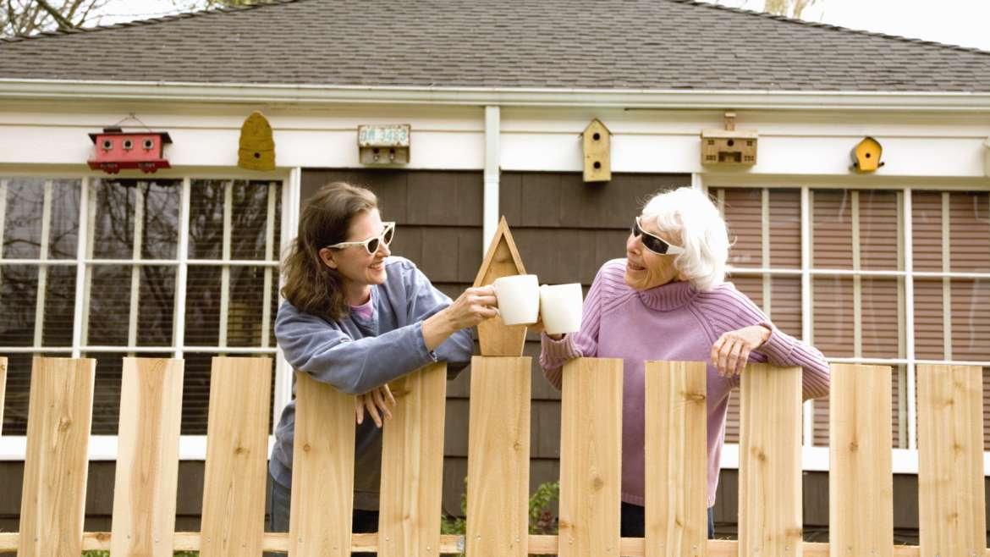



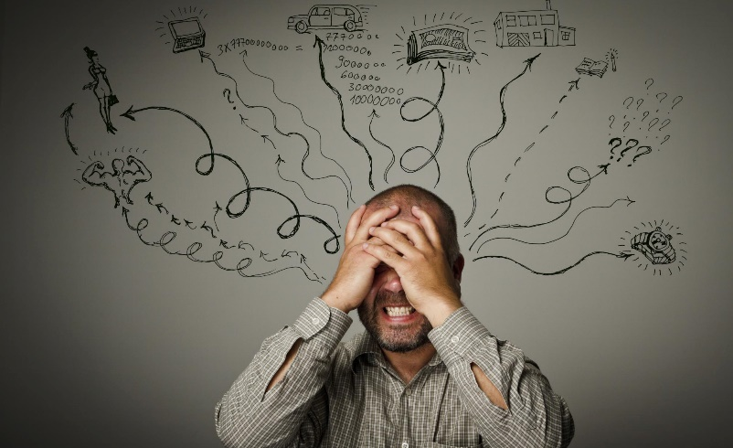
Who’s responsible for patient’s health?
Notes:
So we have to move on from the classic paternalistic approach (to which the doctor is pushed under the influence of very tight bureaucratic constraints) to a different relationship in which the patient is influenced by other forms of information (the neighbor or the internet) and is influenced in his choices by other interests (work, but also other thoughts and problems). Yet in the end, he or his caregiver is responsible for everything, because it is he who decides whether or not to take any drug or act in any healthy way once he is at home, alone.

Slide 8
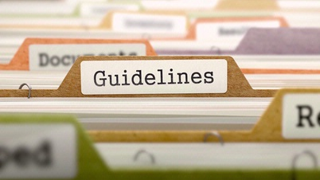
So we need to forge an alliance…
Notes:
Ci ritroviamo schiacciati tra quelle che sono le linee guida e quella che è la vita reale che spesso si presenta in forme che non sono previste dalle linee guida per cause burocratiche, logistiche o semplicemente per volontà del paziente

Slide 9
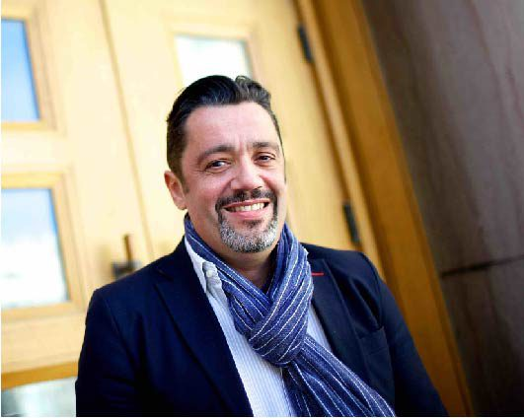
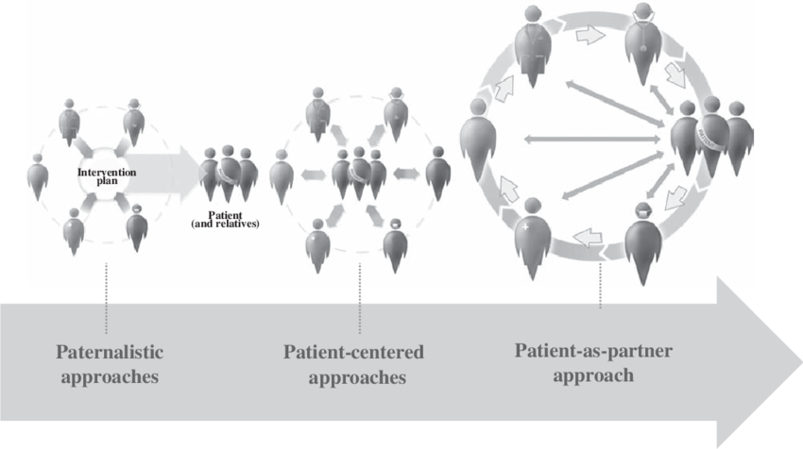
What should we listen to?
Notes:
Therefore, it is necessary to move from an approach on symptoms (paternalistic or informative) to an involvement of the patient, not only in the illustration of needs (in fact, if we take care of everything, we end up straight into burnout) but in taking an active part in his health, through evaluation of its expertise and its empowerment.

Slide 10

Structure of a modern medical consultation (PRACTICAL)
Prior to consultation there’s the patient history
Relationship: permission to connect
Anxietis: the patient expresses ideas, concerns, expectations
Common language: summarize to align the patient’s thoughts to medical knowledge
Translating from real life to medicine: verbal and physical examination
Interaction: define shared understanding
Converting insight into action: proposal of actions and prescriptions
Agreement check
Leave from consultation

Slide 11
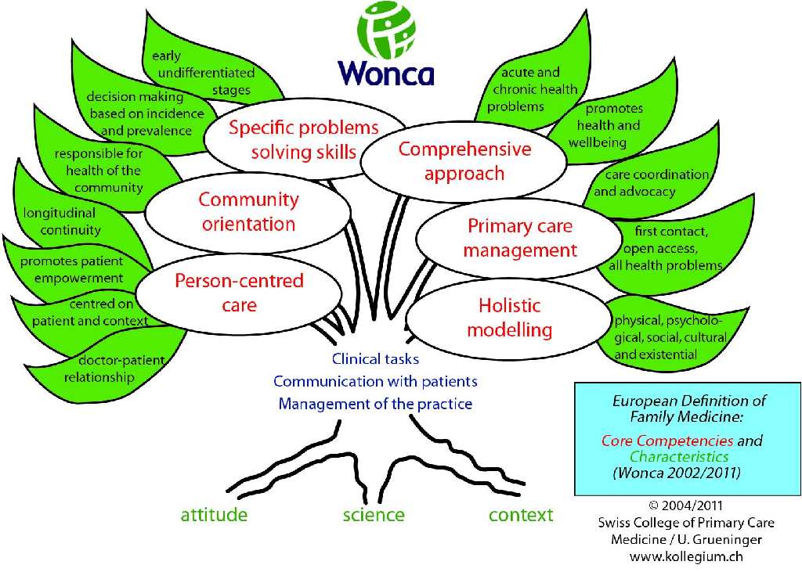
Why is general practice the best option?

Slide 12
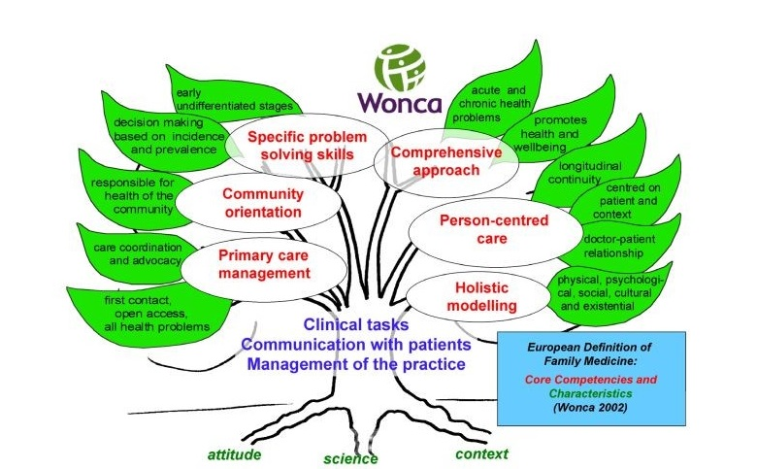
Why is general practice the best option?
Direct access
Trust and knowing the patient is important in changing lifestyles
Chance of multiple accesses and follow up
Knowledge of the opportunities (es: Al Anon) in the patient’s specific community
Education skills and capacity to empower the patient
Advocacy and political impact
Chance to associate a drug therapy (vareniclin, disulfiram)

Slide 13
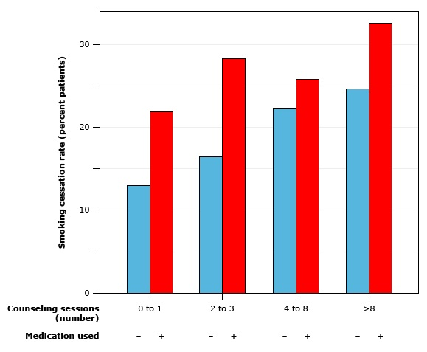
Do alliance and counselling work?
Notes:
These are 2 graphics showing that the conuselling for smoking cessation and for an increase in physical activity after 12 months is efficient.

Slide 14
Behavioral Counseling in people without risk factors
The net benefit of counseling about healthy living in people who are already relatively healthy is small but still positive.

Slide 15
Why is general practice the best option?

Slide 16
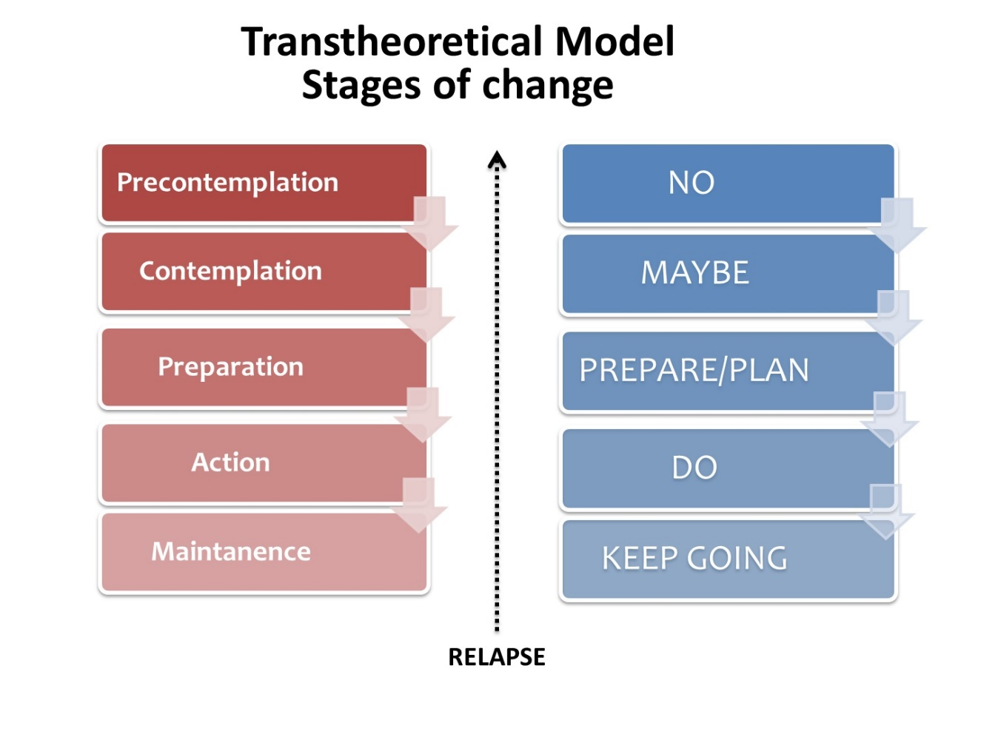
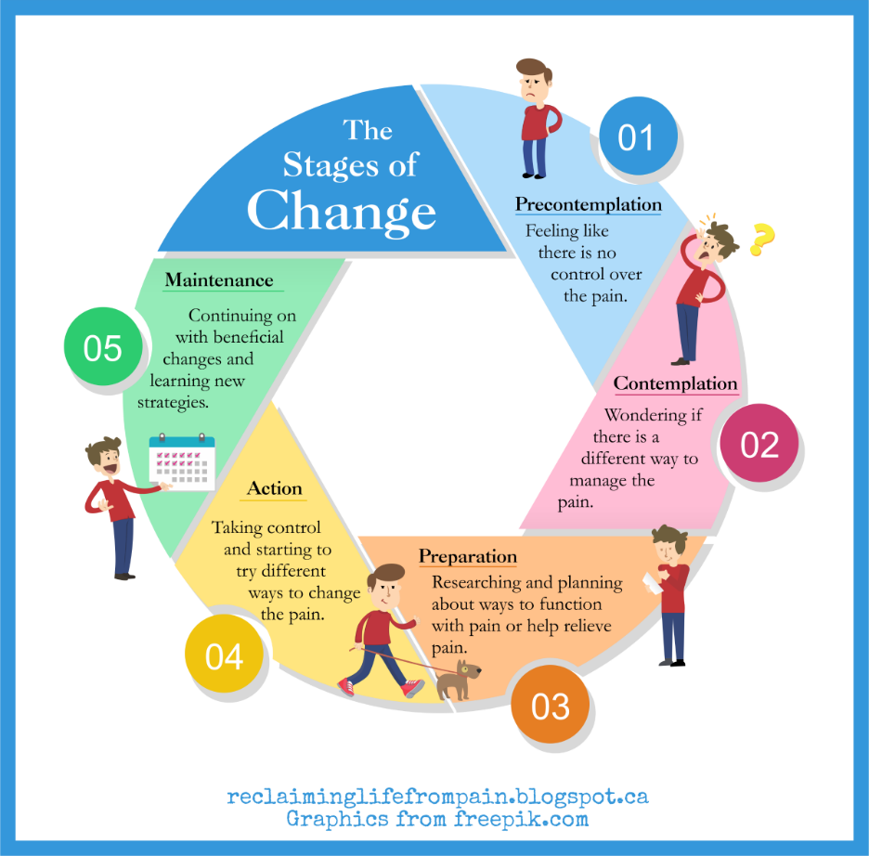
Transtheoretical model of health behaviour change

Slide 17

Precontemplation
The person doesn’t intend to take action in the next 6 months
This can happen because of denial or ignorance of the problem
Strategies:
  Inform
  Assess risks of current behaviour
  Ask if ever thought of changing

Slide 18

Contemplation
The person intends to take action in the next 6 months
The person’s approach is ambivalent: he/she is aware of the pros of changing, but the costs represent a barrier
Strategies:
  Weigh pros and cons
  Identify barriers to change
  Confirm readyness and ability to change

Slide 19

Preparation
The person intends to take action in the next month
The person’s decided to act, but the plan is still ambiguous or uncertain
Strategies:
  Prepare a plan for action
  Define the short and long term goals
  Strengthen the will to change

Slide 20

Action
The person has started to take action in the past 6 months
The person’s taking action towards a goal, but obstacles may stop, expecially if not planned adequately
Strategies:
  Reinforce change
  Reward the success
  Seek for social support

Slide 21

Maintenance
The person has started to take action in the more than 6 months ago
The person’s taking action and is less tempted to relapse (but it’s still possible)
Strategies:
  Reward the success
  Develop strategies to cope with temptation

Slide 22
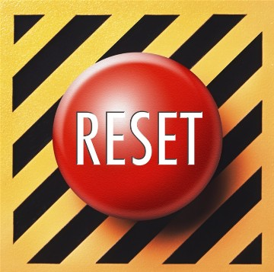
Relapse
The person relapses to his/her bad habit
The person’s disappointed and frustrated, with feelings of failure
Strategies:
  Recognize relapse as a natural part of changing
  Identify the triggers that lead to relapse
  Make new resolutions and set new goals

Slide 23
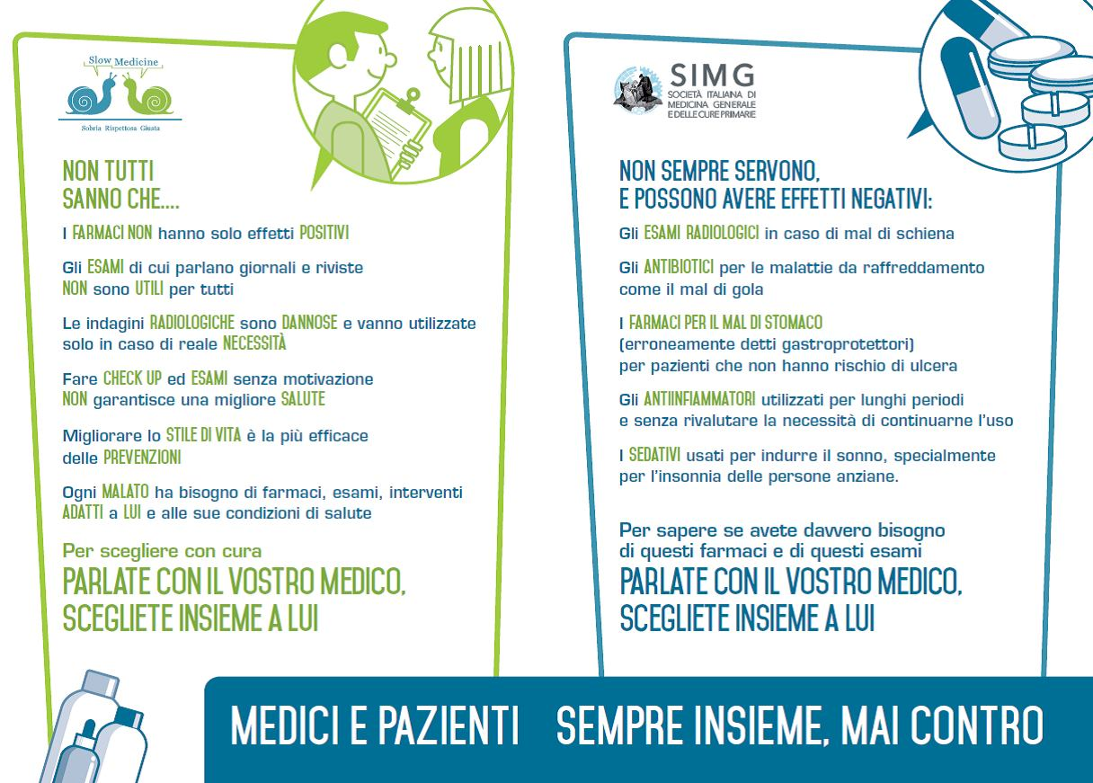

What can we do to improve?

Slide 24
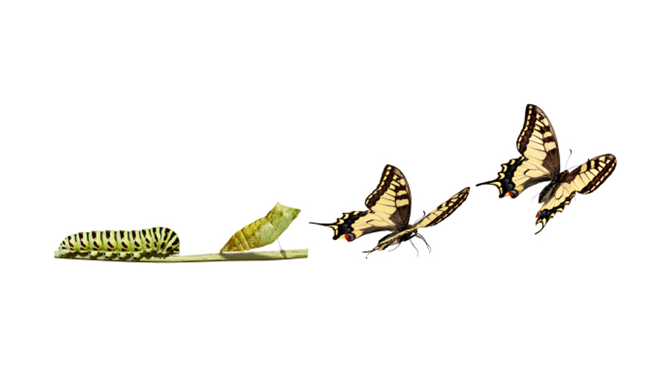
Thank you

