Slide 1
The Societal Impact of Pain platform – from European to national engagement
Sam Kynman – Executive Director, European Pain Federation EFIC
Brussels, April 2018

Slide 2
EUROPEAN Pain federation efic
A multidisciplinary professional organisation in the field of pain research and medicine
Made up of 37 European chapters of the International Association for the Study of Pain (IASP®)
Representing close to 20,000 physicians, basic researchers, nurses, physiotherapists, psychologists and other healthcare professionals across Europe
President – Bart Morlion

Slide 3
EUROPEAN Pain federation efic
Education
Research
Advocacy

Slide 4
What is SIP?
SIP objectives:
To ensure access to adequate pain treatment for all citizens
To unite all organisations and societies advocating for better pain care to jointly address, define and foster pain policies

Slide 5
SIP has been successful AT EUROPEAN LEVEL
European Commission’s decision to dedicate a Stakeholder Group to the ‘social impact of pain’
EU Health ministers call for action on access to treatment for patients suffering from chronic pain
World Health Organisation proposes new definition of chronic pain, giving hope to patients
Pain addressed in current EU research programme – and hopefully in future programmes
Great support amongst EU stakeholders such as MEPs, Commission officials and member state civil servants

Slide 6
IASP: Desirable Characteristics of National Pain Strategies
Key recommendations are:
Access to pain education for health professionals and the general population
Coordination of the care system to ensure timely access to the right support
A quality improvement program to address access and standards of care
A reasonable proportion of direct and dedicated funding for pain research
Critical factors for success are:
Gathering of evidence on the burden of pain to the nation
Gathering of information on access to care
Development of government policy on pain services
Formation of a broad coalition of stakeholders
A clear plan with timescales to achieve strategic actions
The International Association for the Study of Pain (IASP) supports the development of policies that ensure implementation of advances in both the science and delivery of health care for people in pain.
The document should be read in conjunction with the Declaration of Montréal asserting that access to pain management is a fundamental human right.
https://www.iasp-pain.org/DCNPS?navItemNumber=655

Slide 7
SIP 2018 – Supporting national SIP platforms
Share results
Secure implementation (e.g. National SIP platform)
Ensure policy support (e.g. via Parliamentary intergroups)
Identify target audience (e.g. key Members of Parliament)
Train SIP advocates in standardised methodology
Identify national SIP allies and priorities
SIP steering committee

Slide 8
SIP 2018 – Supporting national SIP platforms
SIP is live in:
Malta
France
Cooperation is starting in:
The Netherlands
Portugal
Belgium
Slovenia

Slide 9
SIP stakeholder Group and thematic network
Thematic network: 1-year project aimed at producing a joint statement on the societal impact of pain builiding on existing relevant intiaitives and aimed at providing input to EU health policies, open to all the members of the EU health policy platform
Stakeholder group: long term platform to collect best practices and provide a forum for dialogue and exchange to the pain stakeholder community (accessible upon approval of the moderators EFIC and PAE)

Slide 10
Sip JOINT STATEMENT – our timeline
April – June
gather data and draft the framing paper
25 June
first WebEx Webinar with the Commission and other members of HPP with the objective to call for comments and endorsement of the framing paper
20 September
second WebEx Webinar with the Commission and other members of HPP with the objective of gathering input on the joint statement
November
Presenting the final joint statement at the Commission premises
Opportunities for engagement all across the project!
And then what? .....
....Build on the work of the joint statement to jointly address, define and foster pain policies!
Notes:
Detailed timeline of the initiative
Connecting with relevant existing initiatives – April - May
- We are reaching out to the Health Workforce Joint Action, to CHORDIS+ and ECDA to ensure alignment with their initiatives and see how we can fit in/build on them and we aim to include anything relevant that come from these contacts in the next steps of the joint statement
Information gathering – till mid-May
-We are currently collecting all the relevant data among our networks of partners and endorsers and participants on the EU health policy platform and we are hosting it in the library of the SIP thematic network – we will gather data until the 11 of May
We are organising the data to collect around:
Data on the impact of pain on societies, economies and people (on national and/or European Level)
examples of policies addressing the societal impact of pain (national and European)
examples of advocacy initiatives addressing the societal impact of pain
examples of research initiatives addressing the societal impact of pain
examples of initiatives to educate the health workforce and patients on pain
Framing paper compilation – till early June
- From the 11 of May to early June we will draft a framing paper, build on the evidence collected and outlining issues to be addressed in policy
- We aim to share the draft framing paper with the Commission and with the thematic network two weeks in advance of our webinar, which will take place on 25 June
Presentation of 1^{t} Framing paper document at 1s webinar – 25 June 11.30 am
- Present the 1st Framing paper and ask stakeholders for their contribution and input on the recommendation
- Produce the joint statement on the basis of the input received
Publish new draft of the joint statement on thematic network, disseminate, further engage stakeholders to ensure input
Presentation of Framing paper and Joint Statement at 2nd webinar – 20 September 11.30 am
- Present Joint statement/call to action and ask stakeholders for their contribution and input
- Produce final joint statement on the basis of the input received and present it to the Commission - November date TBC

Slide 11
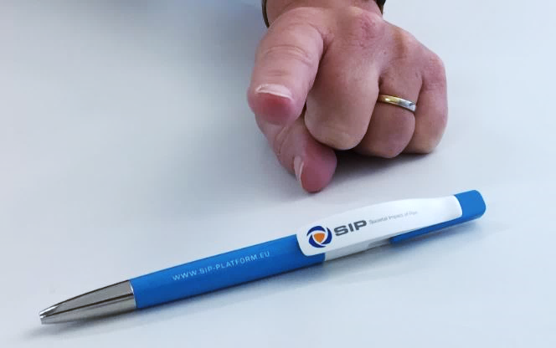
Sip JOINT STATEMENT – HOW TO GET engaged?
The first opportunity for engagement is right now!
Join the Health Policy Platform and our Thematic Network
Share any documents or links to web pages you deem relevant on the following topics:
Data and documents on the impact of pain on societies, economies and people (on national and/or European Level)
Existing policies addressing the societal impact of pain (national and European)
Existing advocacy initiatives addressing the societal impact of pain
Existing research initiatives addressing the societal impact of pain
Existing initiatives to educate the health workforce and patients on pain
Please provide your contribution by the 11th May 2018.
Notes:
Further info on how to engage
Documents here above could represent your own organisation’s initiatives, or initiatives and actions that you know they exist and you think they relate to the proposed subjects. We are building a knowledge base and would like to include as much as possible of the literature on these Topics.
How to contribute exactly?
You can send the documents or relevant links to sources to Vittoria.carraro@efic.org and at a.pop@pae-eu.eu. Should you have any doubts or questions, please don’t hesitate to contact us both at the same addresses.
Specifications on the documents: we understand that there are a lot of initiatives in several European languages, but for the scope of this initiatives we need to limit ourselves to English.
To engage with the Societal Impact of Pain partners at national level, please follow our ongoing work on creating national societal impact of pain platforms here.
Please provide your contribution by the 11th May 2018.

