Slide 1


Slide 2
The indirect impact of health emergency in patients suffering from cardiovascular disease
Dott.ssa Alessandra Medolla

Slide 3

Notes:
Due to the infection risk, all the people were advised to stay at home, observe social distancing and don’t access to health care services, in particular elderly and frails people that on the one hand have the worst outcomes in COVID, on another, they are the frequent attenders due to comorbidities and different needs. The consequences of this necessary limitations are differents

Slide 4
Social and physical isolation
Psychological distress
Limited access to care
Decreased medication adherence
Adoption of unhealthy lifestyle behaviours

Slide 5
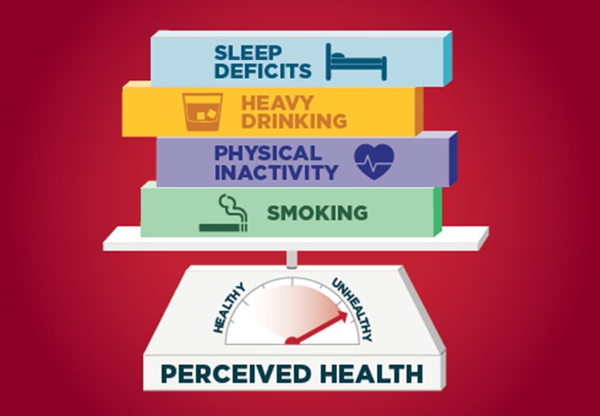
Notes:
As we already know due to the restrictions of movement people experienced sleep deficit caused by different issues as physical inactivity or anxiety, physical inactivity is a big problem to solve in particular for people leaving in urban areas; a study has estimated that on the contrary people living in rural areas adopted a more active lifestyle because of the possibility to practice sport in total loneliness. Plus, anxiety isolation and in many cases, the loss of work has increased the assumption of alcohol, cigarettes and other substances, in part this behaviour is encouraged by advice about the protective effect of tobacco consumption toward COVID-19. Alcohol consumption, usually considered protective for an unspecified effect on cv system, may have a dangerous effect on the heart with a high risk of life‐threatening arrhythmias. Alert about the use of medications as sartans, ace-inhibitors, and selective serotonin reuptake inhibitors in covid have had a bad influence on the adherence to the therapy.

Slide 6
Unhealthy dietary intake
Decreased physical activity
Substance consumption
Notes:
Advice about protective effect of tobacco consumption toward COVID-19
Alert about the use of medications as sartans ande ace-inhibitors and selective serotonin reuptake inhibitors
Alcohol consumption may have a dangerous effect on heart whth a hifg risk of life‐threatening arrhythmias.

Slide 7
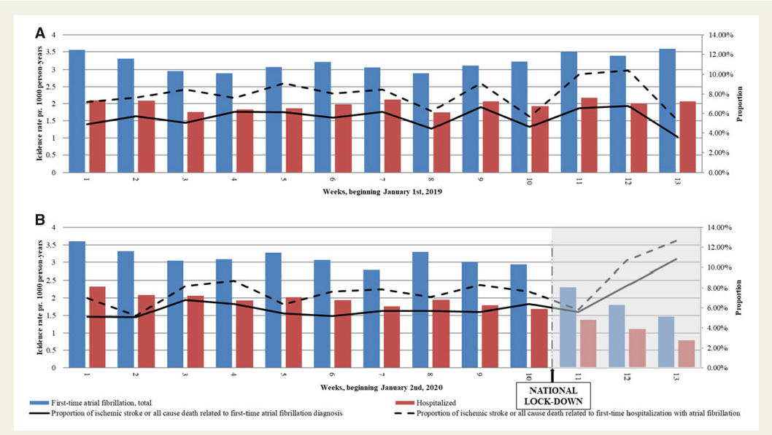
Diagnosis of FA in Denmark
Notes:
●A Danish study has registred an important decreasing of af diagnosis after national lockdown compared with the same period in 2019 and the previous period of 2020. A worrying issue is the important increment of the number of ischemic strokes and all-cause death due to AF in and out of hospital

Slide 8
the diagnosis of new-onset AF decreased by 47%
High prevalence of comorbidity (Cancer. Hearth and vascular disease)
younger and with a lower CHA2DS2-VASc score
Notes:
Patients diagnosed with new-onset AF during the lockdown were younger and with a lower CHA2DS2-VASc score

Slide 9
Dicresead number of diagnosis
Reduction of routinary medical evaluation
Reduction of Hospital access
Programmed services activity postponed
Notes:
Gp: the major part of the AF are diagnosticated with an opportunistic evaluation and ECG in primary care, both reduced during lock-down

Slide 10
younger and with a lower CHA2DS2-VASc score
Higher access to technology?
Older people encouraged to stay at home
Better physical resources
From 2% to 12% the new-onset AF contact

Slide 11

Technologycal GAP between generations
Notes:
●The technological gap between generations play a role in the access to care in this periods, elderly, unexpert and poor access to the technology of a part of the population increase the GAP, thinking about poor, people with disabilities, clandestines

Slide 12


Congestive Heart Failure: Foundations of management
Healty behaviours
Avoid smoking
Follow-up
Regular clinical evaluations
Intake of salt
Weight control
Adherence to therapy
Physical activity
Notes:
●During the sixth and seventh weeks of lockdown (which started 17 March 2020), 150 randomly selected CHF patients from the Dijon University Hospital Heart Failure Clinic cohort. The study enlighted that the major part of the patient put in place unhealthy behaviours like increased consumption of tobacco, less control of weight, people don’t undergo regular evaluations, but they refer a constant adherence to therapy

Slide 13
“At the same time, a significant number of patients (≈20%) switched from an in‐person consultation to telemedicine after the initiation of the lockdown”
Notes:
●And this is an encouraging argument, but we have to wait a long time until it will universally put in place in all the health system

Slide 14
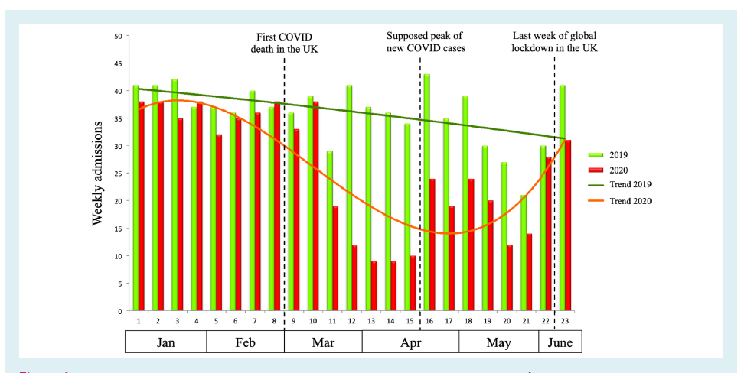
Report from heart failure referral centres-London
Hospital admissions
Notes:
The impact of the COVID-19 pandemic on health care systems has been all-encompassing. Similarly to other cardiovascular conditions, hospital admissions for decompensated HF have
consistently declined during the outbreak

Slide 15
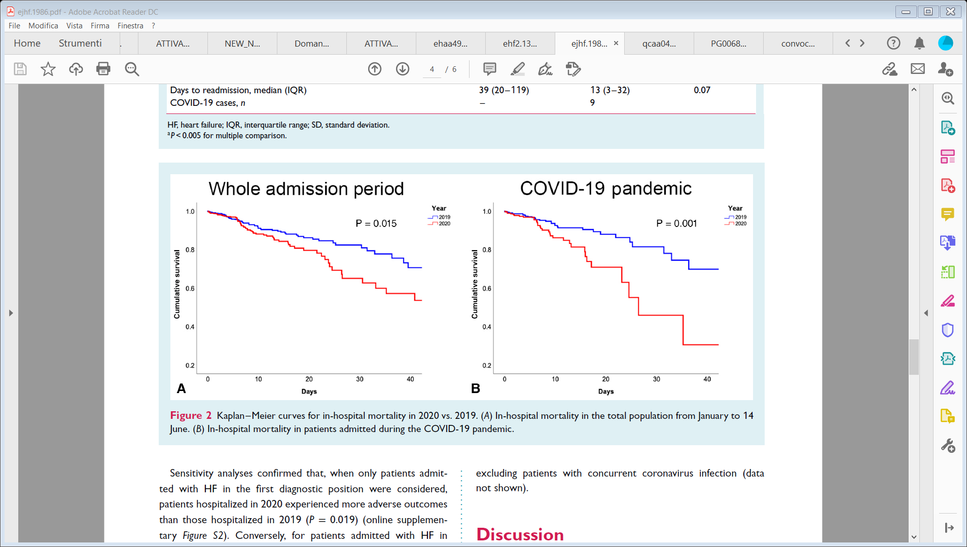
In Hospital mortality- Congestive heart failure
From 14° January to June 2020
In Hospital mortality was significantly higher compared with the same period in 2019
People admitted in the lock-down period had worse clinical conditions
Notes:
●Patients admitted with HF in 2020 experienced worse outcomes compared with those admitted in 2019. Indeed, in-hospital mortality was significantly higher in 2020 compared with 2019. The fear of contagion had played a huge role in the delay of access to hospital

Slide 16
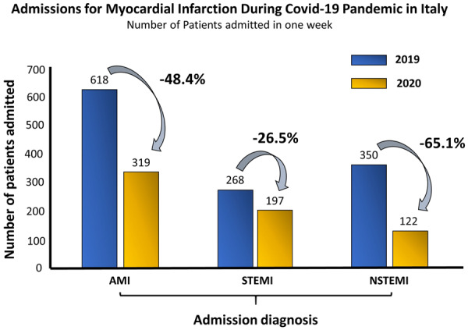
fear of contagion
most healthcare resources relocated to manage the pandemic
Notes:
This data show the dramatic reduction in the number of hospitalizations for AMI across Italy during the COVID-19 pandemic. In fact, admissions for AMI were halved during the pandemic compared with the equivalent period of the previous year.

Slide 17
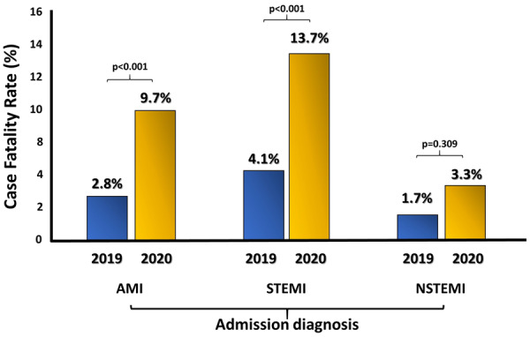
Increasing of time to have a revascularization procedure
Worsen conditions of people admitted
The higher reduction of admissions for STEMI among women (41.2%) compared with men (25.4%)
Notes:
●The number of fatal cases of acute myocardial infarction and stemi was tripled,

Slide 18
Dicreased admission rate
HF 47%
AMI 48%
PE 62%
AF 53%
Notes:
The lower admission rate for HF (46.8%),PE (63.2%), DF (29.4%), and AF (53.4%) is also worrisome.

Slide 19
Starting from this data
Responsible use of Health Service
Mind the gender GAP
Reallocate funds
Notes:
●What measures do you think could help to manage the «usual emergencies» in covid emergency period? I propose a reallocation of funds because investments are essential to improve every sector of the health care system to enable it to face all the event, covid and all the other situations that like in all the periods occur. All the citizens have to be informed and conscious about the limit of the availability of the health care system and use it properly. People and governments have to see with worry the gender GAP about the access to the cure of women, we already know that women die more than men due to cardiovascular disease and one of the major cause is the delay of access to care, is it a health care system problem or social problem?

