Slide 2
Successful advocacy experiences on CVDs: Stroke advocacy in Europe
Arlene Wilkie,
Stroke Alliance for Europe, Director General

Slide 3
My presentation
Stroke Alliance for Europe – who we are and what we do (2 slides)
Top 9 tips for successful advocacy in stroke (11 slides)
What we have achieved and what we are doing (5 slides)

Slide 4
Who we are
Stroke Alliance for Europe (SAFE)
Membership organisation
36 stroke support organisations
30 countries
Represent SSOs views
Represent the voice of patients, survivors and carers

Slide 5
What we do
Vision
To work towards greatly decreasing the number of strokes in Europe and that all who are touched by stroke get the help and support they need.
Aims
To reduce the numbers and the effects of strokes across Europe.
Current priorities
Support stroke patients to receive better access to specialist care and rehabilitation
Encourage and grow stroke support organisations
Campaign at EU level
Disseminate the results of EU research projects
Raise awareness of secondary prevention of strokes
Ensure strong governance and sustainable resources for SAFE

Slide 6
Why advocacy?
Stroke services differ between countries
Each country is autonomous in final decisions of the health services within the country = need for country specific actions
Local hospitals and regions could set up own approach leading to inequalities of care within a country
Health and care provision cannot fulfilled only internally within the stroke profession or by a stroke support organisation
Solution:
A cooordinated national/regional leadership approach
Involving all relevant stakeholders
Requires decision makers on policies, priorities and resources within a country = Ministers of Health, regional health departments

Slide 7
Tip 1: involve the right people
Professional societies
provide professional advice and expertise to decision makers
cover all aspects of stroke prevention and stroke care
provide scientific and economic data and evidence
provide epidemiology data, and health and care service data
provide solutions to a long term plan
Stroke support organisations
bring the lived experience – the voice of the stroke survivor
support the development of patient reported outcome measure (PROMs)
provide data and evidence from the patient perspective
demand for improvements in health care (Bill of Rights, World Stroke Organisation)
demand participtation rights in policy development (Partcipation Act of Regione Lazio 2019)
provide solutions to a long term plan

Slide 8
Tip 2: understand the challenges you face
Competition of attention and resources with other diseases
General elections and ever changing contacts
Political platform is very different from the scientific one or normal day to day one
most of us have not received any training in taking health issues to the political/Ministry of Health level
Establishing and retaining contacts and communication
Time to prepare, to follow up and to keep up the pressure

Slide 9
Tip 3: review what have others done
In some countries:
communication with Ministers of Health, regional health departments politicians, civil servants is already established
there are national stroke plans
learn from good examples (from all parts of the stroke chain)

Slide 10
Tip 4: research your political world – understand who is best placed to do what you want
Find someone/people to advise you and support your work
Ask all your contacts to introduce to members of parliament etc they know
Ask your local stroke support organisation and national scientific society members who may already have good political contacts
Talk to your local member of parliament
Identify the public/private institutions that are already working on stroke/or could be potential partners
If money allows, bring in advocacy/communications expertise

Slide 11
Tip 4 contd: research your political world – understand who is best placed to do what you want
Once you have found your advisory champion(s)
Learn about your country's political system
National ministries of health, federal/regional health ministries, health committees, parliamentary groups
Agree where you need to exert pressure

Slide 12
Tip 5: think like a politician or civil servant
For a meeting or briefing document - the questions that will be asked:
Why should stroke specifically be addressed?
What are your arguments?
How can this be solved?
Why now?
Why is this relevant to my constitiuents?
What do you want me to do?
Responses need to well prepared, specific and immediate at hand
For politicians – keep is short, solutions focused and relevant to their contituents/votes
For civil sevants – they need the detail

Slide 13
Tip 6: make arguement/solutions relevant – what is the issue for their constituents
What is the problem in your country
Demonstrate the size of the problem
Refer to an evidenced based source document
Demonstrate gaps and inequalities in occurence of stroke and in stroke service
Take the patient story/constituent to the politician – just stating statistics is in sufficient

Slide 14
Tip 6 contd : make it relevant – what is the issue for their constituents
Go to them with solutions
Tailored on your country, consistent and sustainable
Show that substantial improvements can be made by their actions
Demonstrate that actions are extremely cost effective for the society
Show them how progress can be measured
Surveillance and quality of care
Targets
Key performance indicators
Overall – show them how they can be a champion for the people (and win votes)

Slide 15
Tip 7: prepare to be involved – keep up the pressure
Get them something to do to show their committment
Plan an event to sign a declaration of committment
Ask questions or whole a debate in parliament
Invite them to your hospitals/units/events
Get photos, media coverage to enable positive publicity for them
Attract and retain their attention – keep up the noise:
Distribute campaign reports, send briefings ahead of debates
Attend Parliamentary Group and health committee meetings
Hold regular events (Parliamentary receptions on stroke awareness or report launch days)
Attend at Party Conferences
Be known by other Government bodies (Relevant committees, advisory/regulatory bodies)

Slide 16
Tip 8: Don’t be shy
The arguments for stroke are good!

Slide 17
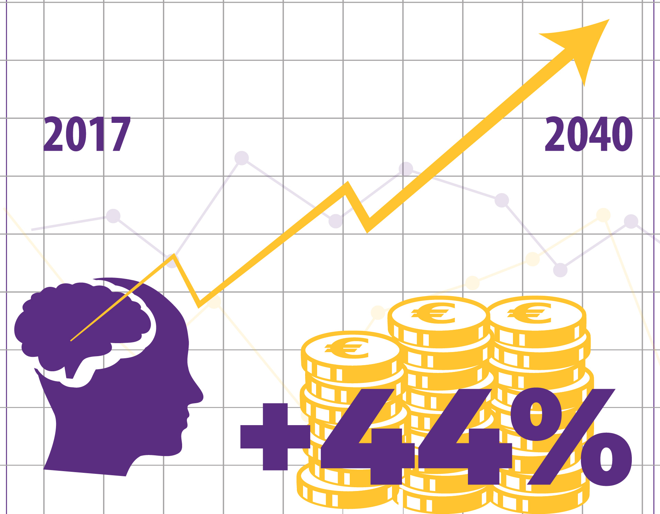
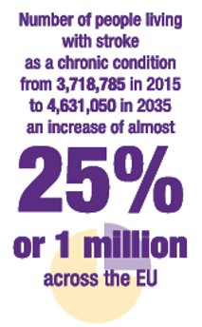
SAFE work phase 1: data/evidence
www.safestroke.eu

Slide 18
Stroke is an increasing cause for concern BUT it is a viable investment proposition
Investing in stroke care
Three interventions which are in the latest stroke guidelines:
the treatment of atrial fibrillation to prevent stroke
mechanical thrombectomy (the clot retrieval from the blood vessel in the brain) treatment in the acute phase of stroke
rehabilitation after stroke
Interventions work – overall
increase outcomes
tend to generate cost savings
generally good value for money for all countries involved in the research

Slide 19
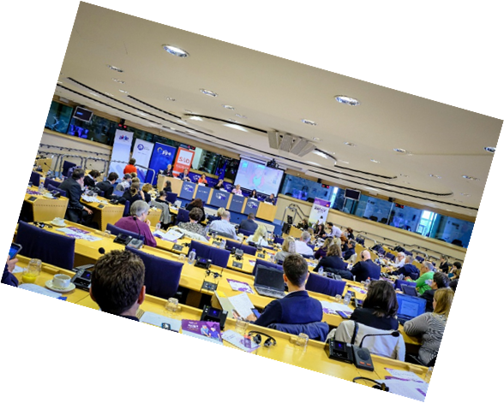
SAFE work phase 2: solution

Slide 20
Stroke Action Plan for Europe
www.safestroke.eu

Slide 21
SAFE work phase 3: call to action
Campaign: to implement the Stroke Action Plan for Europe recommendations within each European country
Roadmap:
Group meetings: national support organisations and stroke support organisations from across Europe
Tools: how-to-sessions (stakeholder analysis, strategy development, involve patients, how to work with politicians) and KPI (12) development across the whole stroke care pathway
Action: each country to launch its strategy for improvement in collaboration with policy makers
Annual audit: KPI data collection to demonstrate improvement in stroke care
https://actionplan.eso-stroke.org/

Slide 22
Thank you for listening
Arlene Wilkie
Arlene.wilkie@safestroke.eu

