Slide 1
Advancing policy change in heart failure
Marissa Ayano Mes, PhD
Programme Lead, Heart Failure Policy Network
The Heart Failure Policy Network is an independent, multidisciplinary platform made possible with financial support from AstraZeneca, Vifor Pharma and Novartis Pharma. The content produced by the Network is not biased to any specific treatment or therapy, and is endorsed and owned by the Network’s members. All members provide their time for free.

Slide 2
Overview
Heart failure and its political context
The Heart Failure Policy Network
  The handbook of multidisciplinary and integrated heart failure care
  Heart failure policy and practice in Europe
Advancing meaningful policy change in heart failure

Slide 3
Heart failure and its political context

Slide 4
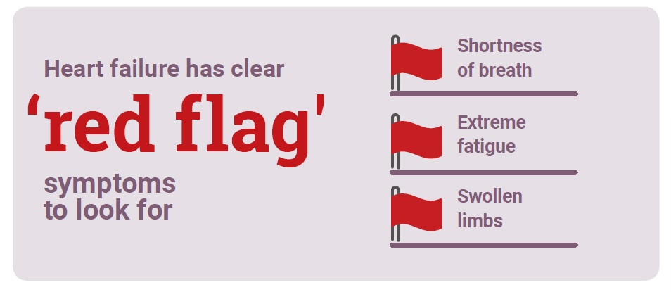
Heart failure is a common and complex syndrome
Heart failure (HF) occurs when the heart becomes too weak or stiff to pump enough blood to meet the body’s needs.
Risk factors include other conditions or diseases (high blood pressure, diabetes) or lifestyle behaviours (unhealthy diet, smoking).
Mortality from HF is higher than from several common cancers in men (prostate and bladder) and women (breast cancers).

Slide 5
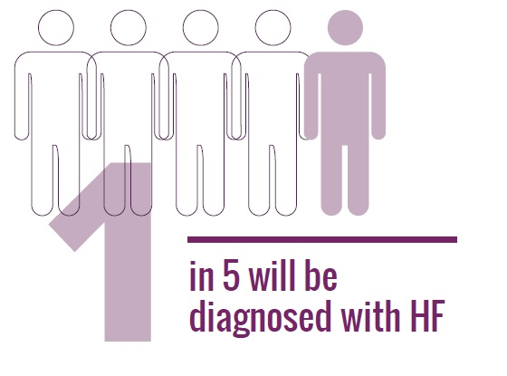
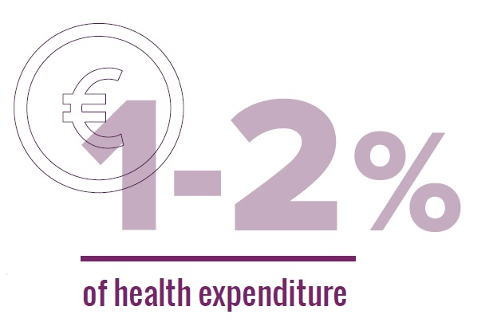


Heart failure places a considerable burden on people, healthcare systems, the economy and society
More than 15 million people in Europe are estimated to be living with HF.
HF is a leading cause of hospital admissions in the EU, and many of these hospitalisations are preventable.
HF generates substantial economic burden due to its direct and indirect costs.
The COVID-19 pandemic has severely affected HF care and people living with HF.

Slide 6

The right package of care can improve outcomes for people living with heart failure
Best practice in HF refers to multidisciplinary and integrated care.
Best practice care models have the potential to reduce HF hospitalisations and costs by up to 30%.
With the right support, people with HF can manage their condition, return to work and continue to enjoy productive lives.

Slide 7
The Heart Failure Policy Network

Slide 8

The Heart Failure Policy Network was created to help improve the lives of people living with heart failure
Members and supporters of the HFPN gathered at the European Parliament, Brussels, to mark the launch of The handbook of multidisciplinary and integrated heart failure care in 2018
The goal of the Heart Failure Policy Network (HFPN) is to raise awareness of unmet needs surrounding HF and its care.
The Network is an independent, multidisciplinary group of healthcare professionals, patient advocacy groups, policymakers and other stakeholders from across Europe. Members provide their time for free. All content produced by the HFPN is non-promotional and non-commercial.

Slide 9
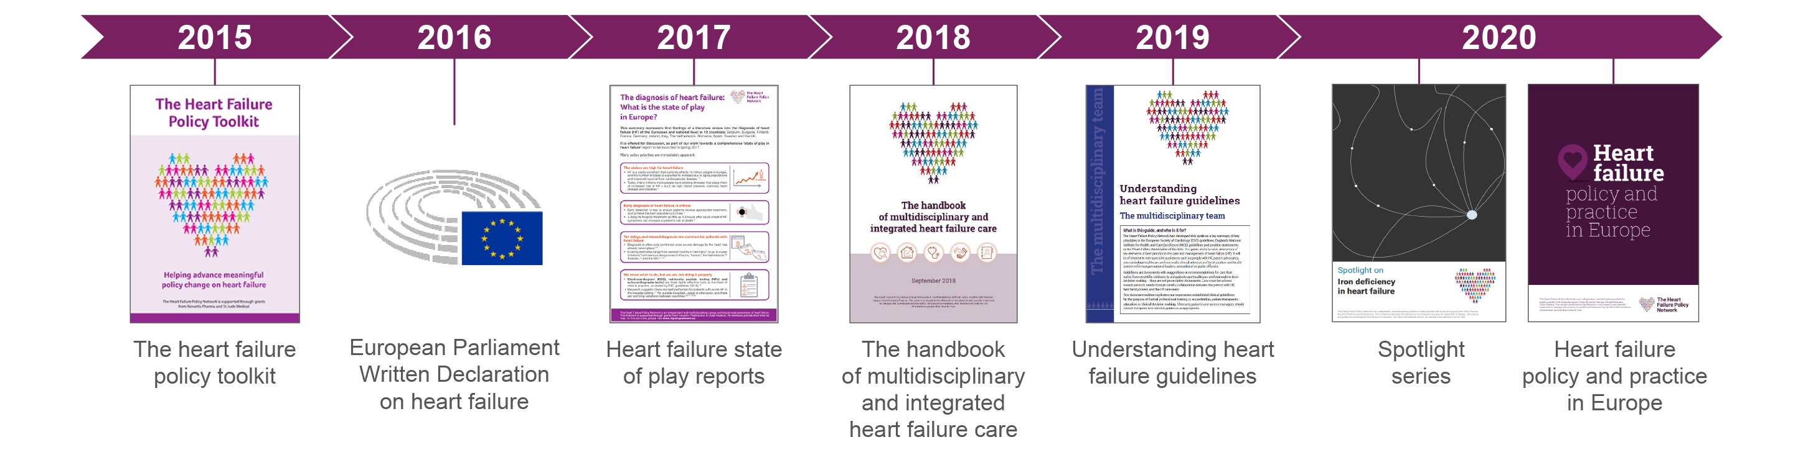
We have been active since 2015, working to drive greater government recognition of heart failure
We have sought to transform the way health system leaders view HF, and support the HF advocacy community to drive meaningful changes in policy and practice.

Slide 10
The handbook of multidisciplinary and integrated heart failure care

Slide 11

The handbook made a European call to action based on measurable policy and system elements
Explained why multidisciplinary and integrated care is essential for HF
Presented a comprehensive summary of evidence of effectiveness/value proposition.
Described current ‘state of play’ in Europe in terms of performance and barriers.
Identified five key areas where care typically fails patients.

Slide 12
This work has supported national advocates in pushing for meaningful change in heart failure policy and practice
Spain: national translation of The handbook, HF will be included in the forthcoming national strategy on cardiovascular health.
Portugal: high-level national forum has published recommendations for HF for consideration by the government.
England: submission to the NHS Long Term Plan in 2019 and presentation to the NHS England Implementation team.
France: plans for national translation of The handbook and national White Paper on HF.
Poland: national translation of summary leaflet, presentation of The handbook at the Polish Heart Failure Congress.

Slide 13
Heart failure policy and practice in Europe

Slide 14
This work aimed to create a foundation for political change in heart failure across Europe
Heart failure policy and practice in Europe aims to equip national advocates across Europe with a clear picture of central leadership and overall performance in HF.
It offers a comprehensive analysis of:
national policy issues in HF
key gaps in care
examples of best practice

Slide 15
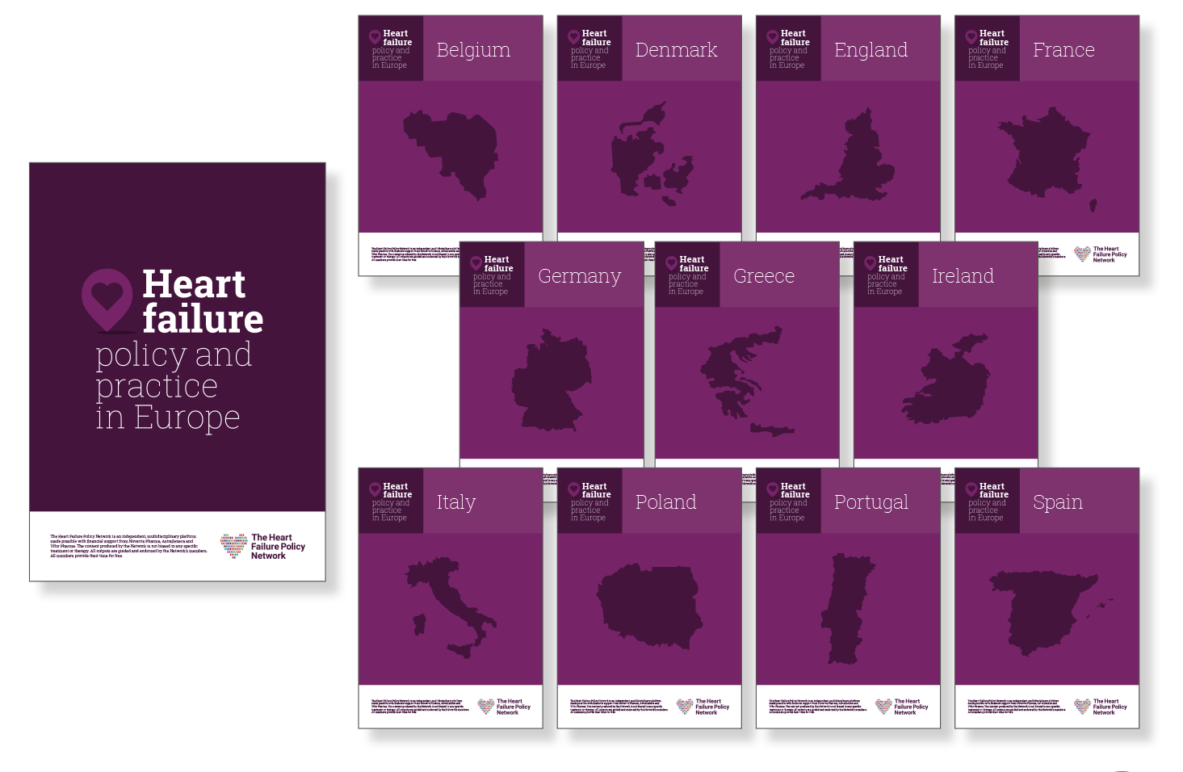
Heart failure policy and practice in Europe evolved in consultation with key experts
With input from more than 50 HF experts from across Europe, we developed
a pan-European report and 11 standalone country profiles.
This work has been publicly endorsed
by more than 30 organisations, including
professional societies and patient
advocacy groups.
Notes:
As with all HFPN work, we strive to create a multidisciplinary consensus – as such, we engaged with wide range of stakeholders
Briefly outline differences between pan-European report and country profiles

Slide 16
We identified substantial gaps in central policies and heart failure care in all countries
Few countries display central, strategic leadership to overturn systemic barriers and drive transformation in HF
Diagnosis of heart failure is often delayed, and essential components of hospital and community care are often missing.

Slide 17
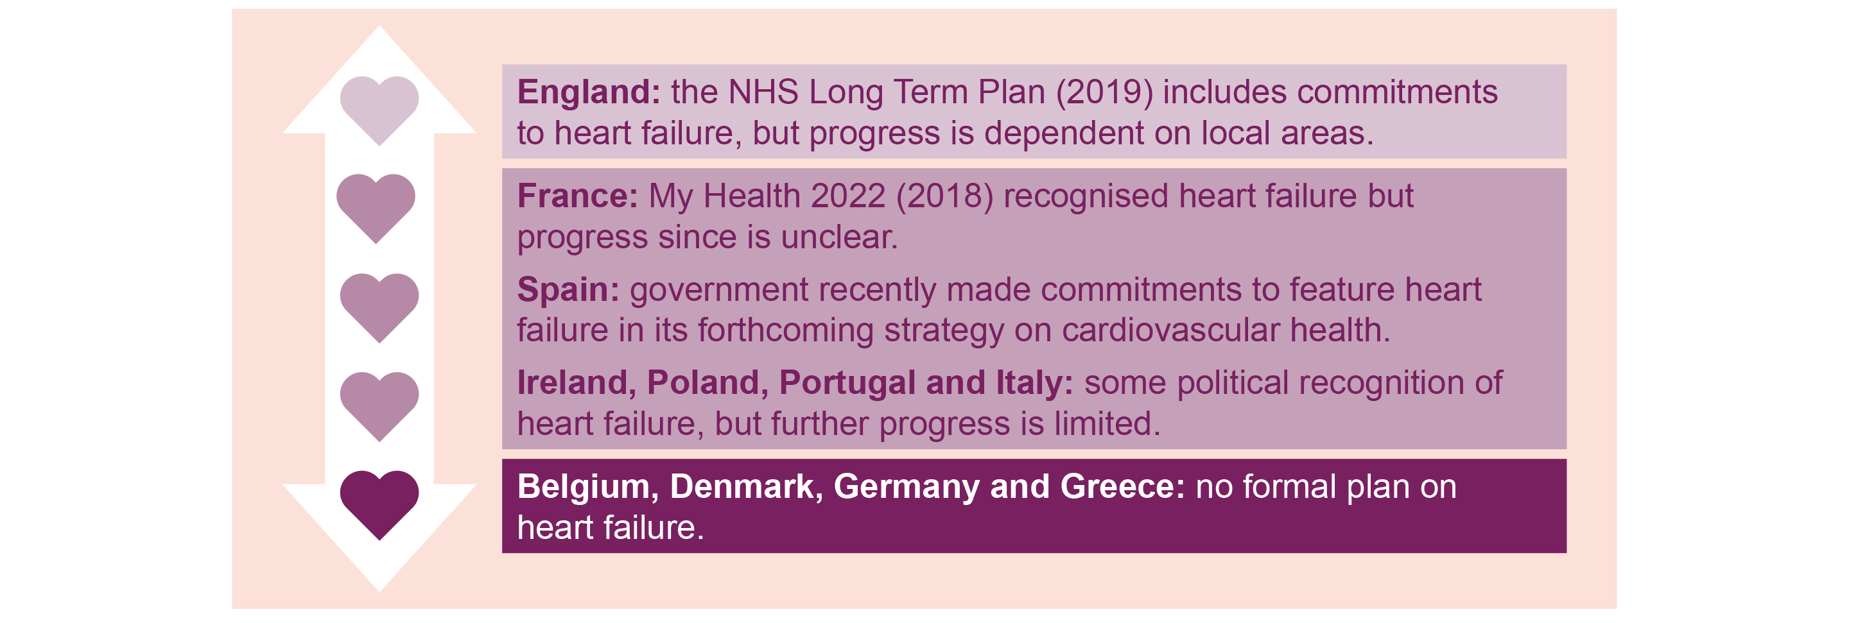
Few countries have a dedicated strategy on heart failure
Where plans exist, they may need to be updated, lack funding or may have stalled.

Slide 18
Essential aspects of heart failure care are missing in community settings
Cardiac rehabilitation is rarely provided for people living with HF in Europe.
Self-care education and psychological support are not consistently offered in HF care.
Belgium: Patient empowerment and therapeutic education are not yet standard practice, particularly in the absence of an HF nurse.
Greece: Cardiac rehabilitation is almost entirely absent from the public health system, partly due to a lack of clinics and training to provide this service.
Poland: Potential barriers to psychological support for people living with HF include the limited number of psychologists employed in hospitals and the stigma associated with obtaining psychological support.
Notes:
Cardiac rehabilitation is rarely provided for people living with HF in Europe. One exception to this is Denmark, where it is consistently offered in HF clinics.
Germany: In 2011, people living with HF made up only 2% of those referred for cardiac rehabilitation, while heart attacks and coronary artery disease accounted for 61% and 20%, respectively.

Slide 19
Advancing meaningful policy change in heart failure

Slide 20
In 2021, the HFPN will focus on mobilising heart failure advocacy to communicate with decision-makers.
We will build a sophisticated online policy advocacy and learning hub in HF, catering to clear opportunities to advance HF policy today.
We are developing an EU Call to Action on Heart Failure, which will outline key policy asks from the European Commission, European Parliament and Council of Ministers.
We will support national advocates in their approach to decision-makers, such as parliamentarians, national officials in health authorities and ministries of health, and senior clinicians and academics involved in decision-making on cardiovascular disease.

Slide 21
Our country profiles are a comprehensive resource for national advocates
Each country profile aims to support national HF advocates in engaging healthcare system leaders on meaningful changes to HF policy and care provision.
Each profile was developed with input from national experts in HF, including healthcare professionals, patient organisations, hospital representatives and researchers.

Slide 22
The Heart Failure Policy Network Team
The Heart Failure Policy Network Team

