Slide 2
Why non adherence to therapy may be hurtful for the patient’s health and costly for the NHS?
Luca Degli Esposti, Economist (CliCon)

Slide 3
Definition of adherence to treatment
«Adherence to treatment may be defined as the extent to which the patient's history of therapeutic drug-taking (such as keeping appointments and schedules and medication adherence) coincides with the prescribed treatment for desired therapeutic outcome»
(Source: Adherence too long term therapies: evidence for action - World Health Organization 2003)​
It implies active responsibility shared by patient and healthcare providers.

Slide 4
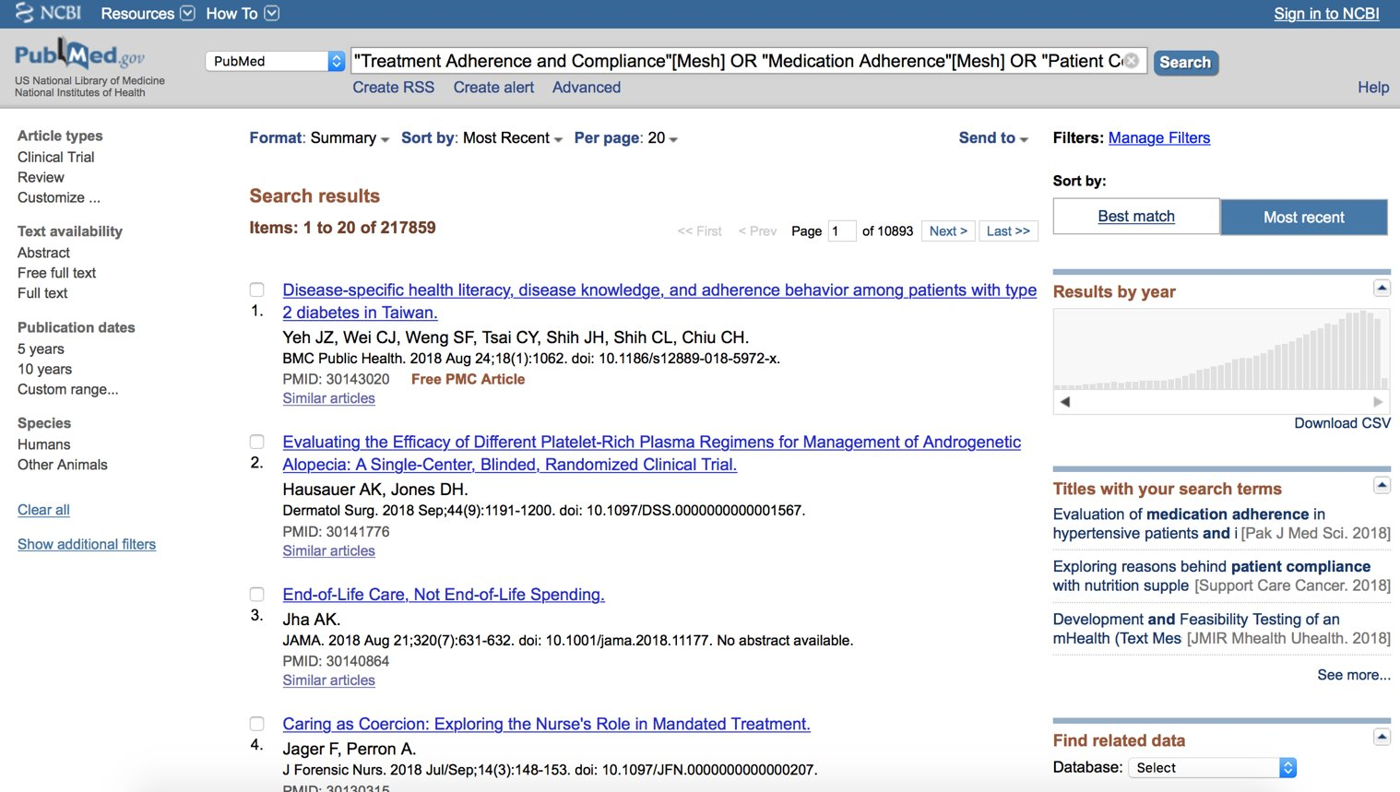
Adherence to treatment in literature

Slide 5
Why is adherence to treatment so important?
Poor adherence
Worse clinical outcomes
Increased healthcare resource utilization
Increased healthcare costs
Economic burden on patient
Source: Conseguenze della non aderenza al l farmaco all’interno del sistema sanitario. Modificata da Iuga AO e McGuire MJ, Adherence and health care costs. Risk Manag Health Policy 2014; 7: 35-44

Slide 6
Why is adherence to treatment so important? (1)
CLINICAL OUTCOMES
«Poor adherence severely compromises the effectiveness of treatment and it is associated with increased need of healthcare resource utilization and related costs as well as increased morbidity and mortality, thus affecting patients, Healthcare System and society.»
Source: Italian Medicines Agency (Agenzia Italiana del Farmaco).

Slide 7
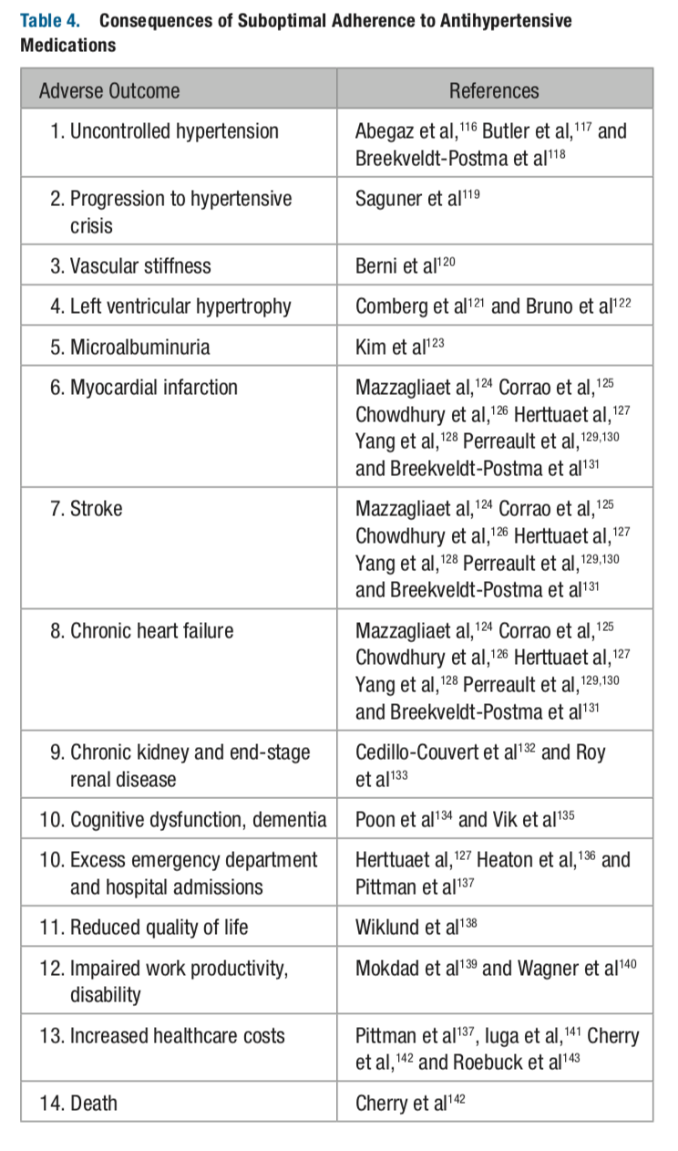
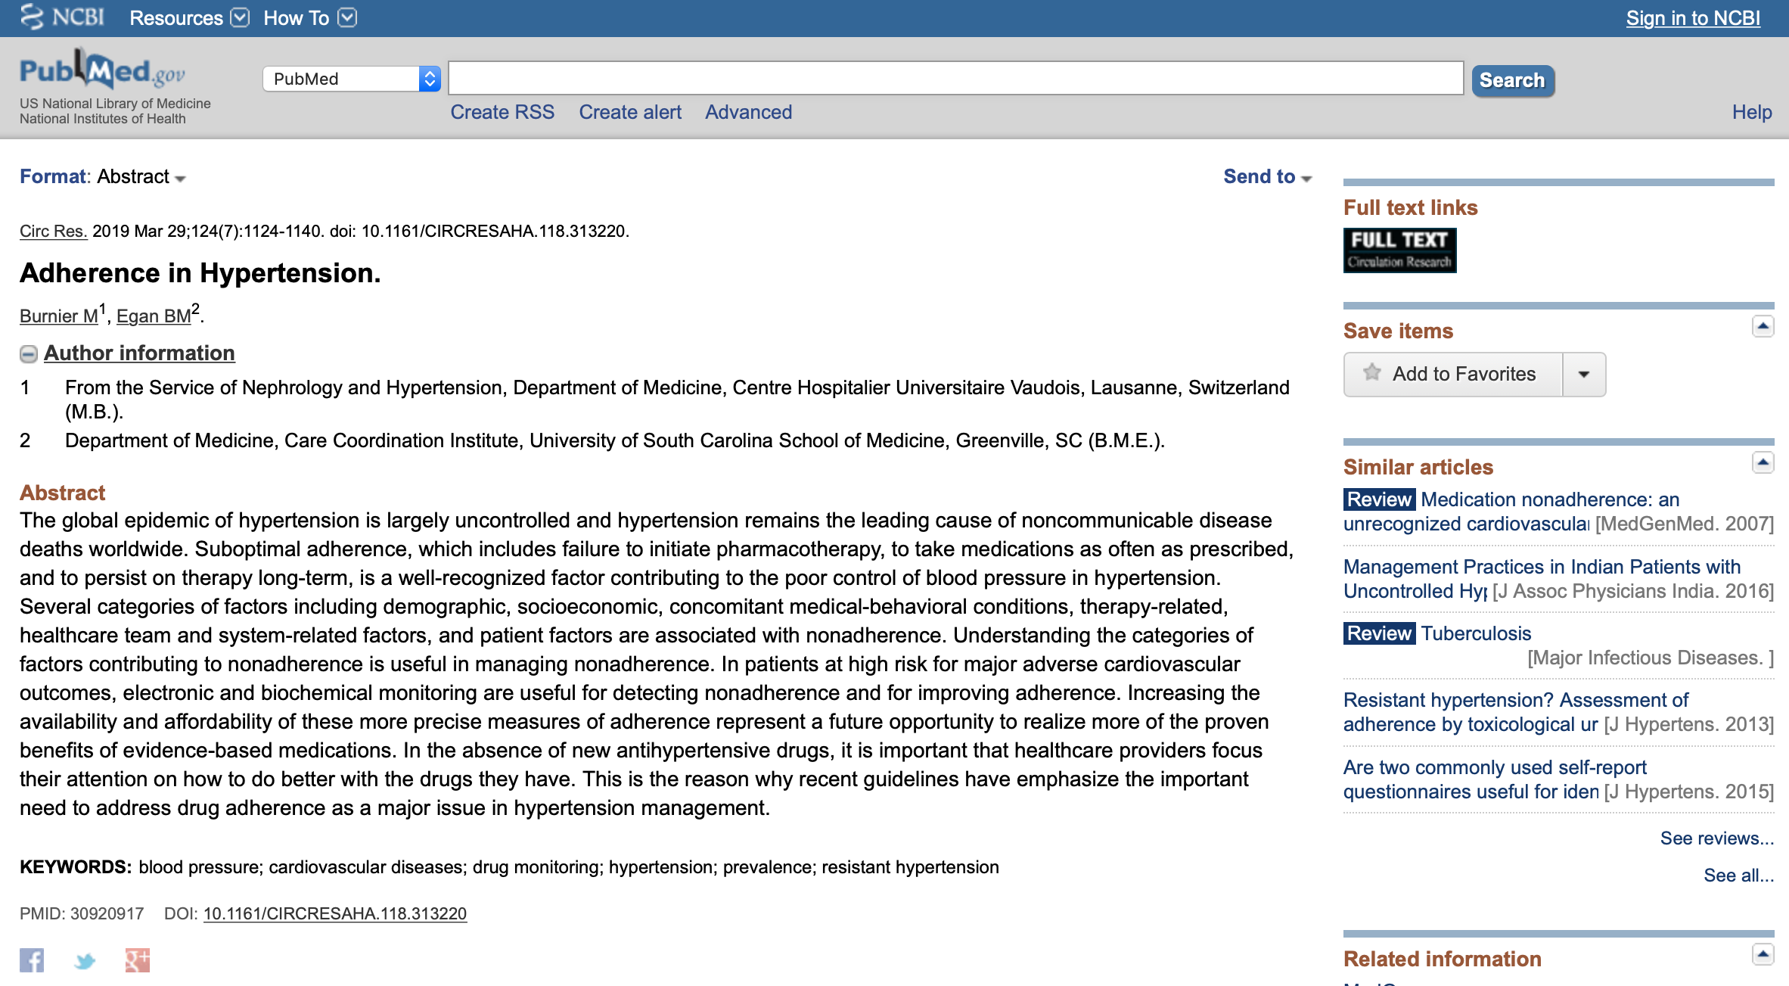
Why is adherence to treatment so important? Clinical outcomes (1.1)
Source: Circ Res. 2019 Mar 29;124(7):1124-1140. doi: 10.1161/CIRCRESAHA.118.313220. Adherence in Hypertension. Burnier M, Egan BM.

Slide 8
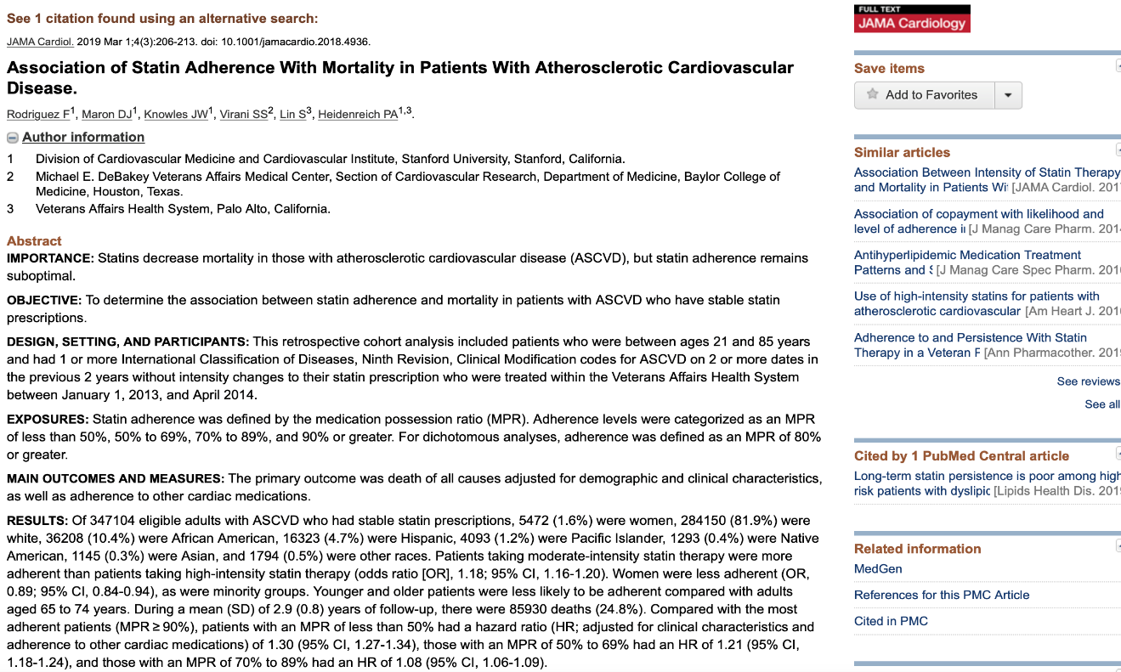
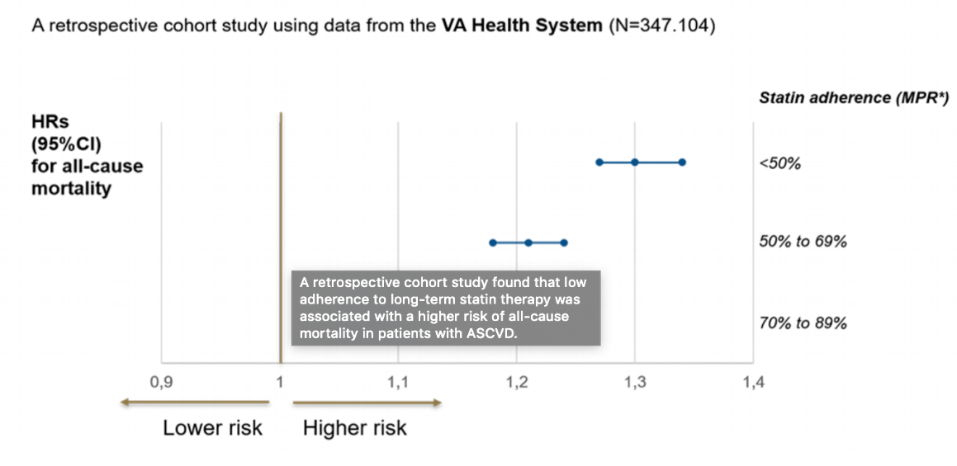
Why is adherence to treatment so important? Clinical outcomes (1.2)
Source: Association of Statin Adherence With Mortality in Patients With Atherosclerotic Cardiovascular Disease.
Rodriguez F, Maron DJ, Knowles JW, Virani SS, Lin S, Heidenreich PA. JAMA Cardiol. 2019 Mar 1;4(3):206-213.

Slide 9
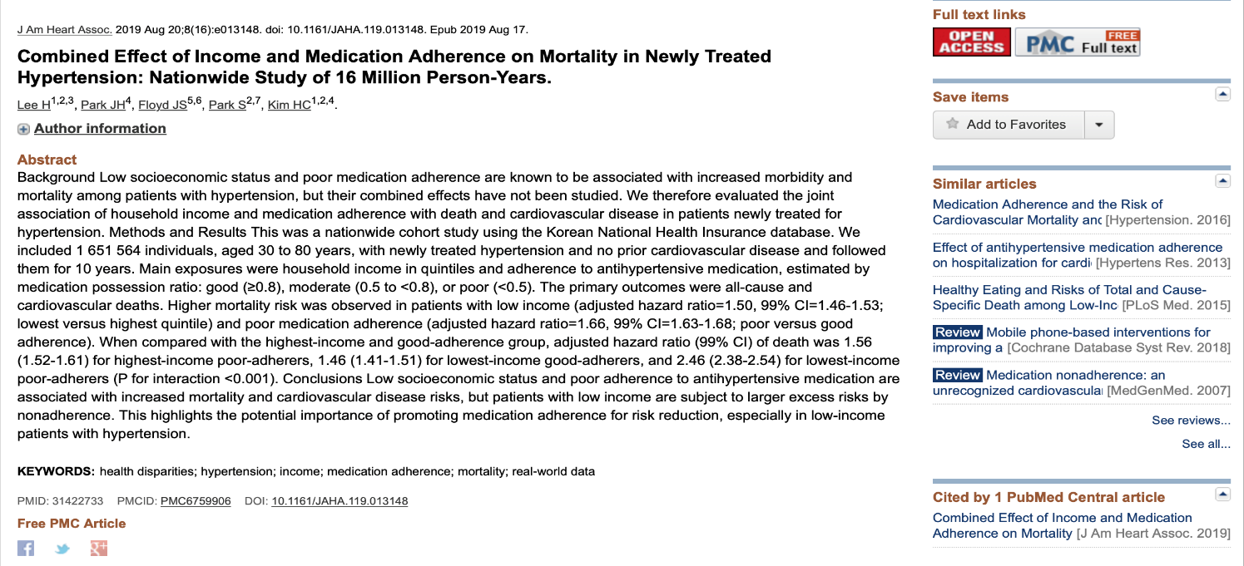
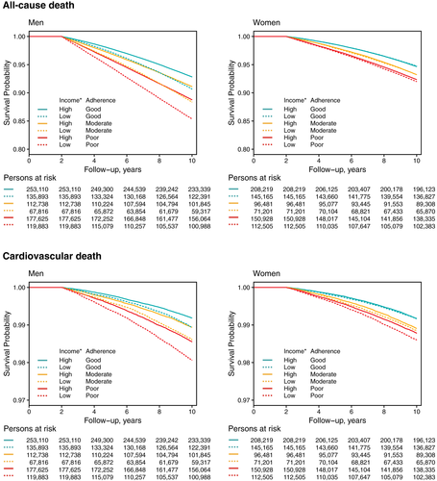
Why is adherence to treatment so important? Clinical outcomes (1.3)
Source: Combined Effect of Income and Medication Adherence on Mortality in Newly Treated Hypertension: Nationwide Study of 16 Million Person-Years. Lee H, Park JH, Floyd JS, Park S, Kim HC. J Am Heart Assoc. 2019

Slide 10
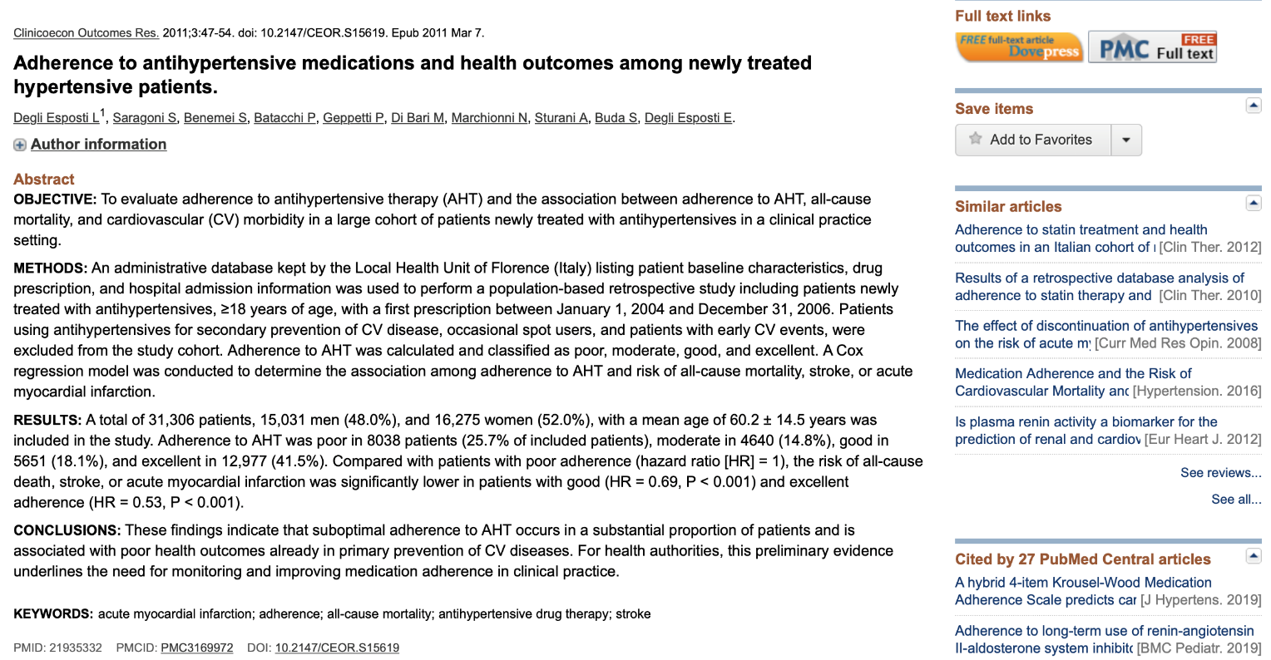
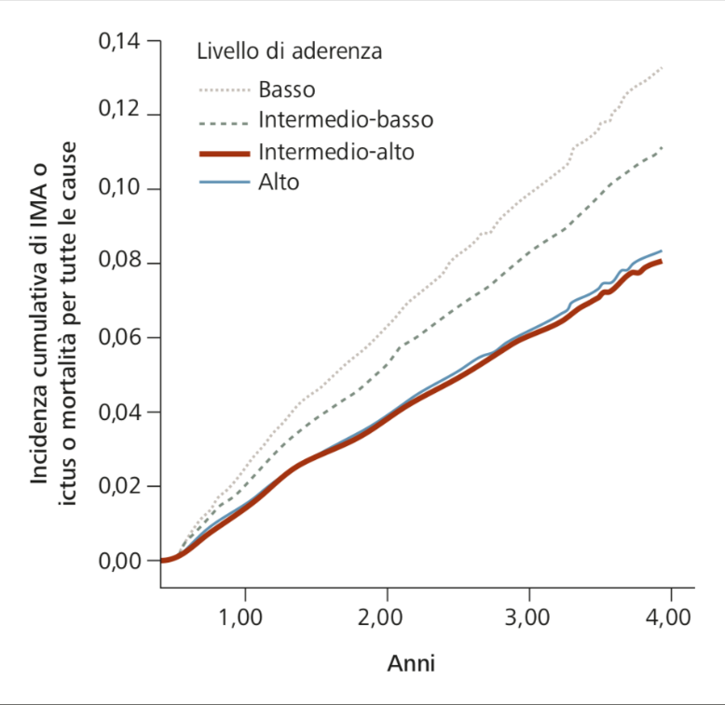
Why is adherence to treatment so important? Clinical outcomes (1.4)
Source: Adherence to antihypertensive medications and health outcomes among newly treated hypertensive patients.
Degli Esposti L, Saragoni S, Benemei S, Batacchi P, Geppetti P, Di Bari M, Marchionni N, Sturani A, Buda S, Degli Esposti E.
Clinicoecon Outcomes Res. 2011;3:47-54.

Slide 11
Why is adherence to treatment so important? (2)
ECONOMIC OUTCOMES
The lack of adherence has consequences for public health, as it can lead to direct and indirect costs for society at large.
Direct costs related to the lack of adherence comprise:
Unnecessary visits to physicians;
Hospedalitations, ER visits, nursinghome;
Additional diagnostic tests.
Indirect costs related to the lack of adherence comprise:
Salary losses for patients;
Productivity losses for patients.

Slide 12
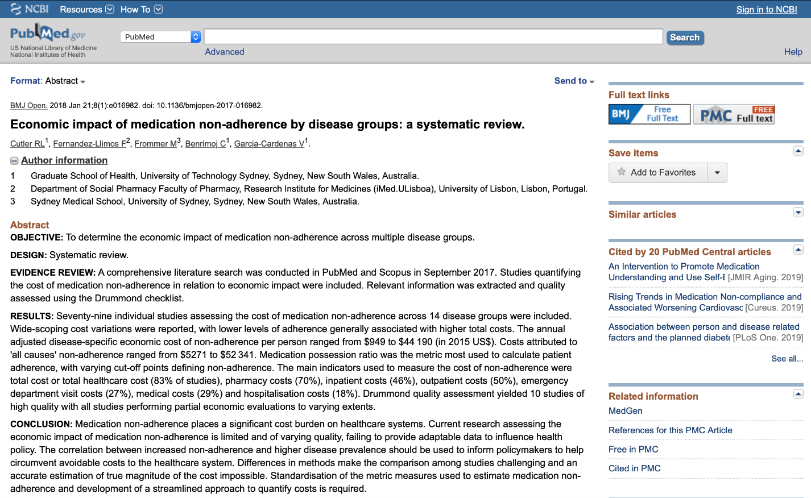
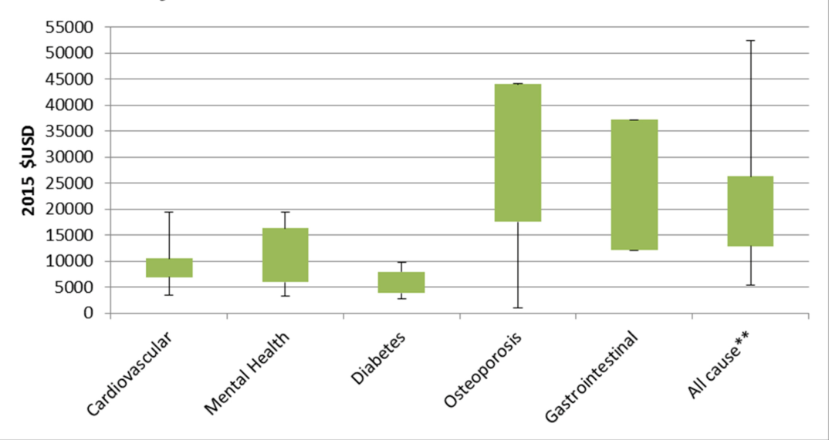
Why is adherence to treatment so important? (2.1)
Source: BMJ Open. 2018; 8(1): e016982. Economic impact of medication non-adherence by disease groups: a systematic review. Rachelle Louise Cutler,Fernando Fernandez-Llimos,Michael Frommer, Charlie Benrimoj and Victoria Garcia-Cardenas.

Slide 13
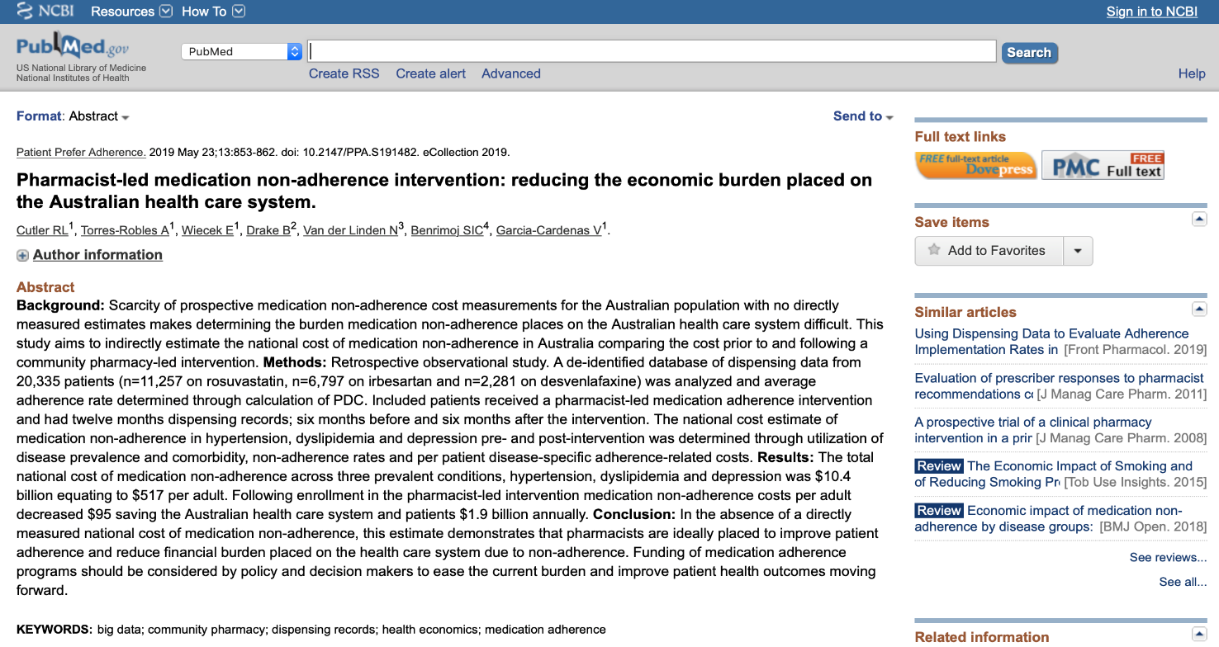
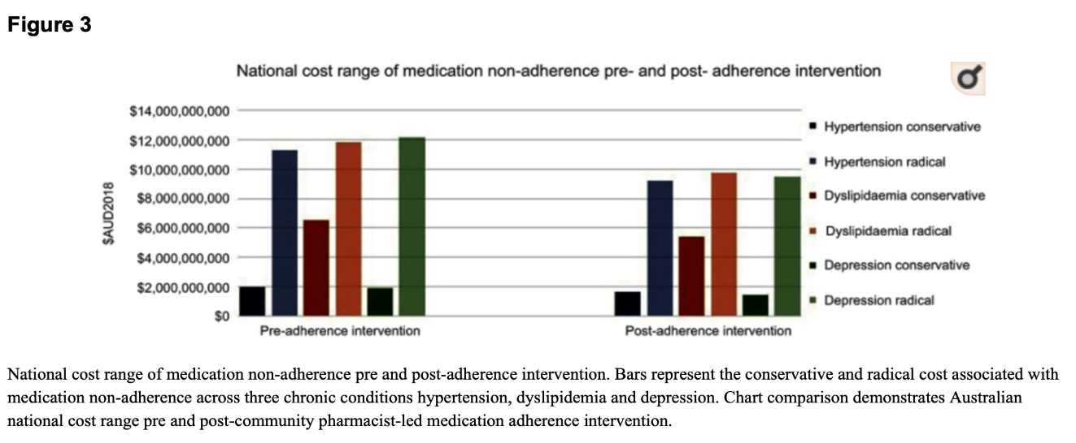
Why is adherence to treatment so important? Economic outcomes (2.2)
Source: Patient Prefer Adherence. 2019 May 23;13:853-862. Pharmacist-led medication non adherence intervention: reducing the economic burden placed on the Australian health care system. Cutler RL1, Torres-Robles A1, Wiecek E1, Drake B2, Van der Linden N3, Benrimoj SIC4, Garcia-Cardenas V1.

Slide 14
Association between adherence to treatment, hospitalizations and healthcare resource consumption
An improved adherence of patients to the prescribed therapy, although carries the inevitable consequence of the increase in costs related to pharmacological therapy, it can positively influence the patient's health status, thus reducing overall costs for other healthcare resources (tests, visits and mainly hospitalizations).
50
12,000
Medical cost
Drug cost
Risk of hospitalizations
40
10,000
30
8,000
Total costs ($)
Risk of hospitalizations (%)
6,000
20
4,000
10
2,000
0
0
00-19
20-39
40-59
60-79
80-100
00-19
20-39
40-59
60-79
80-100
Level of adherence (%)
Adherence level (%)
Source: Sokol MC et al. Impact of Medication Adherence on Hospitalization Risk and Healthcare Cost. Medical Care 2005; 43 (6): 521–530

Slide 15
Why is adherence to treatment so important? (3)
A poor adherence can have a negative effect on disease epidemiology that goes far beyond the negative impact for a single patient, as it can have a large impact on the entire healthcare system.
For instance, a poor adherence to antibiotic treatments can lead to the development of antibiotic resistance and therefore to increased infection rates and disease spreading.

Slide 16
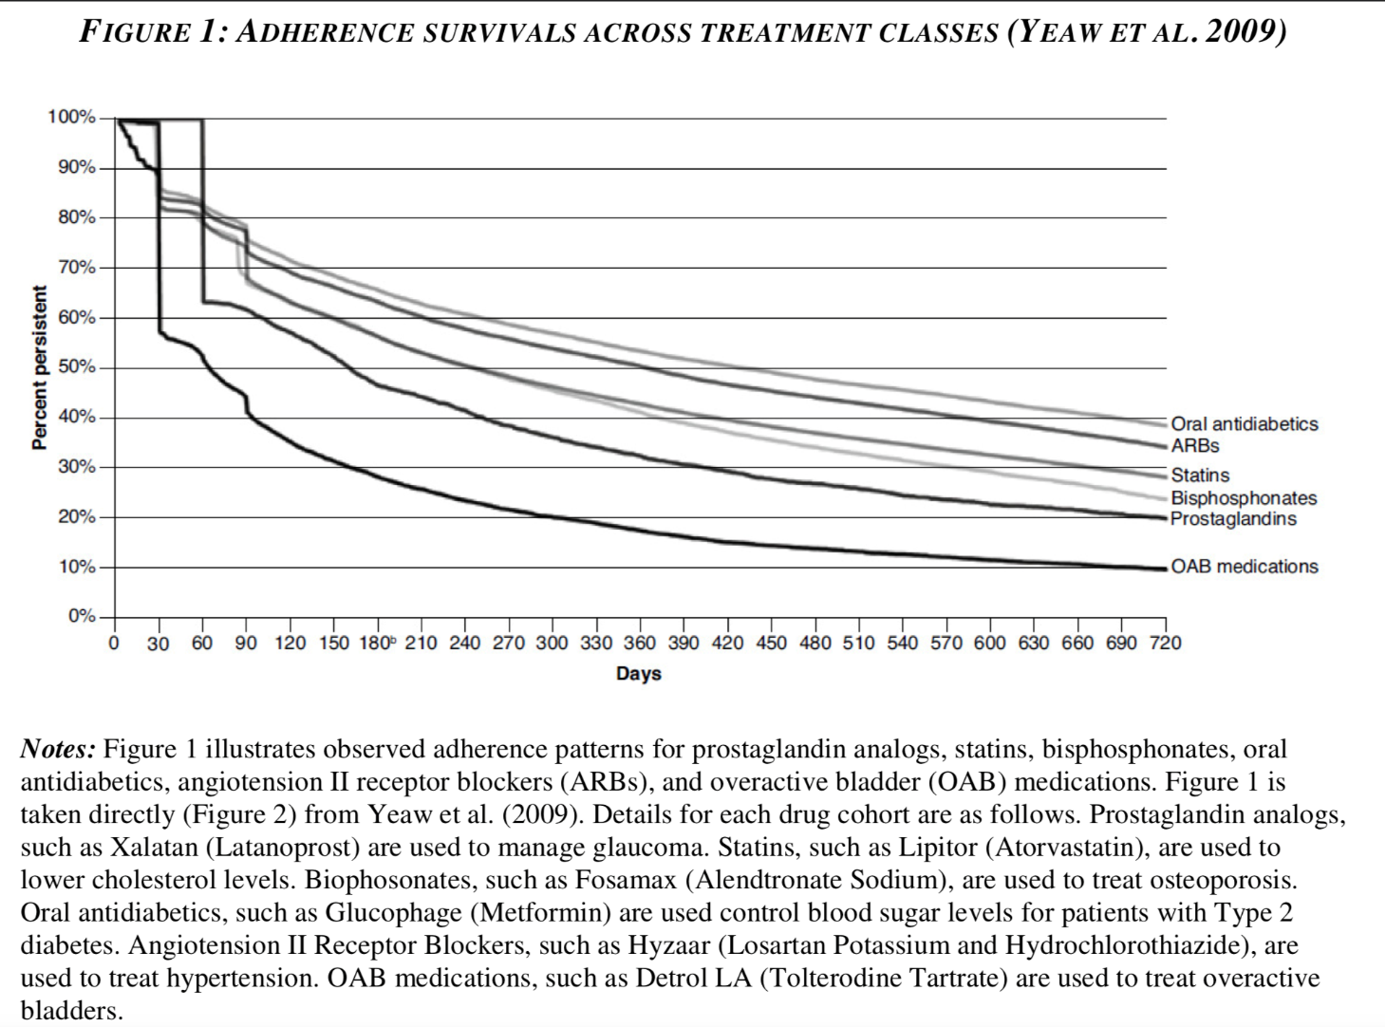
Level of adherence with treatment
Source: May 8, 2015. Non-Adherence In Health Care: Are Patients Or Policy Makers Ill-Informed?
Tomas Philipson

Slide 17
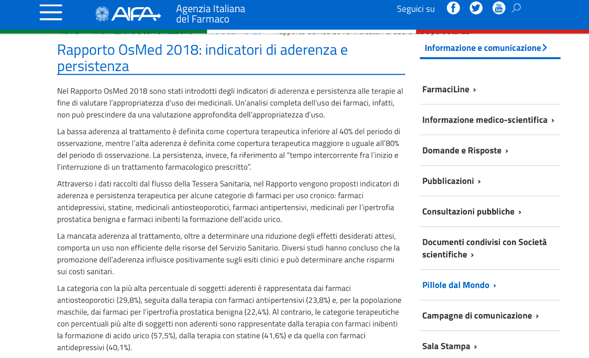
Level of adherence with treatment (including Italian evidence)

Slide 18
Adherence to antihypertensive treatment

Slide 19
Adherence to statin treatment

Slide 20
Factors related to adherence
Patient factor​
forgetfulness (30%)​
other priorities (16%)​
decision to omit doses (11%)​
lack of information (9%)​
emotional factors (7%)​
other causes (27%)​
​
Therapy factor​
complex regimens​
poorly tolerated medication prescribed
failing in providing adequate information
poor consideration of patient
poor therapeutic relationship with patient​
ineffective organitation specialistic-GP
frequency of visits​
absence of computerised system
​
Prescribers/LHU
Multi-year prevention of IA​
multiple CdC involved in IA​
financial pressure on prescribers​
limited access to therapy (AIFA notes)​
switching to a different formulary
reduced awareness​
not adequate system of indicators​
drug selected based on price
Patient
Prescribers/LHU
Therapy
Source: Osterberg L. Adherence to Medication. N Engl J Med 2005; 353: 487-97.

Slide 21
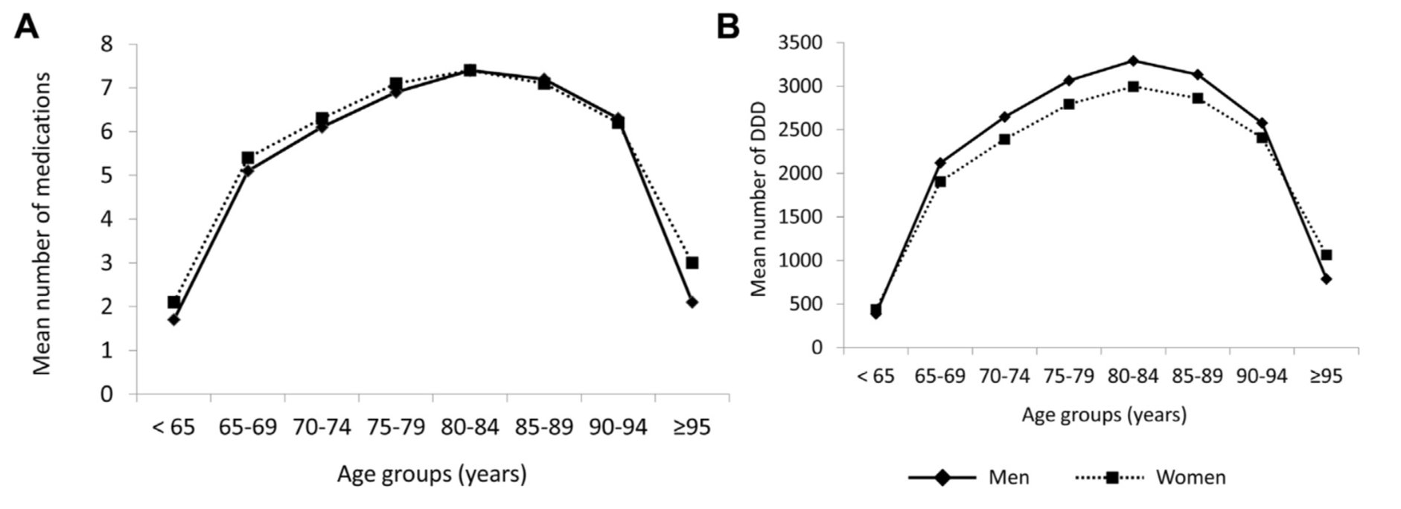
Factors related to adherence and care context
Source: Onder G. Advanced Age and Medication Prescription: More Years, Less Medications? A Nationwide Report From the Italian Medicines Agency. JAMDA 2015.

Slide 22
Why non adherence to therapy may be hurtful for the patient’s health and costly for the NHS?
Luca Degli Esposti, Economist (CliCon)

