Slide 1
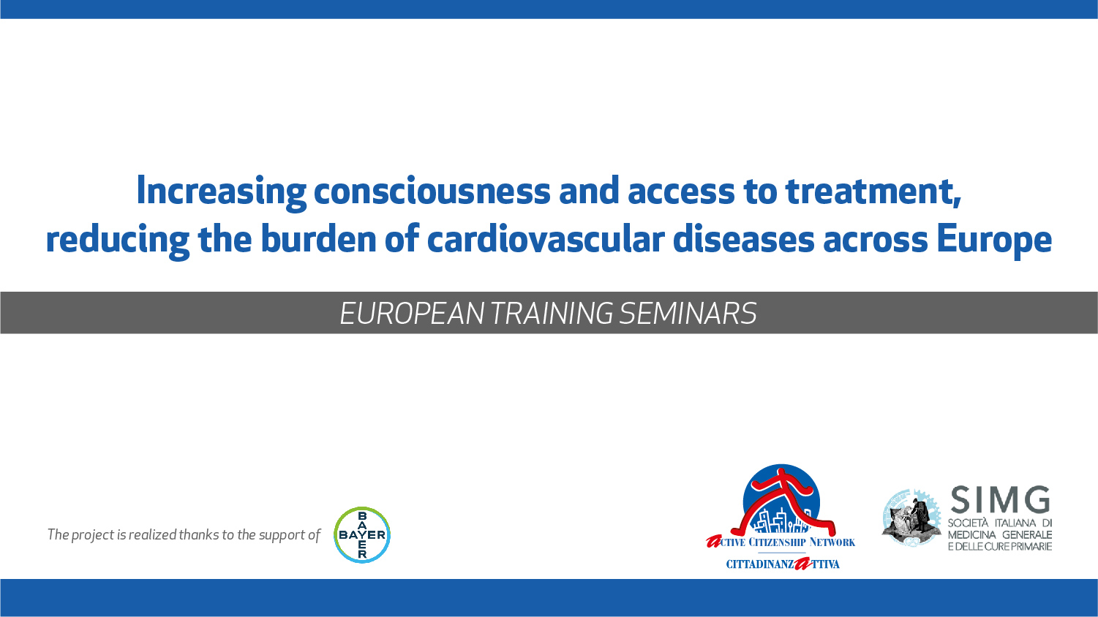

Slide 2
Cardiovascular risk: a population oriented approach
Stratification of the whole population in risk class
appropriate measures on large numbers.

Slide 3
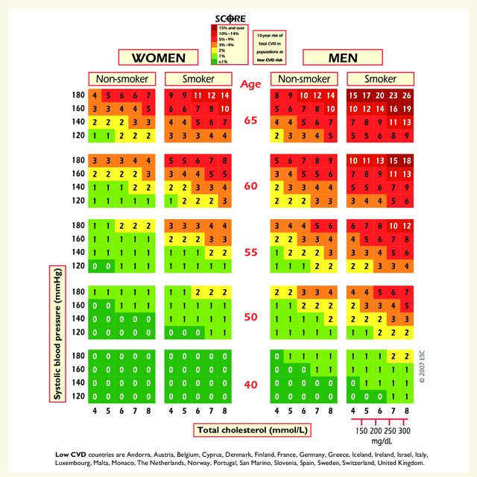
How is CV risk measured
Evaluation of CV events/mortality incidence considering many variables
  Sex
  Age (considered only 50-69 years)
  Cholesterol/HDL/LDL
  Blood pressure
  Smoking status
  BMI
  Ethnicity
  Diabetes

Slide 4
High risk outside the charts
Some categories should be considered at high/very high risk even outside the charts:
  Documented CV disease
  Diabetes Mellitus
  Chronic kidney disease
  Highly elevated single risk factor:
    High cholesterol (>310 mg/dl)
    High blood pressure (>180/110 mmHg)

Slide 5
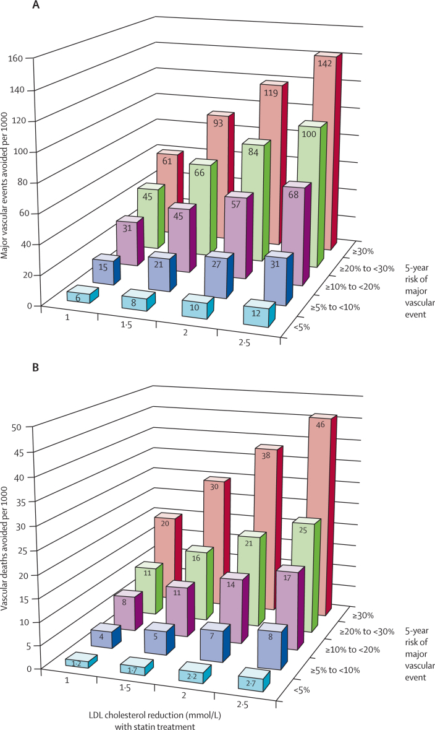
An example: reducing
LDL cholesterol and blood pressure
A reduction of LDL-c concentration and blood pressure reduces the risk of cardiovascular death in all class of risk

Slide 6
Another example: smoking cessation
Smoking cessation reduces heart disease mortality and stroke

Slide 7
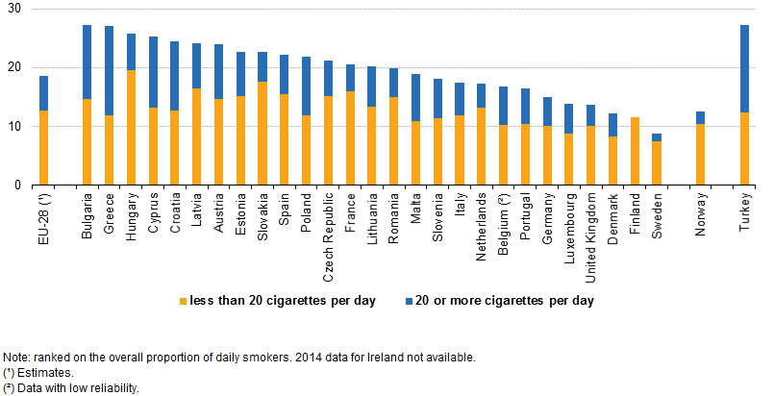
Smoking habits
Daily smokers are more than 10% of the population in almost every EU Country, reaching peaks of over 25% in some of them

Slide 8
Childhood obesity
Obese children reach up to 21% of total children population and overweight children are up to over 40%, especially in Countries of the Mediterranean Area (Cyprus, Greece, Italy, Spain)

Slide 9
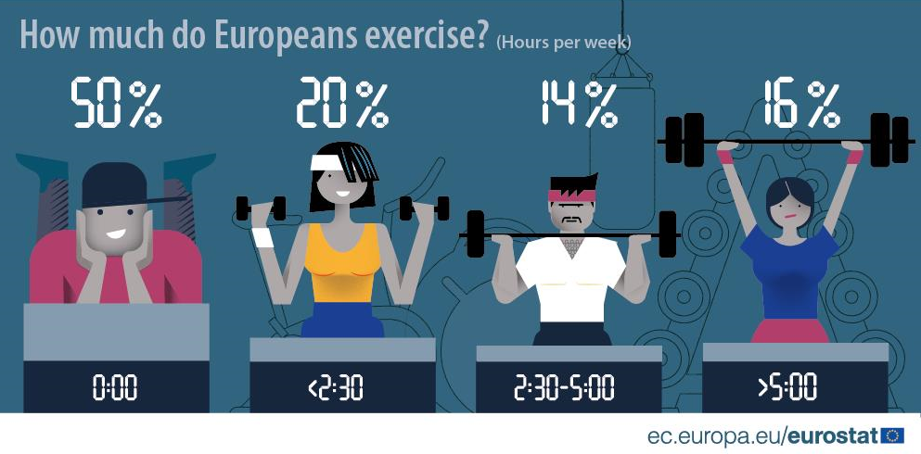
Insufficient physical activity
1 out of 2 European citizen is sedentary.
Another 20% exercises less than necessary.

Slide 10
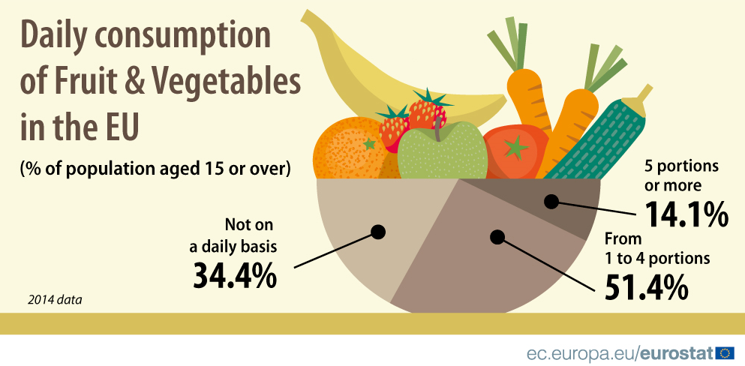
Inappropriate diet
Globally in 2017 diet-linked risk factors have been responsible for 11 million deaths worldwide.
Particularly they were linked to CV diseases, cancer, diabetes.

Slide 11

How at risk is your Country’s population?
Low risk: Andorra, Austria, Belgium*, Cyprus, Denmark, Finland, France, Germany, Greece*, Iceland, Ireland, Israel, Italy, Luxembourg, Malta, Monaco, The Netherlands*, Norway, Portugal, San Marino, Slovenia, Spain*, Sweden*, Switzerland and the United Kingdom.
High risk: Albania, Algeria, Armenia, Azerbaijan, Belarus, Bulgaria, Egypt, Georgia, Kazakhstan, Kyrgyzstan, Latvia, FYR Macedonia, Moldova, Russian Federation, Syrian Arab Republic, Tajikistan, Turkmenistan, Ukraine and Uzbekistan.

Slide 12

Some of the Risk Factors are not considered in the charts
Risk may be different if:
  Sedentary or obese subjects
  Diet
  Family history of premature CVD
  Socially deprived individuals
  Labs
  Other exams
  Comorbidities

Slide 13

Since migration is very important…
Among first-generation immigrants consider:
  Southern Asia: multiply the risk by 1.4
  Sub-Saharan Africa and the Caribbean: multiply the risk by 1.3
  Western Asia: multiply the risk by 1.2
  Northern Africa: multiply the risk by 0.9
  Eastern Asia or South America: multiply the risk by 0.7

Slide 14
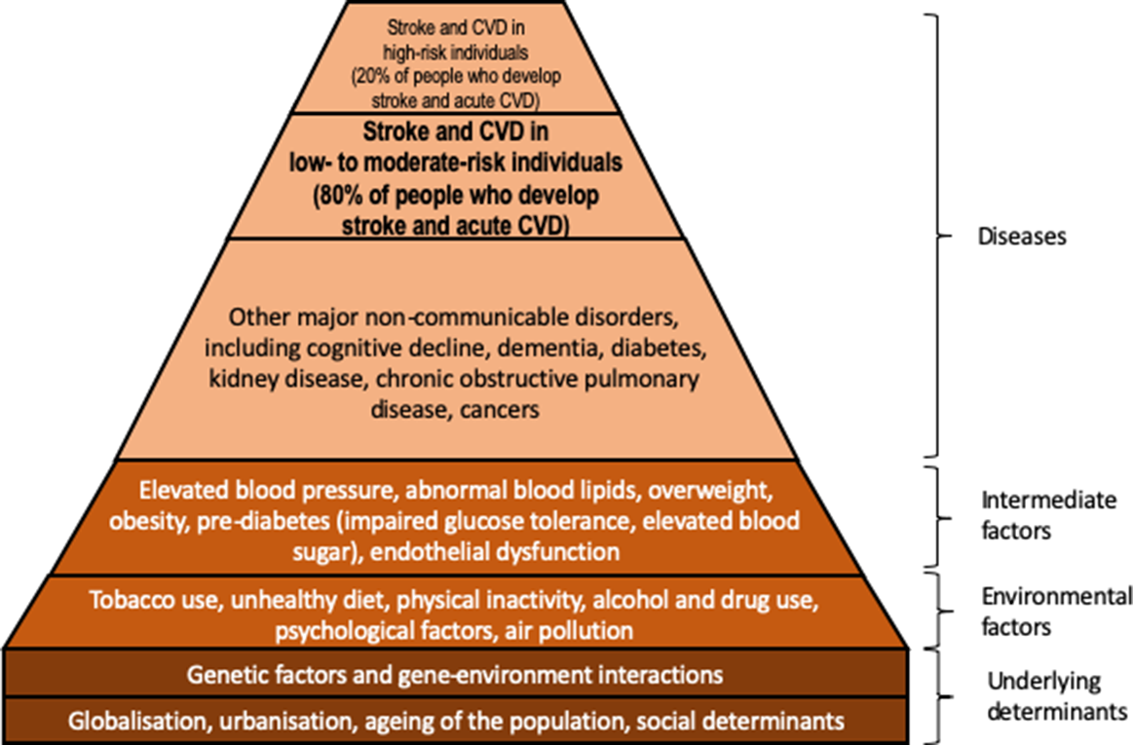
There’s a base under the base
If we want to aim at not only a longer life but at a haigher quality of life, we should target the base of the pyramid

Slide 15
What can the population strategy be?
Evaluation of the whole population through a database analysis
Shift from a waiting medicine to an initiative medicine
Approach can be done inside a medical clinic or outside
Must be considered the social aspects and not only health aspects

Slide 16
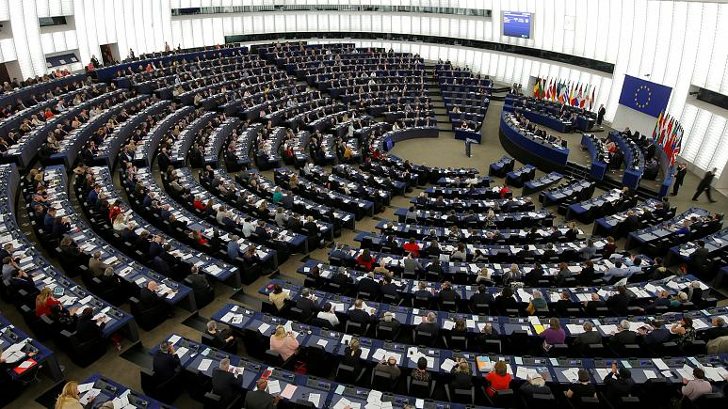
What can the population strategy be?
Policy makers may adopt strategies for CVD prevention and doctors should advocate for them:
  Taxation of tobacco, salt, sugar and alcohol (and reinvestments of the revenues on preventive strategies)
  Limitation of smoking permissions
  Strategies to limit child obesity (avoid snack dispensers in schools, incentives on physical activities, gyms)

Slide 17
What can the population strategy be?
Policy makers may adopt strategies for CVD prevention and doctors should advocate for them:
  Realize public courses for physical education for all ages
  Enhance health education at school
  Let the services for smoking and alcohol cessation be accessible and free
  Enable strategies to reduce pollution and prefer non polluting means of transport

Slide 18

What can the population strategy be?
Doctors and Local Health Authorities should:
  Analyze patients’ databases to track people at higher risk of CVD
  Be able to screen all the people in the ages/populations at risk
  Deal with policy makers to realize initiatives for cardiovascular prevention directly on the population
  Provide services aiming control of CV risk factors

Slide 19

Thank you

