Slide 1
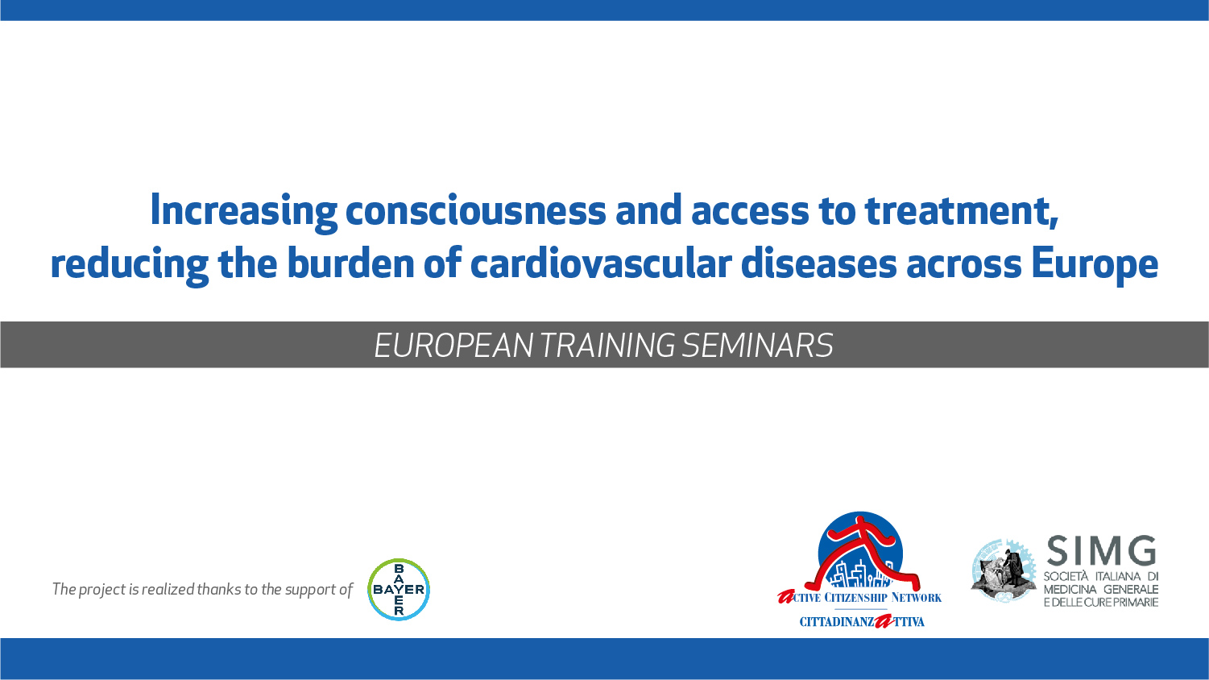

Slide 2
THE AWARENESS-RAISING ABOUT PEOPLE HEALTH
and impact on the health care system
Dott. VATRI MARCO
Notes:
Tetanus, is caused a bacterial infection characterized by muscle spasms. Recovery may take months. About ten percent of cases prove fatal. The bacteria generally enter through a break in the skin by a contaminated object. They produce toxins that interfere with normal muscle contractions.

Slide 3

THE AWARENESS-RAISING ABOUT PEOPLE HEALTH
ENABLES PEOPLE TO INCREASE CONTROL OVER THEIR OWN HEALTH.
IT COVERS A WIDE RANGE OF SOCIAL AND ENVIRONMENTAL INTERVENTIONS THAT ARE DESIGNED TO BENEFIT AND PROTECT INDIVIDUAL PEOPLE’S HEALTH AND QUALITY OF LIFE BY ADDRESSING AND PREVENTING THE ROOT CAUSES OF ILL HEALTH, NOT JUST FOCUSING ON TREATMENT AND CURE.

Slide 4
WHY DO WE NEED PEOPLE TO BE AWARE?
More than 1.2 million people die prematurely every year in EU countries. This could be avoided through better disease prevention policies and more effective health care interventions
790 000 EU citizens die prematurely each year from tobacco smoking, alcohol consumption, unhealthy diets and lack of physical activity.
Notes:
Tetanus, is caused a bacterial infection characterized by muscle spasms. Recovery may take months. About ten percent of cases prove fatal. The bacteria generally enter through a break in the skin by a contaminated object. They produce toxins that interfere with normal muscle contractions.

Slide 5
PROMOTE HEALTH EQUITY: equal opportunities for all, in terms of access to health services and facilities
GENERATE INFORMATION: to reduce the asymmetry of knowledge between doctor and patient
STIMULATE the growth and expression of the person's potential and of the community to which it belongs
WHAT DO WE WANT TO ACHIEVE?

Slide 6


HOW?
CITIZEN
FROM USER
WAYS OF DOING THAT:
group initiatives
active participation
taking charge of health problems
community services
TO PROTAGONIST

Slide 7
TIPES OF PREVENTION
Well Population | At Risk Population | Established Chronic Disease | Controlled Chronic Disease
intervening before health effects occur, when people is completely healthy. | screening to identify diseases in the earliest stages, before the onset of signs and symptoms in selected groups of people | managing disease post diagnosis to slow or stop disease progression | Prevent complications, monitoring and maintenance a good control
PRIMARY PREVENTION
SECONDARY PREVENTION
TERTIARY PREVENTION

Slide 8
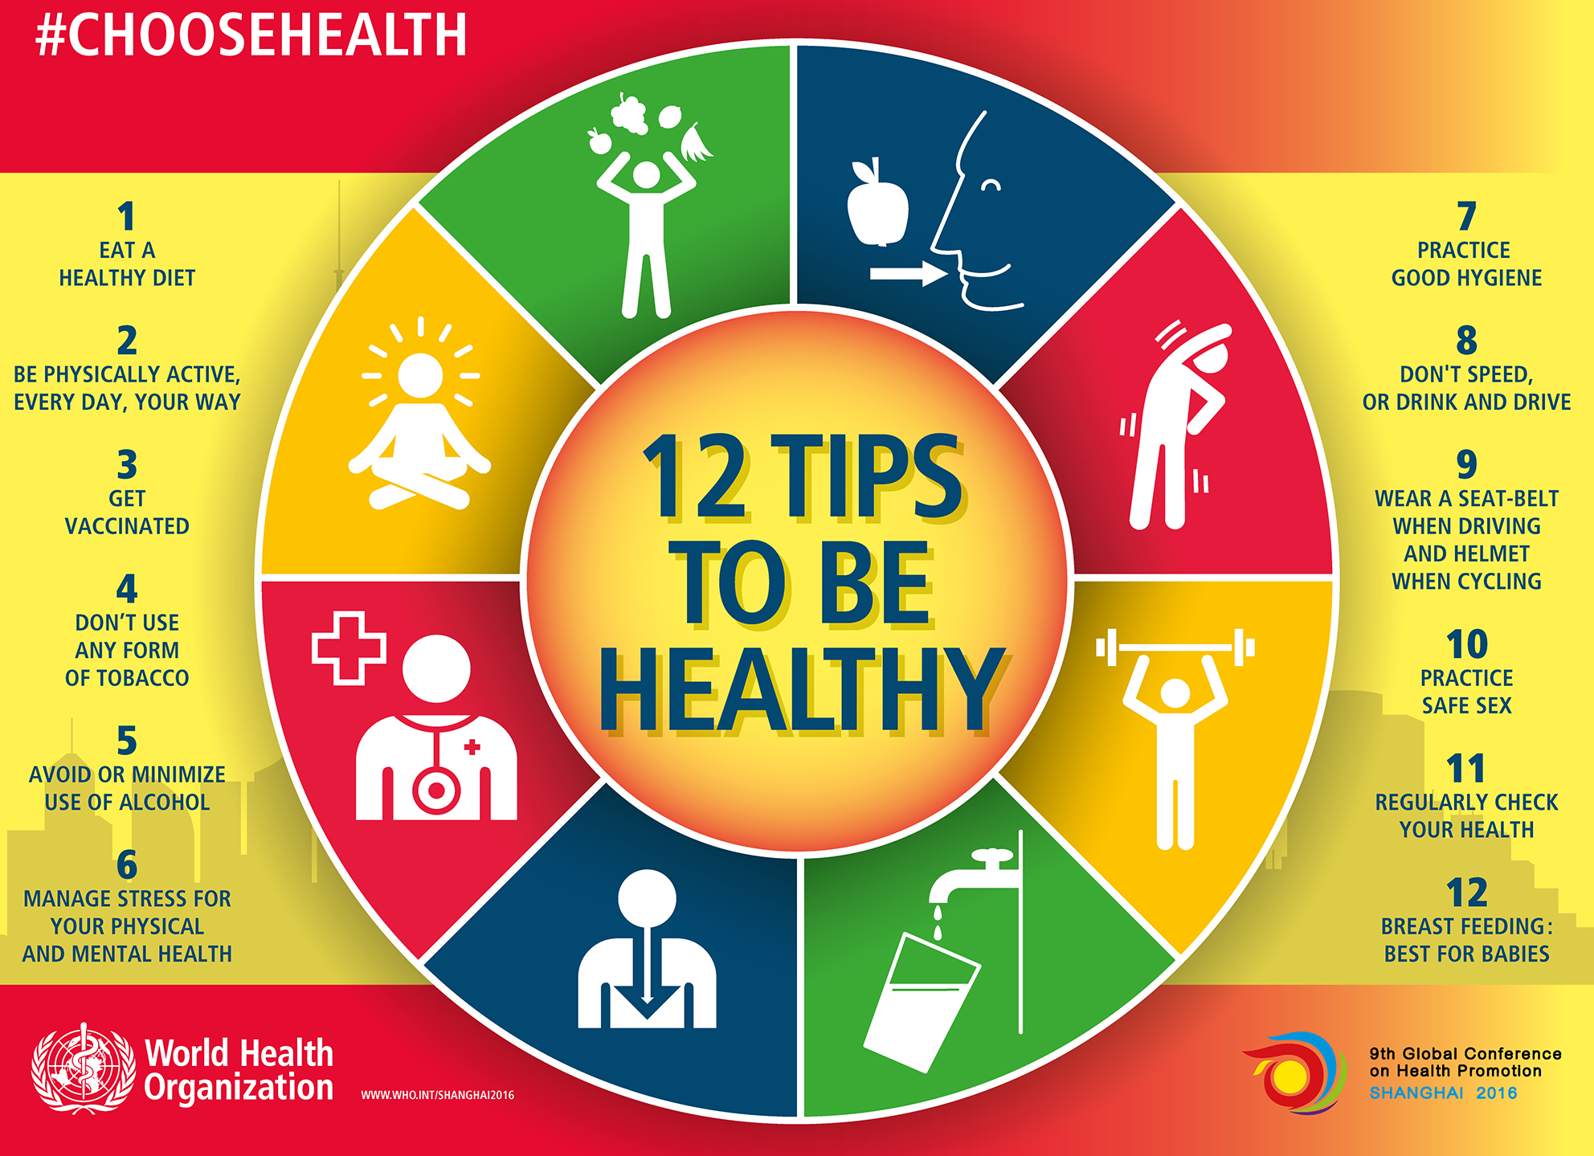
PRIMARY PREVENTION

Slide 9

SECONDARY PREVENTION
Most important thing in secondary prevention in screening.
Screening interventions are designed to identify conditions which could at some future point turn into disease, thus enabling earlier intervention and management in the hope to reduce mortality and suffering from a disease.
The condition should be an important health problem.
There should be a treatment for the condition.
Facilities for diagnosis and treatment should be available.
There should be a latent stage of the disease.
There should be a test or examination for the condition and the test should be acceptable to the population.
The natural history of the disease should be adequately understood.
There should be an agreed policy on whom to treat.
The total cost of finding a case should be economically balanced in relation to medical expenditure as a whole.

Slide 10


BREAST CANCER SCREENING
WOMEN STARTING AT AGE 45-50 YEARS HAVE TO DO A MAMMOGRAPHY EVERY 2 YEARS UNTIL AGE 70 – 75 YEARS.
Breast cancer is the most common cancer in the WHO Europe region women with an estimated incidence of 562,500 in 2018.
1 in 8 women in the EU will develop breast cancer before the age of 85.
THE SURVIVAL RATE IN EARLY DETECTION IS 98% AGAINST 27 % IN LATE STAGE

Slide 11
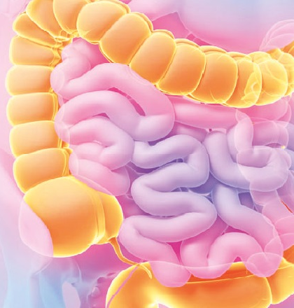
COLORECTAL CANCER SCREENING
MEN AND WOMEN STARTING AT AGE 50–60 YEARS, AND FROM THEN ON:
EVERY 2 YEARS IF THE SCREENING TEST IS THE GUAIAC-BASED FAECAL OCCULT BLOOD TEST OR THE FECAL IMMUNOCHEMICAL TEST
EVERY 10 YEARS IF THE SCREENING TEST IS FLEXIBLE SIGMOIDOSCOPY (FS) OR COLONOSCOPY (TC).
Second most common cancer in women and third in man.
215.000 deaths every year in EU (1 every 3 minutes)
WHEN DIAGNOSED AT STAGE I, THE OVERALL 5-YEAR SURVIVAL RATE IS AROUND 90%, WHEREAS IT IS ONLY AROUND 10% IN THE METASTATIC STAGE IV

Slide 12
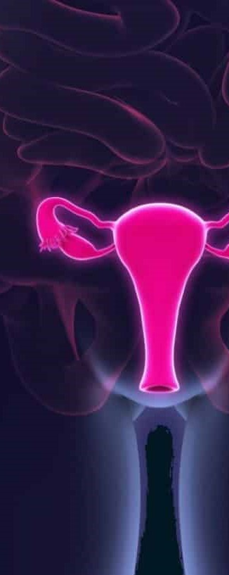
CERVICAL CANCER SCREENING
IF CYTOLOGY (PAP TEST) IS USED FOR SCREENING, WOMEN STARTING AT AGE 21–30 YEARS AND FROM THEN ON, EVERY 3 OR 5 YEARS.
IF HPV TESTING IS USED FOR SCREENING, WOMEN STARTING AT AGE 35 YEARS (USUALLY NOT BEFORE AGE 30 YEARS) AND FROM THEN ON, EVERY 5 YEARS.
About 61,072 new cervical cancer cases are diagnosed annually in Europe.
Second most common cancer death in women
SCREENIG REDUCE RISK OF GETTING CERVICAL CANCER BY 70%
EARLY STAGE DETECTIONS PROVIDE MORE THAN 85% CHANCE OF SURVIVAL

Slide 13


TERTIARY PREVENTION
REHABILITATION PROGRAMS
SUPPORT GROUPS THAT ALLOW MEMBERS TO SHARE STRATEGIES FOR LIVING WELL
REGULAR CHECK-UP
CONTROL OF SIMPTOMS

Slide 14
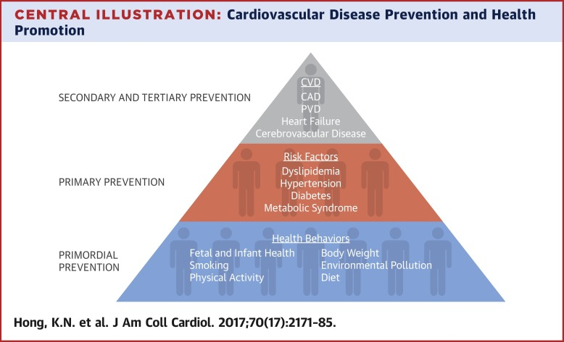


TERTIARY PREVENTION
SECONDARY PREVENTION
PRIMARY PREVENTION

Slide 15

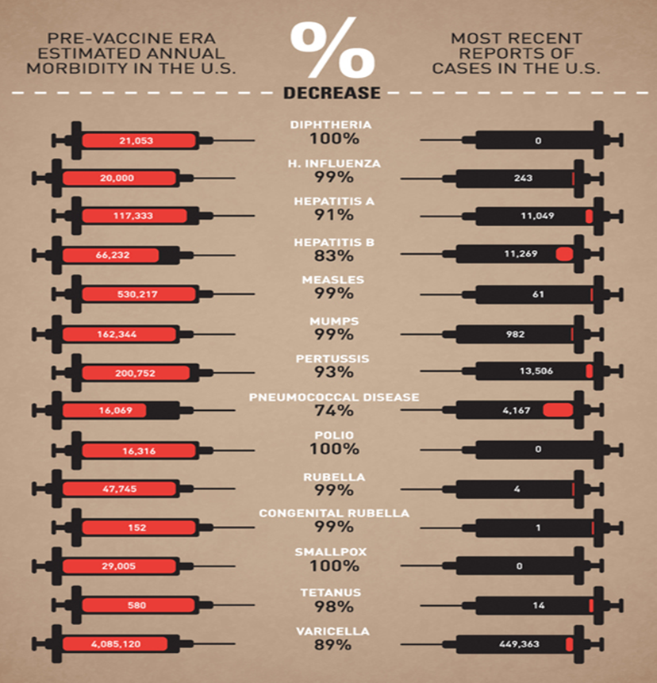
LET’S TALK ABOUT VACCINES
WHY?
VACCINES ARE SECOND ONLY TO WATER PURIFICATION IN TERMS OF REDUCING HUMAN MORTALITY
THEY CAN BE CONSIDERED THE MOST EFFECTIVE MEDICAL INTERVENTION EVER DISCOVERED BY MAN
VACCINES PREVENT MORE THAN 2.5 MILLION DEATHS EVERY YEAR

Slide 16
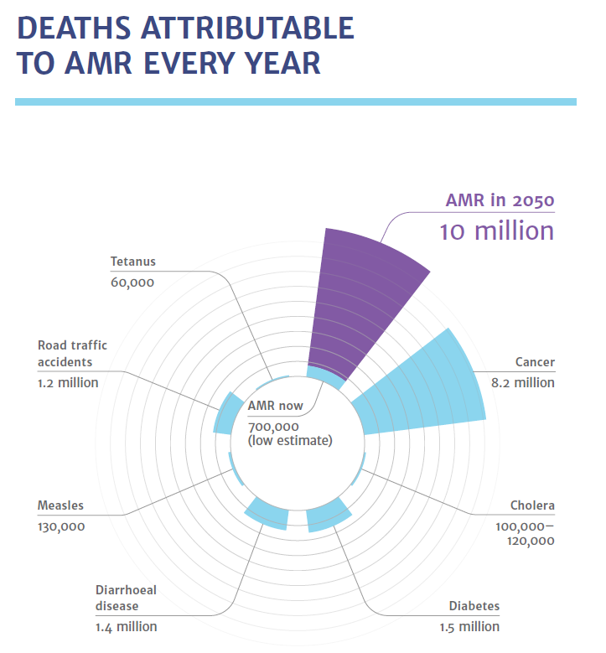
WHY?
WE HAVE TO FIGHT ONE OF THE
MOST IMPORTANT CHALLENGE OF CONTEMPORARY MEDICINE

Slide 17
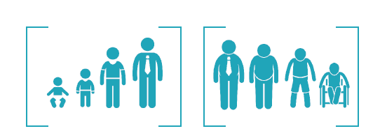

In the 20th century, vaccination was one of the most impactful public health measures in reducing the burden and mortality associated with infectious diseases, especially in children
Adult vaccination is the new challenge facing the 21st century

Slide 18
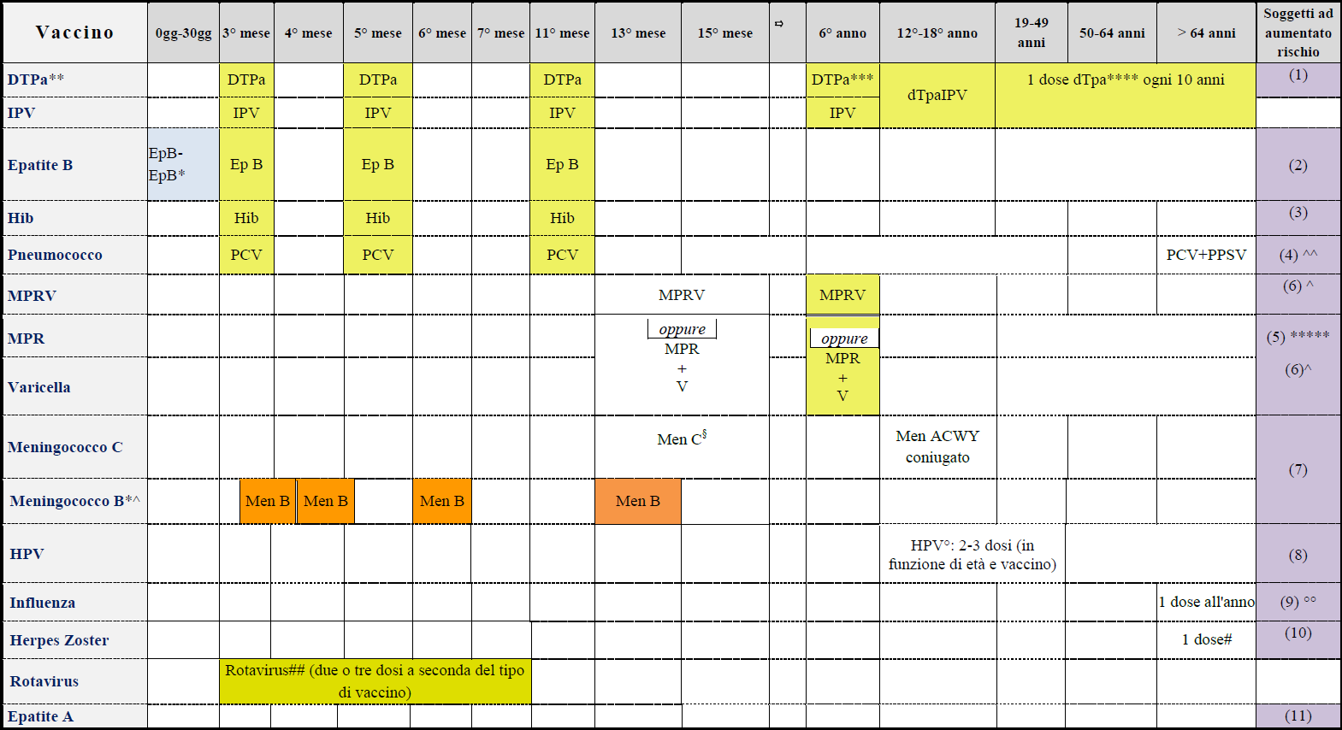
TETANUS/PERTUSSIS
PNEUMOCOCCUS
FLU
HERPES ZOSTER

Slide 19
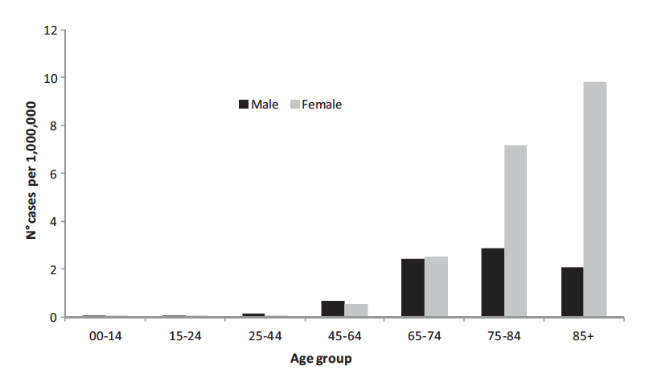
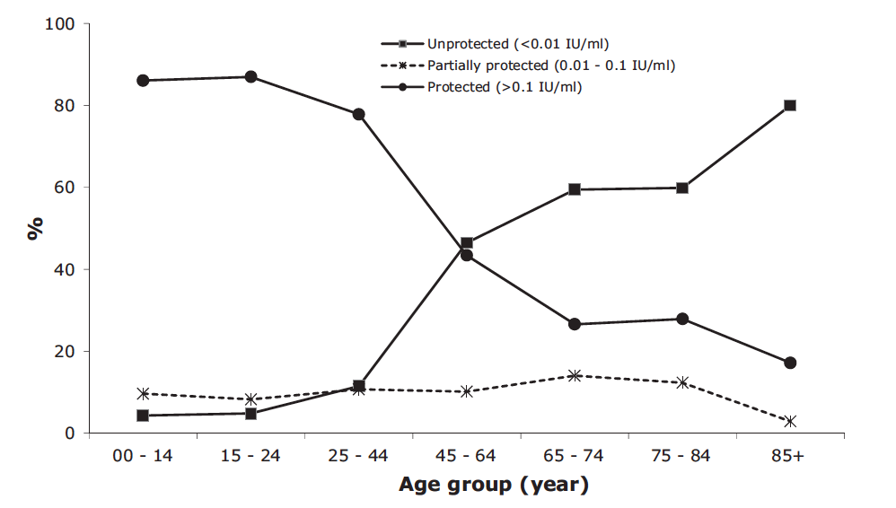
TETANUS
In 2015 there were about 209,000 infections and about 59,000 deaths globally.
Notes:
Tetanus, is caused a bacterial infection characterized by muscle spasms. Recovery may take months. About ten percent of cases prove fatal. The bacteria generally enter through a break in the skin by a contaminated object. They produce toxins that interfere with normal muscle contractions.

Slide 20
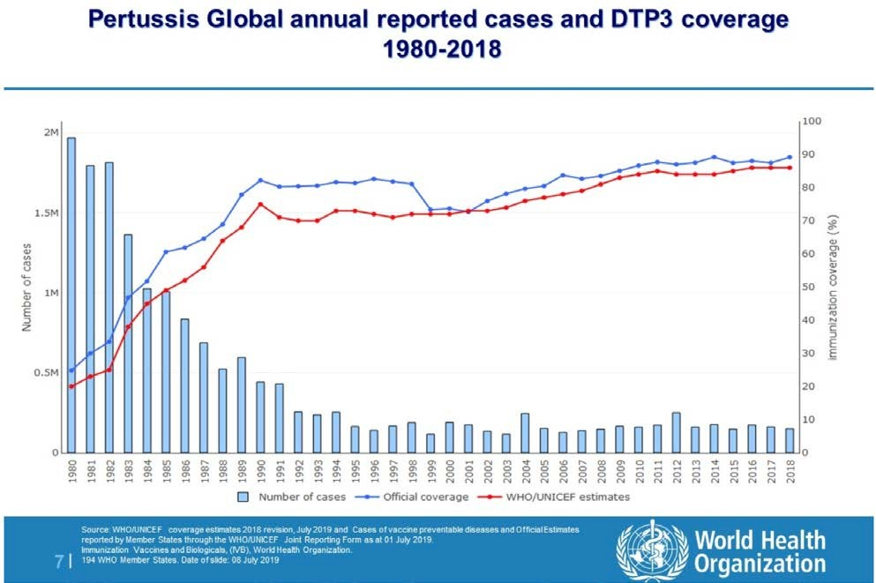
PERTUSSIS
151.074 cases (2018)
89.000 extimated deaths (2008)
86% vaccine coverage (2018)
Notes:
Pertussis is caused by the bacterium Bordetella pertussis. Initial symptoms are usually similar to those of the common cold with a runny nose, fever, and mild cough, but these are followed by weeks of severe coughing fits

Slide 21
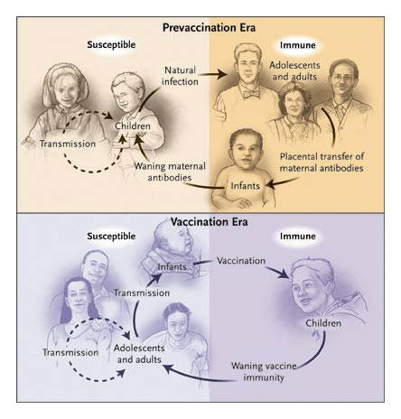
HIGH INCIDENCE IN THE FIRST YEARS OF LIFE
FREQUENT NATURAL BOOSTERS
IMMUNITY IN ADOLESCENTS / ADULTS
PREDOMINANT DISEASE IN YOUNG CHILDREN
LOW INCIDENCE
NO NATURAL BOOSTERS
LOSS OF IMMUNITY IN ADOLESCENTS / ADULTS
MORE FREQUENT DISEASE IN INFANTS (<6 MONTHS) AND IN ADOLESCENTS / ADULTS

Slide 22

COCOON STRATEGY
NEW BORN
PRE-SCHOOL CHILDREN
TEENAGERS AND ADULTS
HEALTHCARE WORKERS
OPERATORS FOR CHILDREN
PREGNANT WOMEN

Slide 23
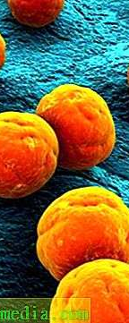
PNEUMOCOCCUS
Streptococcus pneumoniae (S. Pneumoniae) is the leading cause of bacteraemia, meningitis, upper-respiratory tract infections, and otitis media worldwide.
S. Pneumoniae is the most common cause of community-acquired pneumonia (CAP) in adults, accounting for 30/70% of cases requiring hospitalisation.
The nasopharynx is the major ecological reservoir for S. Pneumoniae.

Slide 24
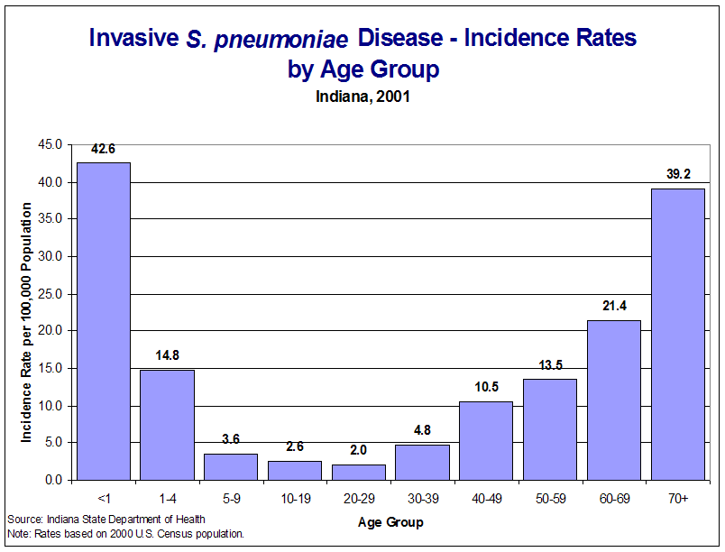
Aging is associated with a decrease in immune functions (immunosenescence) and an increase in comorbidities
This involves, especially if associated with environmental factors, an increase in the risk and severity of infectious diseases

Slide 25
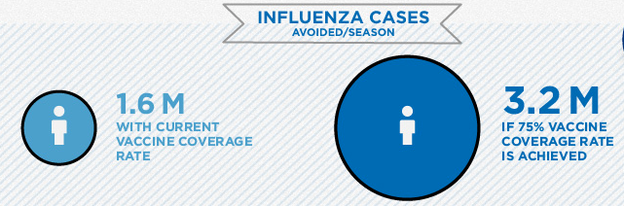
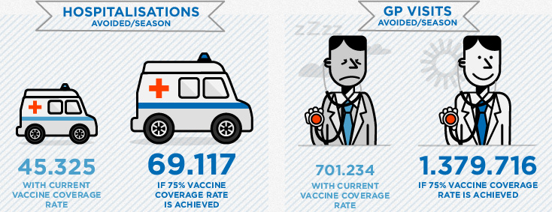
FLU

Slide 26
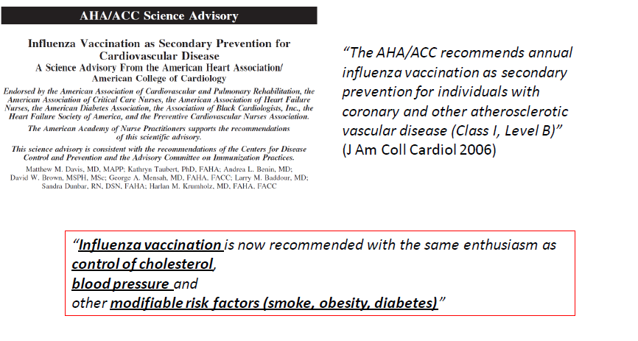
INFLUENZA AND CARDIOVASCULAR RISK

Slide 27
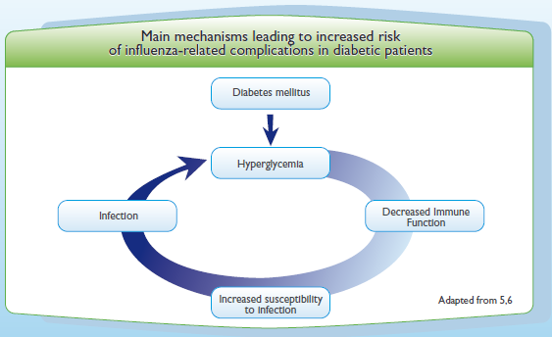
INFLUENZA AND DIABETES
During influenza epidemics, death rates among patients with diabetes
mellitus may increase by 5-15%.
Diabetic patients are at increased risk of complications, hospitalisations and deaths due to influenza
More likely to be hospitalised: risk x 3 to 6 (during influenza epidemics)
More likely to die: risk x 3.7

Slide 28
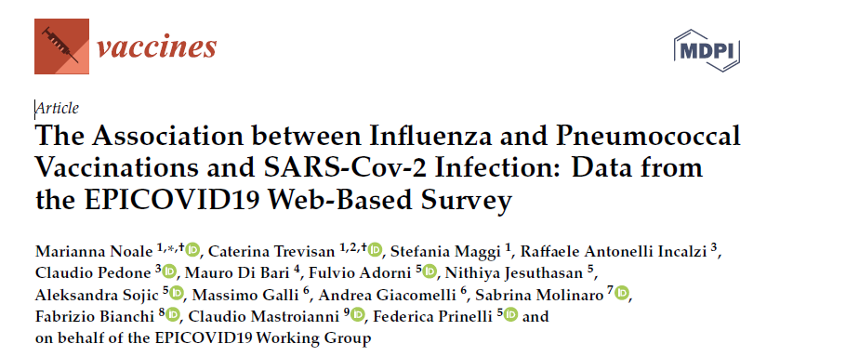
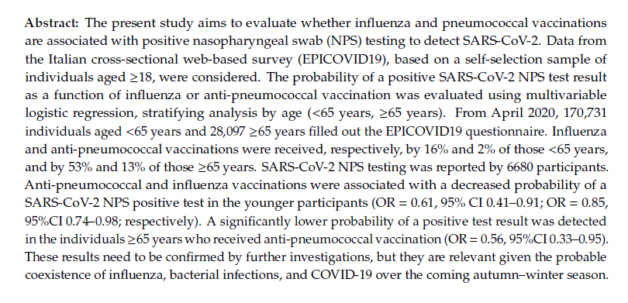
INFLUENZA AND COVID-19

Slide 29
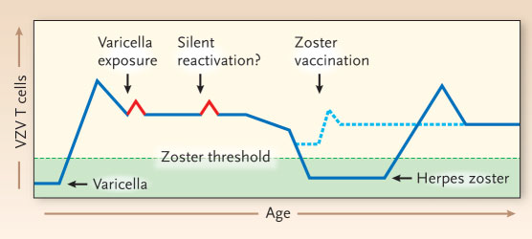
HERPES ZOSTER
Annual incidence of HZ: 6.3 / 1,000 person-years
Estimated 157,100 new cases of HZ each year

Slide 30
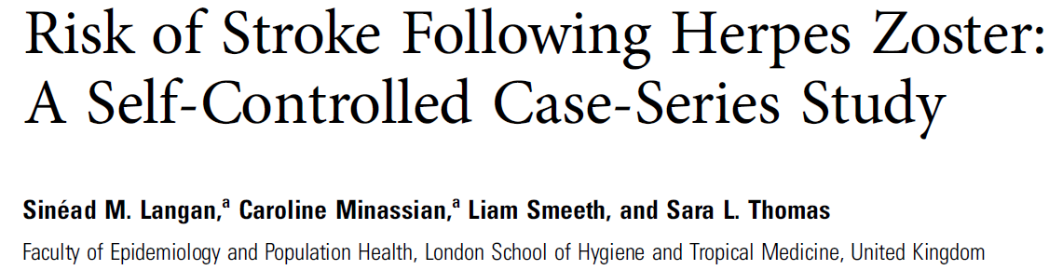
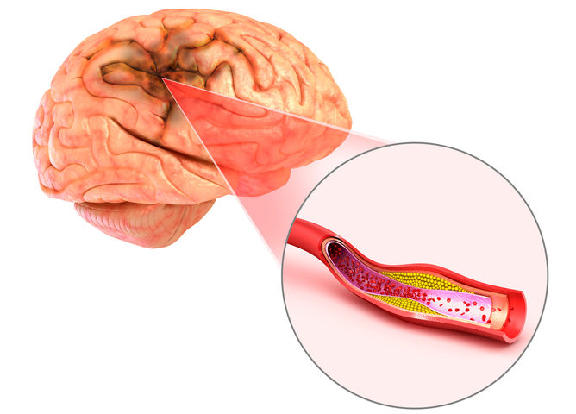
HERPES ZOSTER AND STROKE
HZ HAS BEEN SHOWN TO REPLICATE IN THE CEREBRAL ARTERIES AND CAN CAUSE STROKE

Slide 31

THANK YOU

