Slide 1


Slide 2

LET’S TALK ABOUT NUMBERS: EPIDEMIOLOGY OF THE MAIN CARDIOVASCULAR DISEASES
Incidence, prevalence and mortality of myocardial infarction, stroke, heart failure, atrial fibrillation.
Dott. Vatri Marco

Slide 3
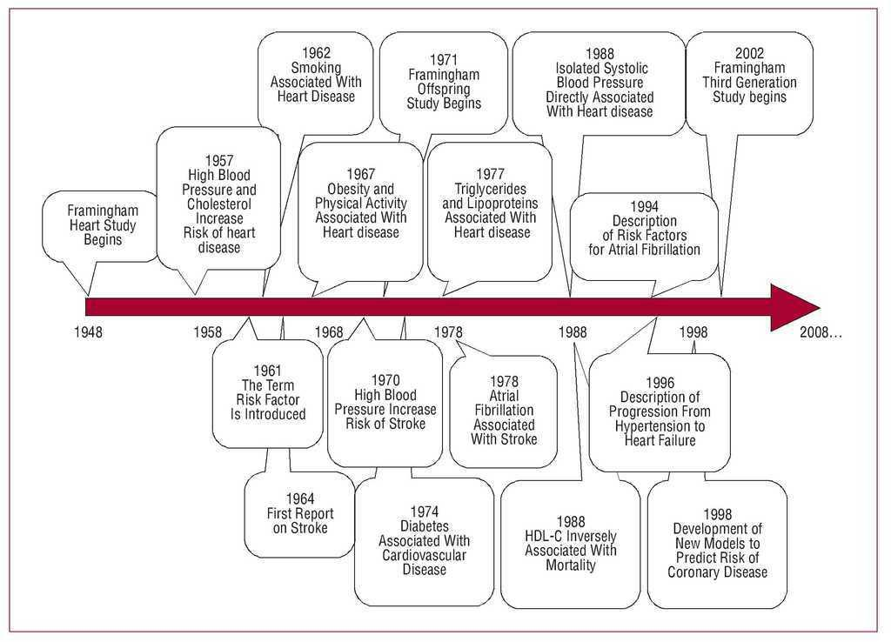
A LITTLE BIT OF HISTORY…

Slide 4

THE FRAMINGHAM HEART STUDY
In 1948, the Framingham Heart Study - under the direction of the National Heart Institute embarked on an ambitious project in health research.
The study, nearly six decades later is the longest running, multigenerational longitudinal study in medical history.
It has helped identify several “risk factors” and their cumulative influence on the manifestation of CVD.
The term ‘risk factor’ was coined by Framingham investigators.

Slide 5
The researchers recruited 5,209 men and women between the ages of 30 and 62 from the town of Framingham, Massachusetts
Since 1948, the subjects have continued to return to the study every two years for a detailed medical history, physical examination, and laboratory tests.
In 1971, the Study enrolled a second generation - 5,124 of the original participants' adult children and their spouses - to participate in similar examinations.
In 1994, the need to establish a new study reflecting a more diverse community of Framingham was recognized, and the first Omni cohort of the Framingham Heart Study was enrolled.

Slide 6
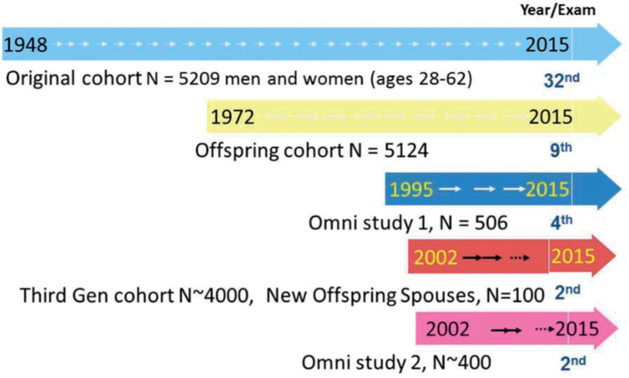

Slide 7


LET’S TALK ABOUT NUMBERS…
INCIDENCE is a measure of the probability of occurrence of a given medical condition in a population within a specified period of time.
PREVALENCE is the proportion of a particular population found to be affected by a medical condition at a specific time.
MORTALITY is a measure of the number of deaths (in general, or due to a specific cause) in a particular population.

Slide 8
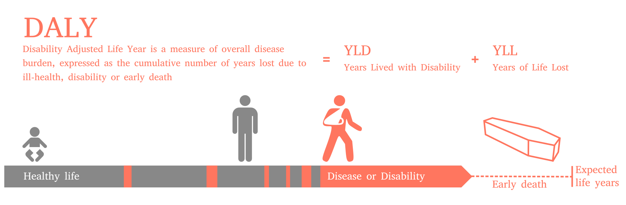
DALY (disability-adjusted life year): It not only includes the potential years of life lost due to premature death, but also includes equivalent years of 'healthy' life lost by virtue of being in states of poor health or disability.
YLD (years lived with disability) = I x DW x L In this formula, I = number of incident cases in the population, DW = disability weight of specific condition, and L = average duration of the case until remission or death (years).
YLL (years of life lost) = N x L where N = number of deaths due to condition, L = standard life expectancy at age of death.

Slide 9

CARDIOVASCULAR DISEASES
PREVALENCE: 523 milions cases in 2019 (+ 26% compare to 2010)
6431 cases per 100000 ab. in 2019 (+ 0,6% compare to 2010)
INCIDENCE: 55,5 milions new cases in 2019 (+ 24,6% compare to 2010)
684 new cases per 100000 ab. in 2019 (- 1,6 % compare to 2010)
DEATHS: 18,6 milions deaths in 2019 (+17% compare to 2010)
239 deaths per 100000 ab. In 2019 (-11% comapre to 2010)

Slide 10
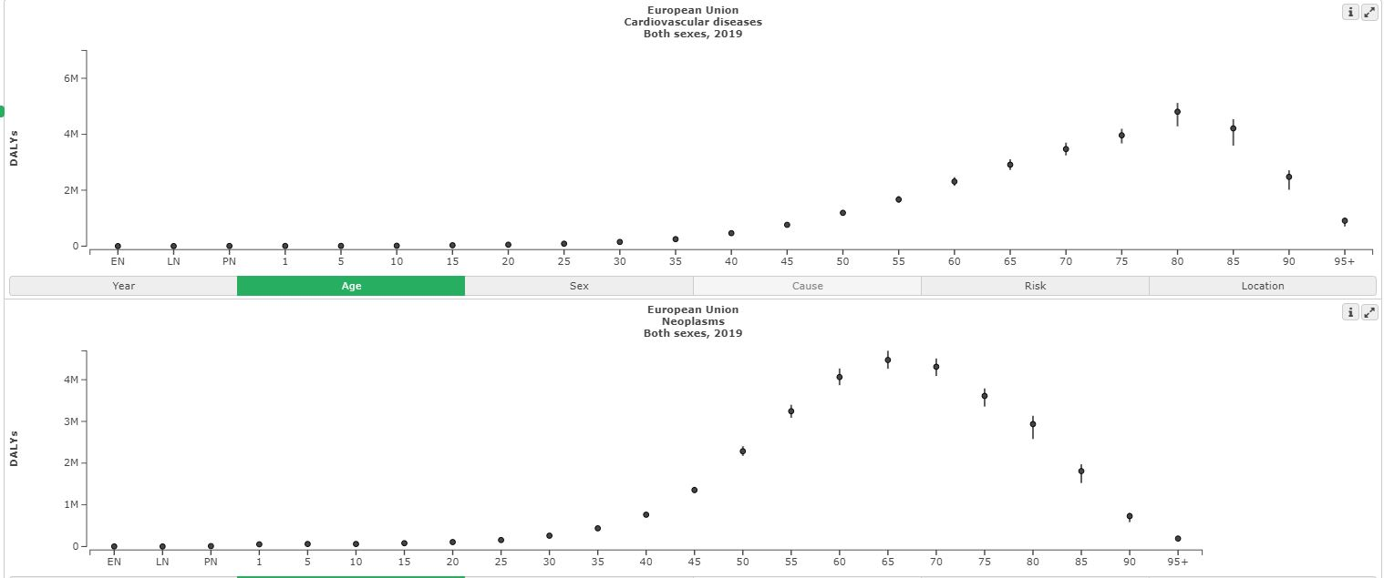
CARDIOVASCULAR DISEASES
DALYs: 393 milions in 2019 ( + 12,5% compare to 2010)
4863 per 100000 ab. In 2019 (- 11,2 % compare to 2010)
WERE THE LEADING CAUSE OF DISEASE BURDEN AND DEATH IN 2019

Slide 11
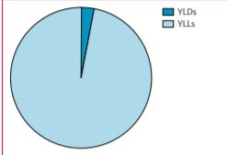
MYOCARDIAL INFARCTION
PREVALENCE: 197 milions cases in 2019 (+ 29% compare to 2010)
2421 cases per 100000 ab. in 2019 (+ 0,1% compare to 2010)
INCIDENCE: 21,2 milions new cases in 2019 (+ 24,5% compare to 2010)
262 new cases per 100000 ab. in 2019 (- 3,6 % compare to 2010)
DEATHS: 9,1 milions deaths in 2019 (+19% compare to 2010)
118 deaths per 100000 ab. In 2019 (-10% comapre to 2010)
DALY: 182 milions in 2019 [YLL 177 milions + YLD 5 milions]

Slide 12
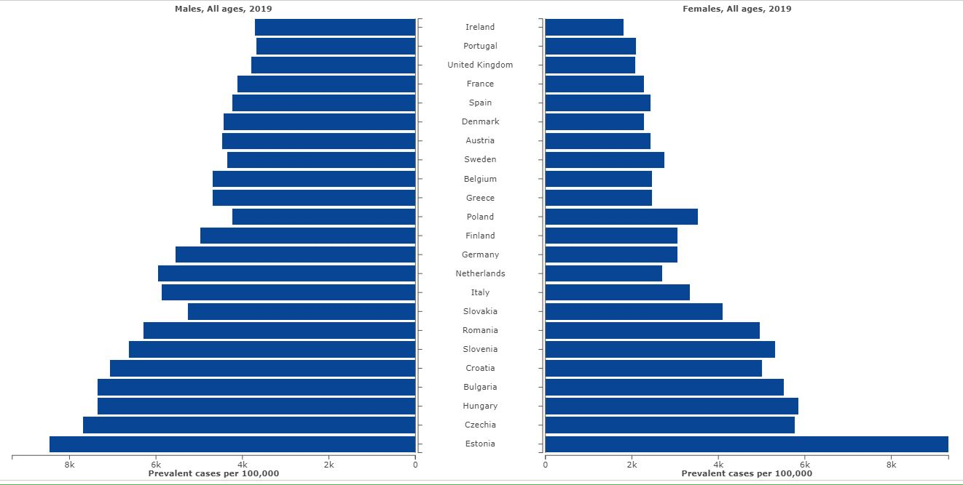
PREVALENCE OF MYOCARDIAL INFARCTION IN EUROPE

Slide 13
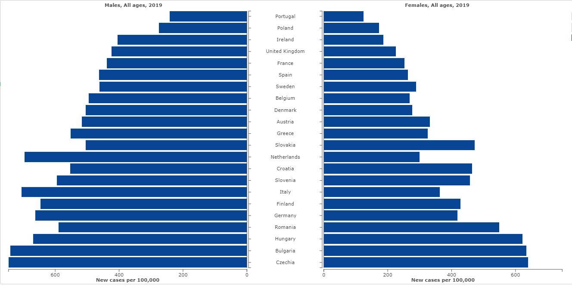
INCIDENCE OF MYOCARDIAL INFARCTION IN EUROPE

Slide 14
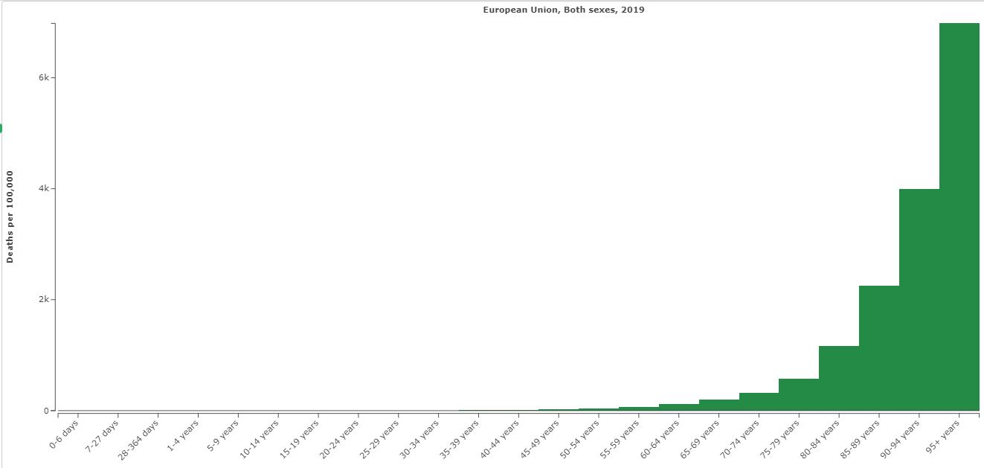
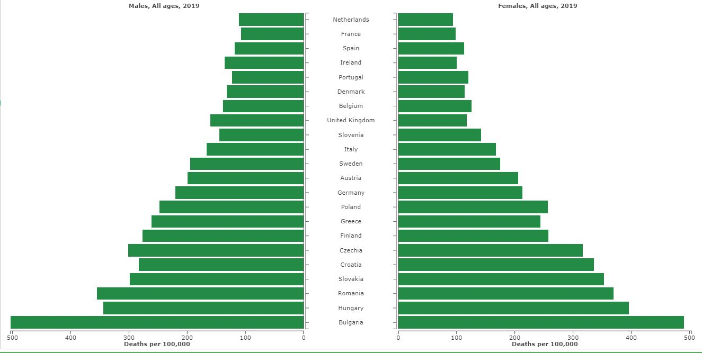
MORTALITY OF MYOCARDIAL INFARCTION IN EUROPE

Slide 15
STROKE
PREVALENCE: 101 milions cases in 2019 (+ 27% compare to 2010)
1240 cases per 100000 ab. in 2019 (+ 2% compare to 2010)
INCIDENCE: 12,2 milions new cases in 2019 (+ 24,7% compare to 2010)
150 new cases per 100000 ab. in 2019 (- 1,5 % compare to 2010)
DEATHS: 6,5 milions deaths in 2019 (+12% compare to 2010)
84 deaths per 100000 ab. In 2019 (-14,7% comapre to 2010)
DALY: 143 milions in 2019 [YLL 125 milions + YLD 18 milions]

Slide 16
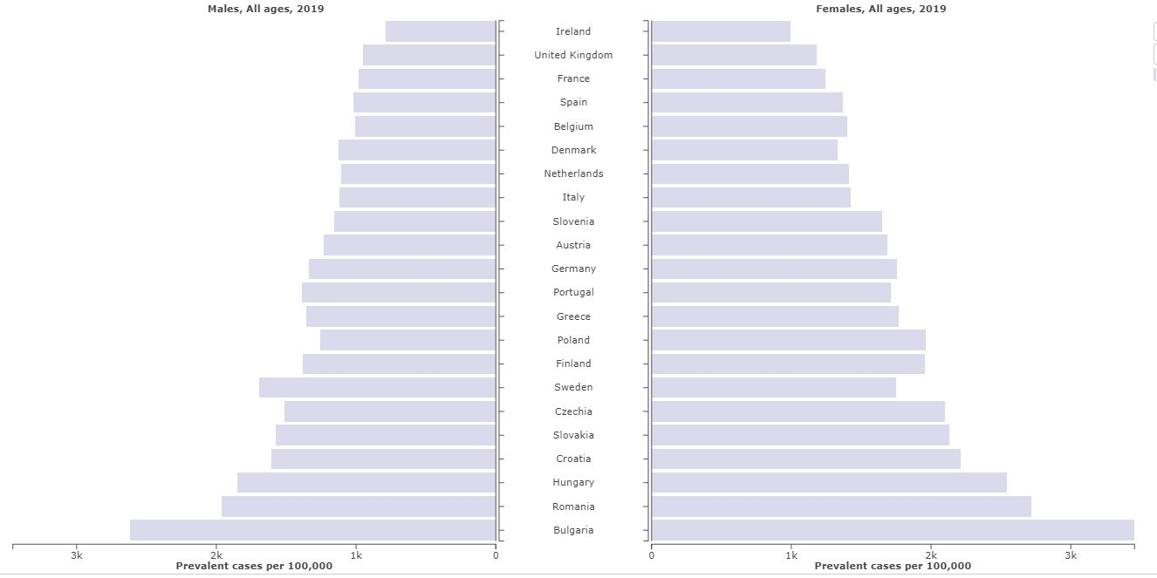
PREVALENCE OF STROKE IN EUROPE

Slide 17
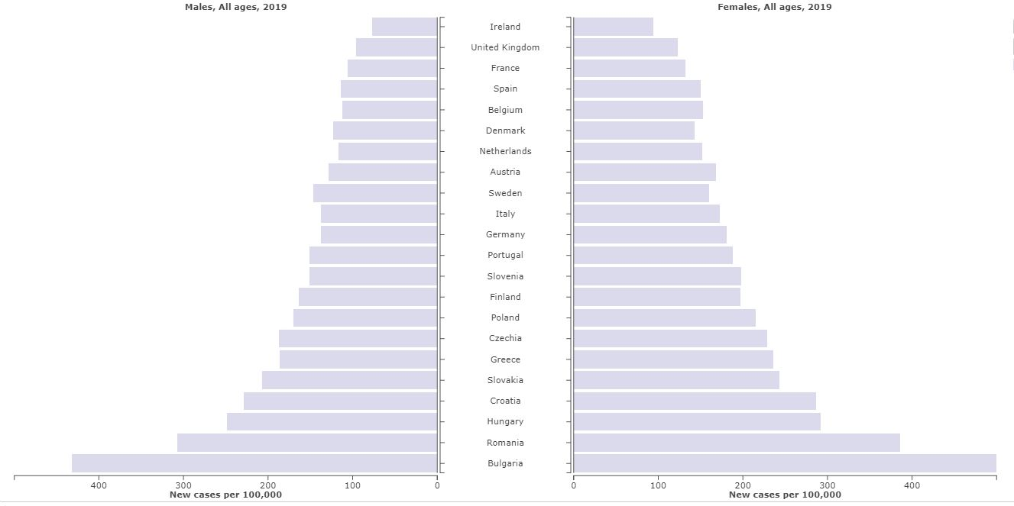
INCIDENCE OF STROKE IN EUROPE

Slide 18
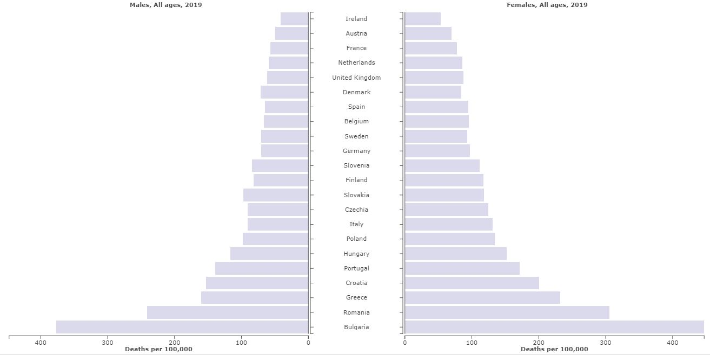
MORTALITY OF STROKE IN EUROPE

Slide 19
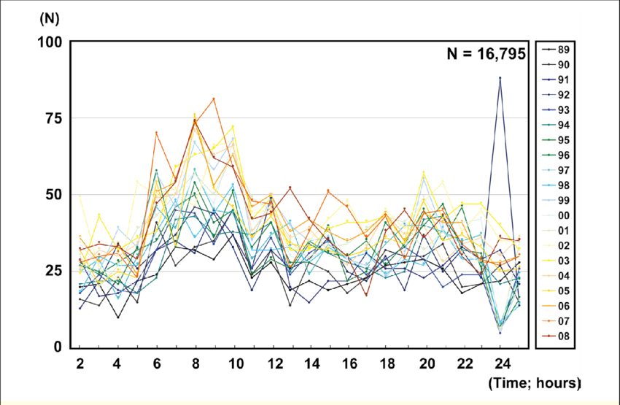
TIME OF STROKE

Slide 20
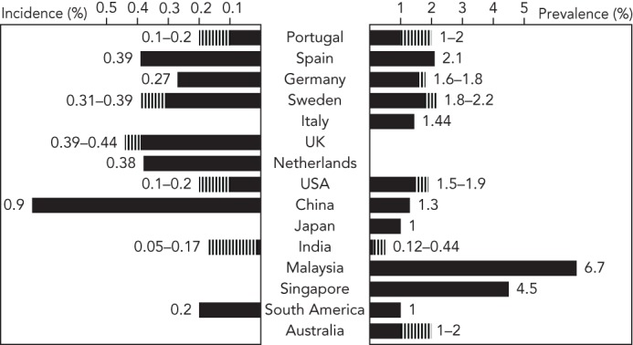
HEART FAILURE
PREVALENCE: 64,3 millions in 2017
INCIDENCE: 420 new case per 100000 ab

Slide 21
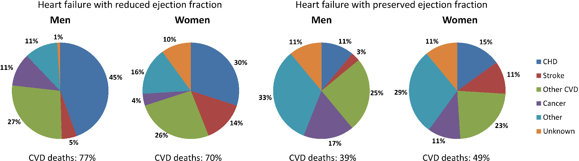
MORTALITY OF HEART FAILURE
Notes:
CHD coronary heart desease

Slide 22
ATRIAL FIBRILLATION
PREVALENCE: 60 milions cases in 2019 (+ 31 % compare to 2010)
743 cases per 100000 ab. in 2019 (- 0,1 % compare to 2010)
INCIDENCE: 4,7 milions new cases in 2019 (+ 30 % compare to 2010)
57 new cases per 100000 ab. in 2019 (+ 1,2 % compare to 2010)
DEATHS: 315000 deaths in 2019 (+ 40 % compare to 2010)
4 deaths per 100000 ab. In 2019 (+ 0,8 % comapre to 2010)
DALY: 8,4 milions in 2019 [YLL 3,8 milions + YLD 4,6 milions]

Slide 23
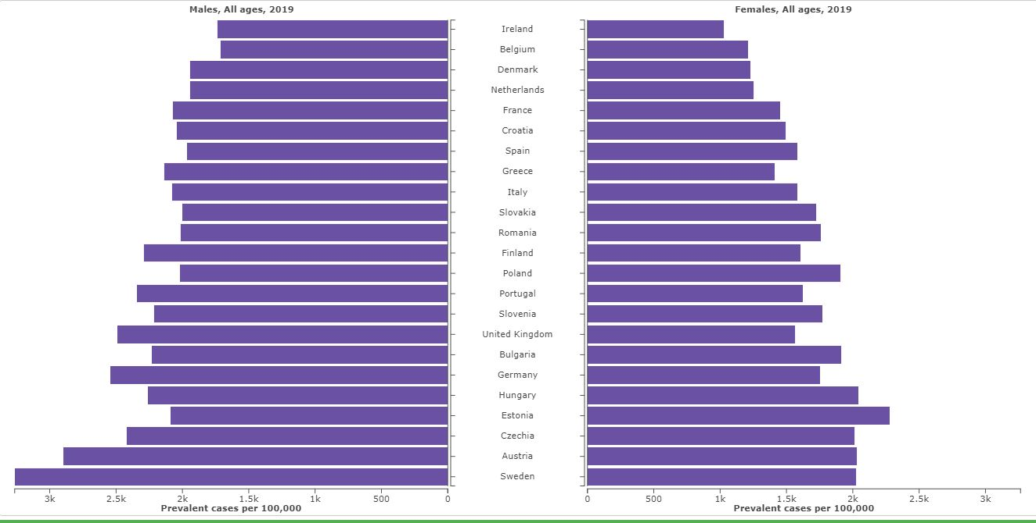
PREVALENCE OF AF IN EUROPE

Slide 24
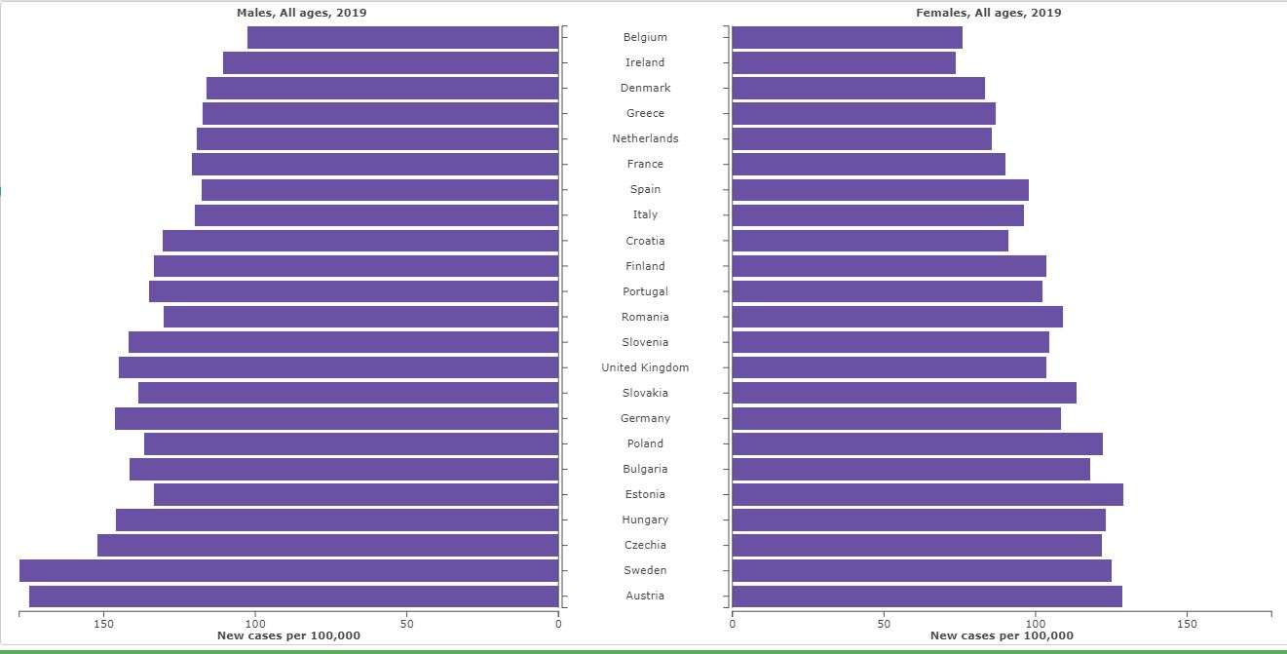
INCIDENCE OF AF IN EUROPE

Slide 25
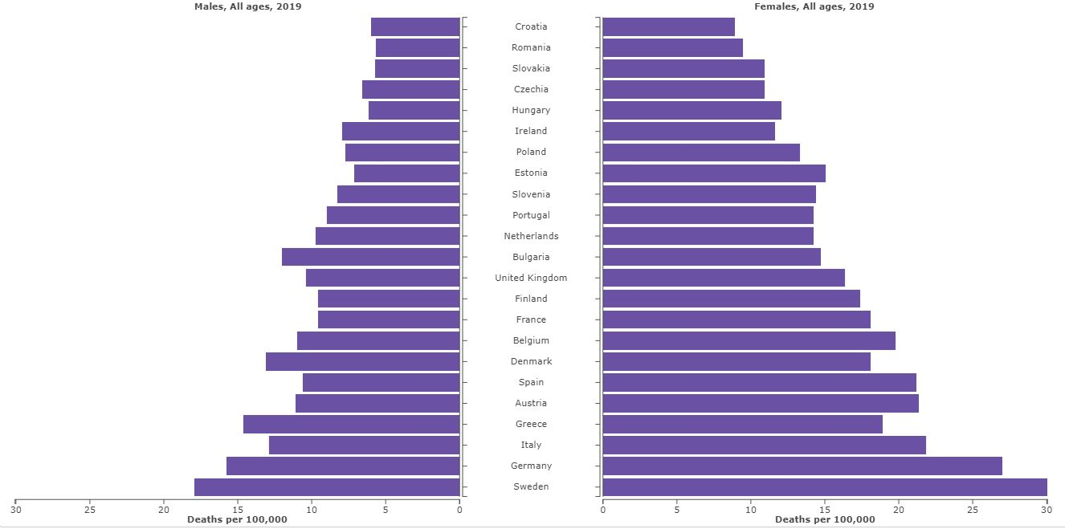
MORTALITY OF AF IN EUROPE

Slide 26
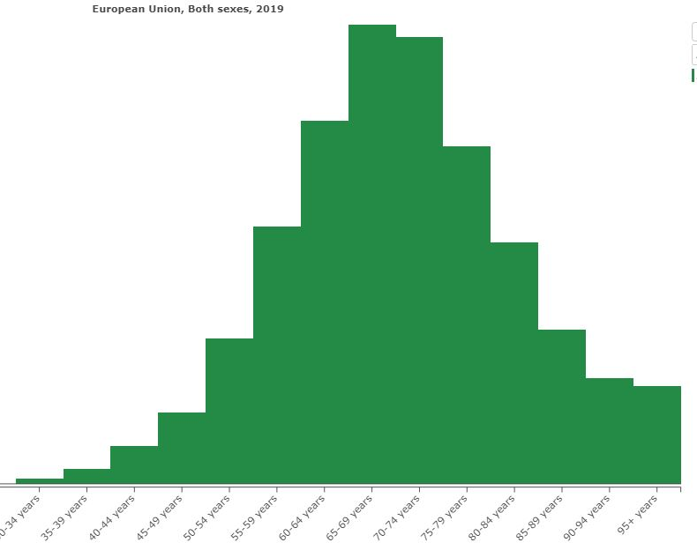
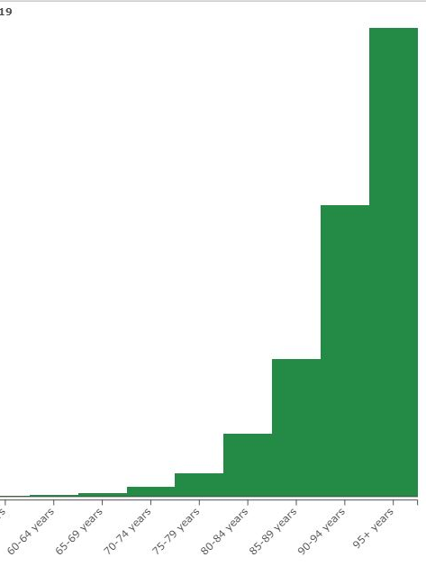
INCIDENCE PER 100000 AB
DEATHS PER 100000 AB

Slide 27


THANKS FOR THE ATTENTION

