Slide 1


Slide 2


CARDIOVASCULAR DISEASE SCREENING: EARLY DIAGNOSIS PROCEDURES.
Future prospects for people
and Health Care System
Dott. Vatri Marco

Slide 3


Cardiovascular risk factors are clinical conditions that determine an increased susceptibility to develop major cardiovascular events.
This risk is defined as the probability of having a cardiovascular event over a period of time between 5-10 years compared to a subject with the same characteristics, but without the presence of risk factors.
Notes:
such as acute myocardial infarction, ischemic heart disease, stroke, heart failure congestive, end-stage renal failure and death for cardiovascular causes.

Slide 4

RISK FACTORS
MODIFIABLE |  | NON-MODIFIABLE
MAJOR | MINOR
SISTOLIC BLOOD PRESSURE | DIASTOLIC BLOOD PRESSURE | AGE
HIGH TOTAL COLESTEROL | LOW HDL COLESTEROL | GENDER
DIABETES | HIGH TRIGLICERIDS | RACE AND ETHNICITY
SMOKE | ABDOMINAL OBESITY | GENETIC FACTORS
 | SEDENTARITY
 | EMOTIONAL OR FISICAL STRESS
 | IPERURICEMIA
 | METABOLIC SINDROME
 | HIGH FLOGOSIS INDEX

Slide 5

KEY SCREENING TESTS FOR MONITORING CARDIOVASCULAR HEALTH:
BLOOD PRESSURE MONITORING
FASTING LIPOPROTEIN PROFILE
BODY WEIGHT
BLOOD GLUCOSE TEST
SMOKING, PHYSICAL ACTIVITY, DIET

Slide 6
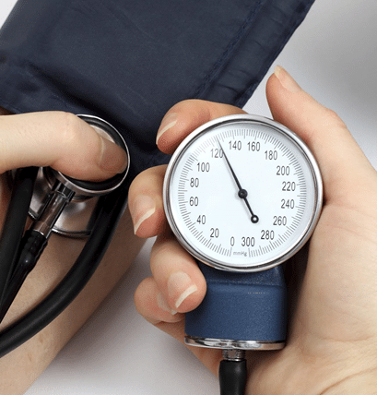
BLOOD PRESSURE MONITORING
Blood pressure is one of the most important screenings because high blood pressure usually has no symptoms so it can’t be detected without being measured.
HOW OFTEN?
Each regular healthcare visit or at least once per year if blood pressure is less than 120/80 mm Hg

Slide 7
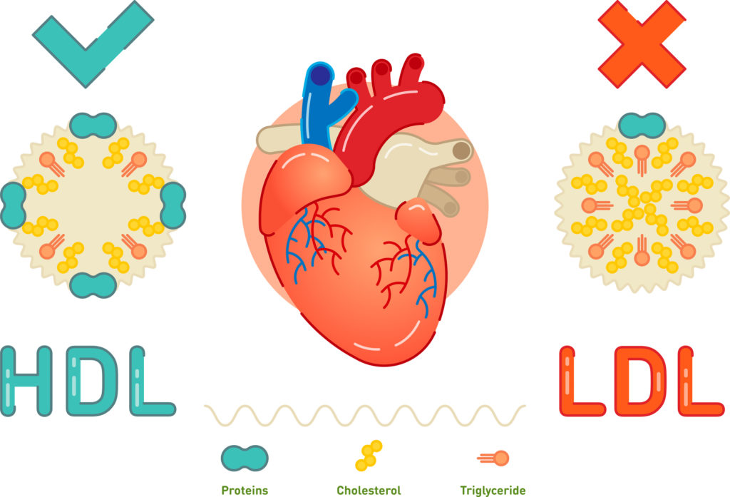
FASTING LIPOPROTEIN PROFILE
This is a blood test that measures total cholesterol, LDL cholesterol and HDL cholesterol.
HOW OFTEN?
Every 4-6 years for normal-risk adults; more often if any you have elevated risk for heart disease and stroke.

Slide 8

BODY WEIGHT (BMI) and
WAIST CIRCUMFERENCE
HOW OFTEN?
During your regular healthcare visit. Once every month.

Slide 9

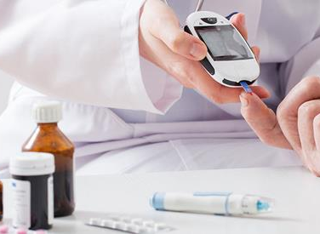
BLOOD GLUCOSE TEST
Untreated diabetes can lead to many serious medical problems including heart disease and stroke.
HOW OFTEN?
If you have no risk factors for diabetes at least every 3 years

Slide 10




SMOKING
PHYSICAL ACTIVITY DIET
HOW OFTEN?
At least each regular healthcare visit

Slide 11
ORGAN DAMAGE SCREENING
12-LEAD ECG
URINE ALBUMIN/CREATININE RATIO
BLOOD CREATININE AND EGFR
FUNDOSCOPY
ECHOCARDIOGRAPHY
CAROTID ULTRASOUND
ABI (ANKLE-BRACHIAL INDEX)

Slide 12
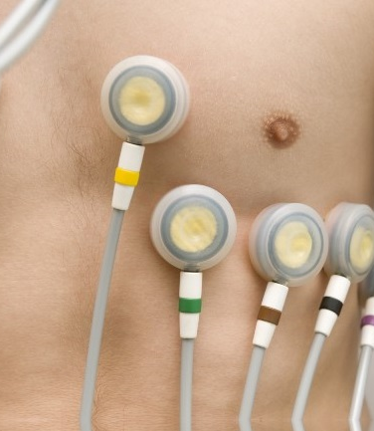
12-LEAD ECG
Screen for left ventricular hypertrofy and other possible cardiac abnormalities, and to document heart rate and cardiac rhythm

Slide 13

URINE ALBUMIN/CREATININE RATIO.
BLOOD CREATININE AND EGFR
To detect possible renal disease

Slide 14

FUNDOSCOPY
To detect hypertensive retinopathy,

Slide 15
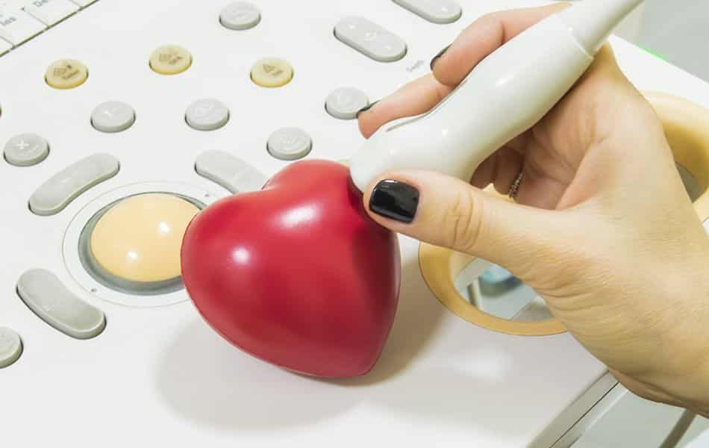


ECHOCARDIOGRAPHY
CAROTID ULTRASOUND
To determine the presence of carotid plaque or stenosis

Slide 16
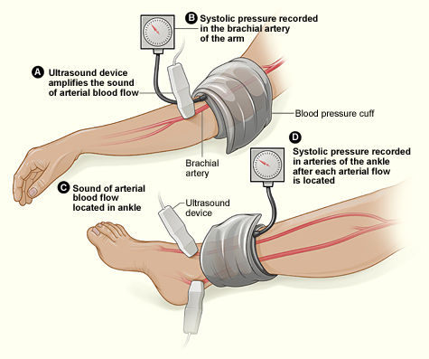
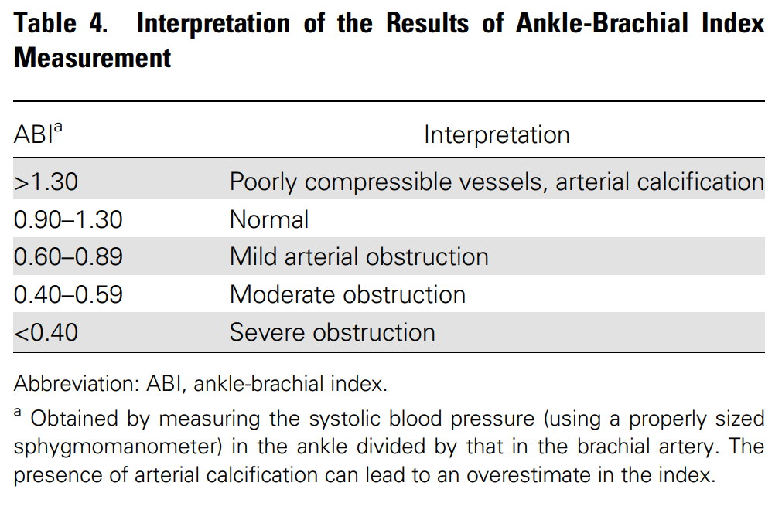
ABI (ankle-brachial index)
The ABPI test is a tool for the non-invasive assessment of Peripheral vascular disease (PVD).

Slide 17
FUTURE POSSIBILITY
CORONARY ARTERY CALCIUM
ENDOTHELIAL DYSFUNCTION
CARDIAC MRI

Slide 18
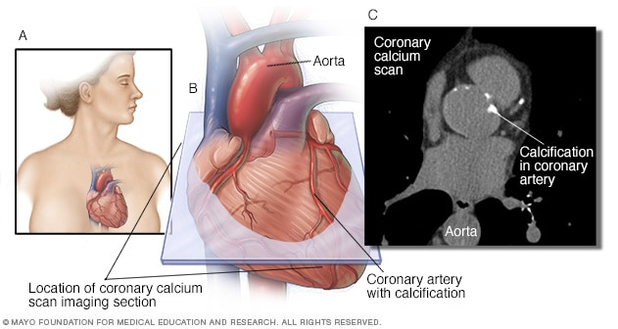
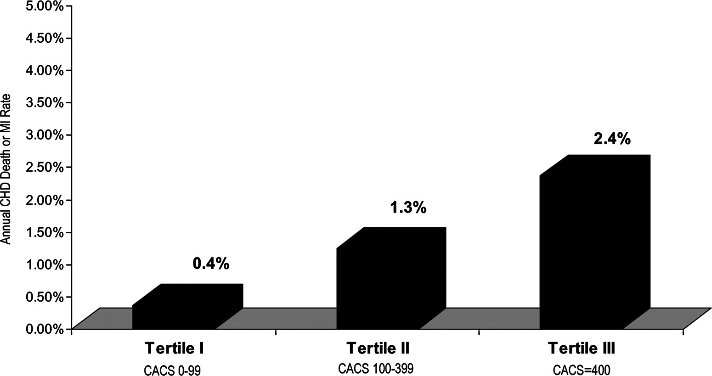

CORONARY ARTERY CALCIUM
The coronary artery calcium score plays an Important role In cardiovascular risk stratification, showing a significant association with the medium- or long-term occurrence of major cardiovascular events.

Slide 19
ENDOTHELIAL DYSFUNCTION
Endothelial dysfunction is involved in lesion formation by the promotion of both the early and late mechanisms of atherosclerosis.
Noninvasive tests for the assessment of coronary endothelial function that have been described include Doppler echocardiography, PET, and MR. However, the gold standard test requires invasive coronary angiography.

Slide 20
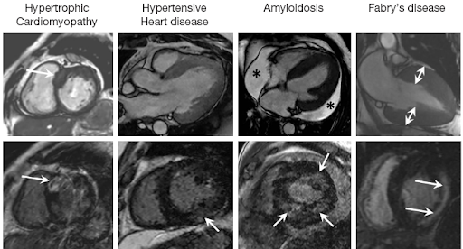
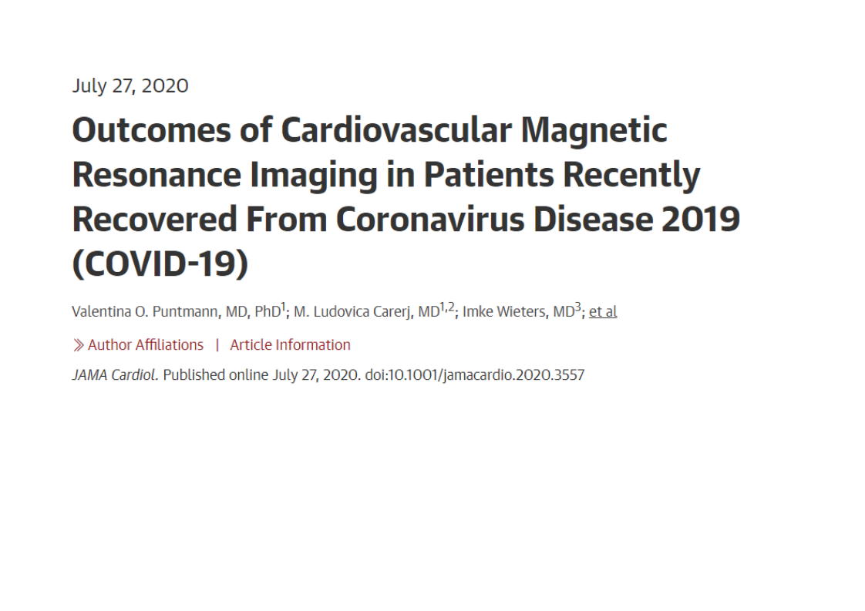
CARDIAC MRI

Slide 21
PREDDITIVE VALUE AND IMPACT ON THE HEALTH SYSTEM
 | PREDDITIVE VALUE | REPRODUCIBILITY | AVAILABILITY | COST-EFFECTNES
ECG | MEDIUM | HIGH | HIGH | HIGH
ECHOCARDIOGRAPHY | HIGH | MEDIUM | MEDIUM | MEDIUM
CREATININE AND EGFR | MEDIUM | MEDIUM | HIGH | HIGH
CAROTID US | MEDIUM | MEDIUM | MEDIUM | MEDIUM
ABI | MEDIUM | MEDIUM | MEDIUM | MEDIUM
FUNDOSCOPY | MEDIUM | LOW | HIGH | MEDIUM
Notes:
Positive predictive value is the probability that subjects with a positive screening test truly have the disease. Negative predictive value is the probability that subjects with a negative screening test truly don't have the disease

Slide 22
PREDDITIVE VALUE AND IMPACT ON THE HEALTH SYSTEM
 | PREDDITIVE VALUE | REPRODUCIBILITY | AVAILABILITY | COST-EFFECTNES
CORONARY ARTERY CALCIUM | LOW | MEDIUM | LOW | VERY LOW
ENDOTHELIAL DYSFUNCTION | LOW | VERY LOW | VERY LOW | VERY LOW
CARDIAC MRI | LOW | MEDIUM | LOW | LOW

Slide 23

THANK YOU

