Slide 1
Balanced Pain Management (US) Neil Betteridge Strategic Adviser, GAfPA Brussels 26 April 2018

Slide 2
Physician and Patient Voices
Informing Policymaking

Slide 3
A Better Way

Slide 4
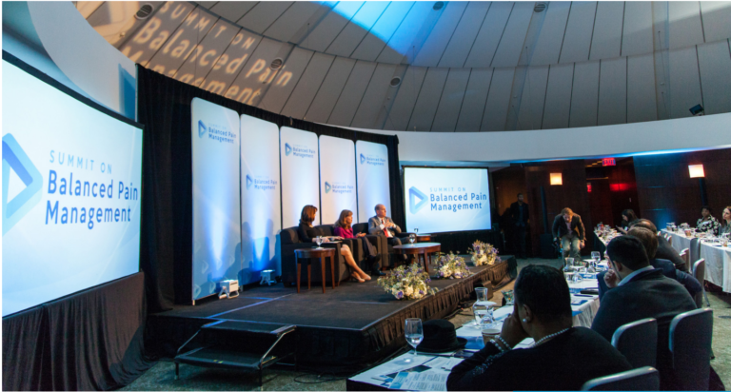

Slide 5
Advocating for Balanced Treatment Options

Slide 6
Advocating for Balanced Treatment Options

Slide 7
Advocacy

Slide 8
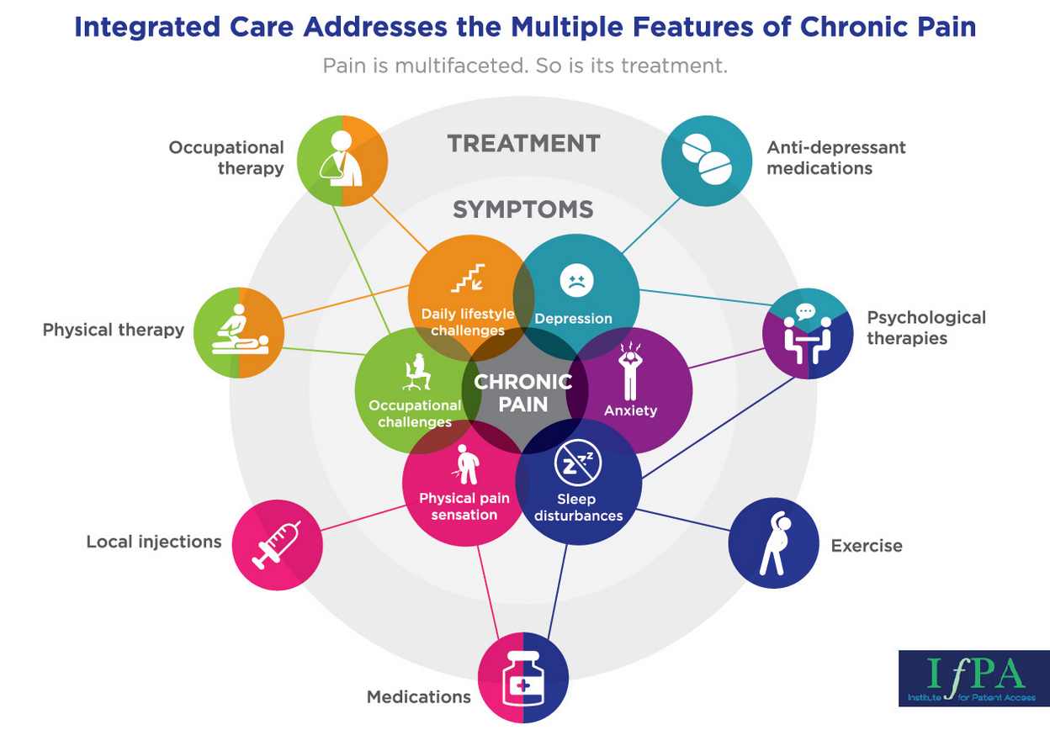
Integrated Care for Chronic Pain

Slide 9
Multimodal Analgesia for Acute Pain

Slide 10
Advocating for a Balanced Policy Approach

Slide 11
Advocating for a Balanced Policy Approach

Slide 12
Abuse-Deterrent Technology
2010
2017
FDA approves the first abuse-deterrent opioid pain pill
The Institute for Clinical and Economic Review deems the technology too expensive, not cost effective

Slide 13
The Institute for Clinical and Economic Review

Slide 14
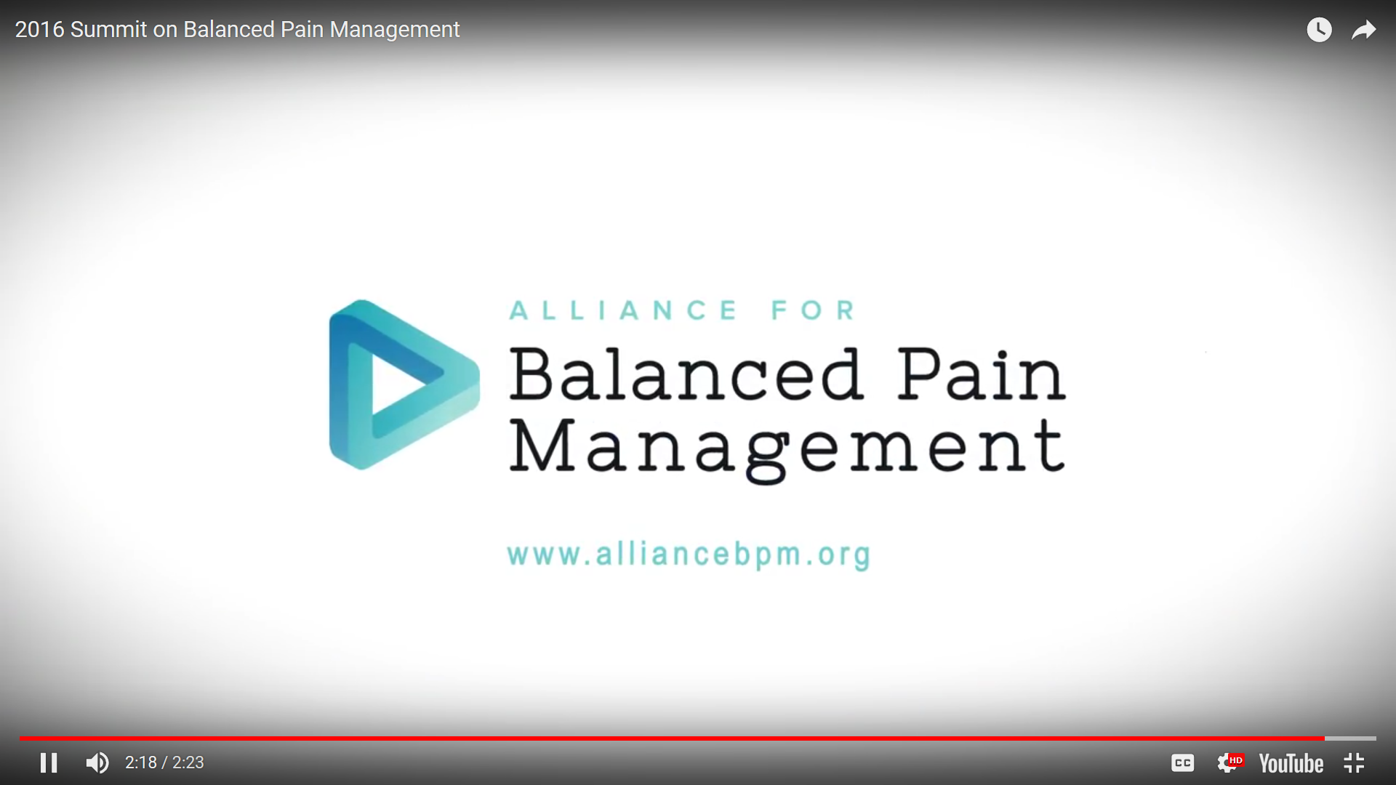
Summit 2016

Slide 15
Final Thoughts

Slide 16
EAfPA workshops at: - SIP 2017, Malta - EFIC 2017, Copenhagen - EULAR, 2017 and 2018

Slide 17
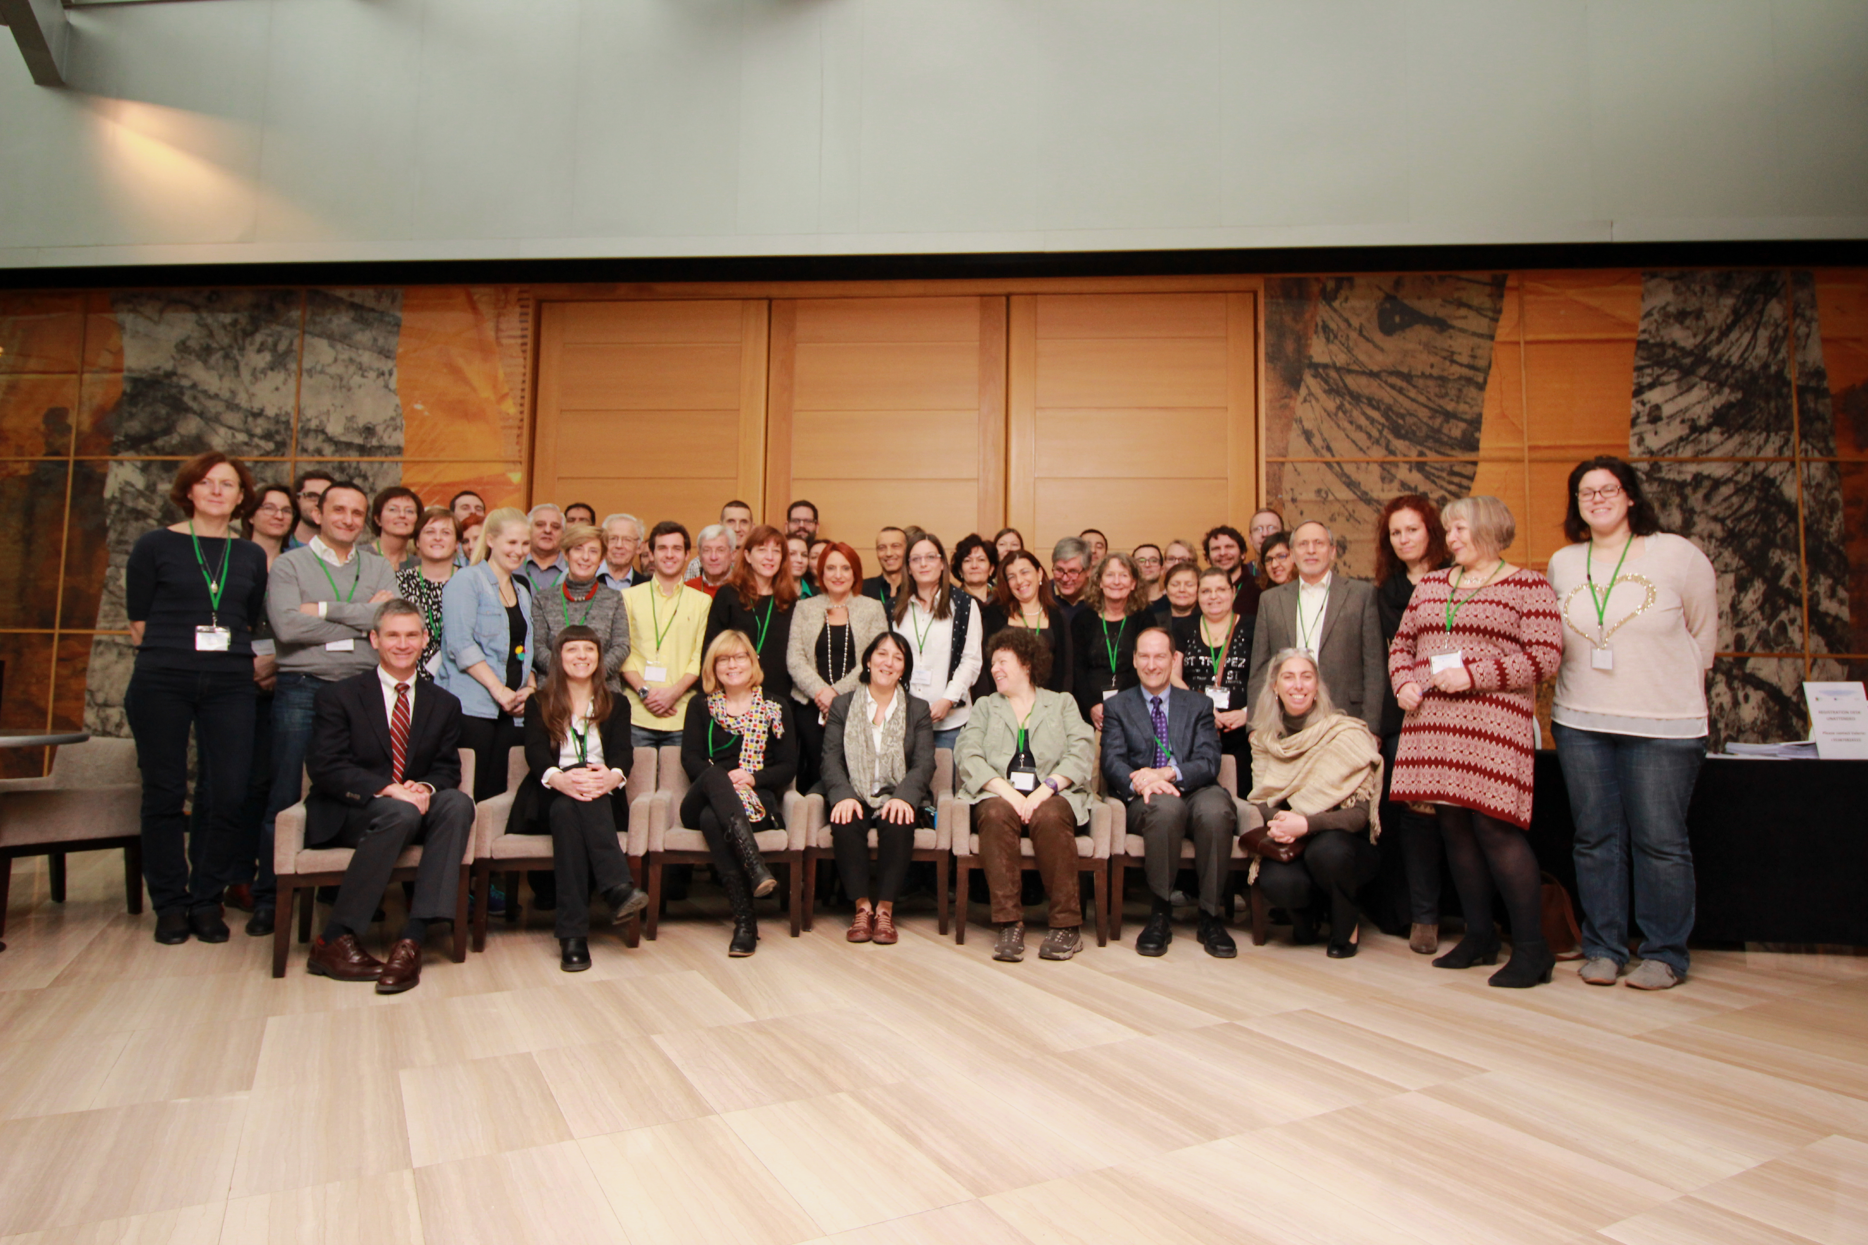
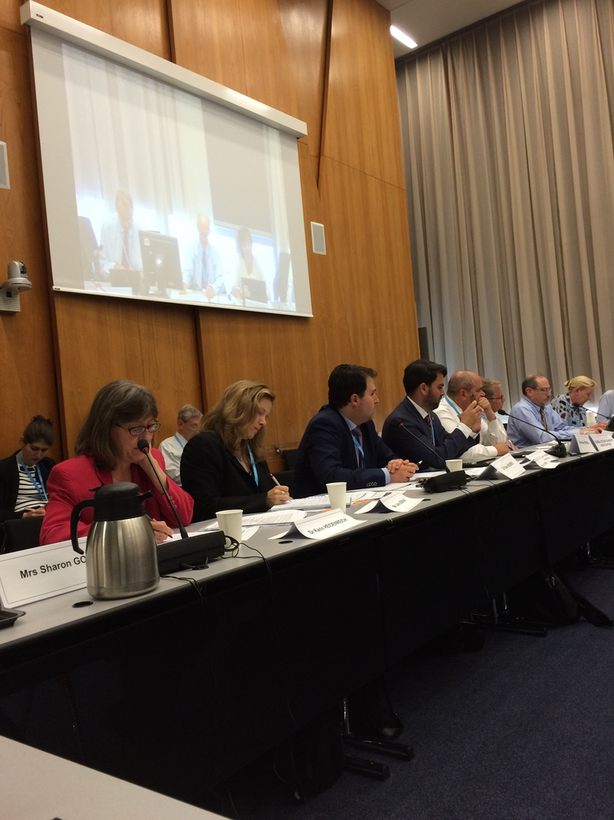
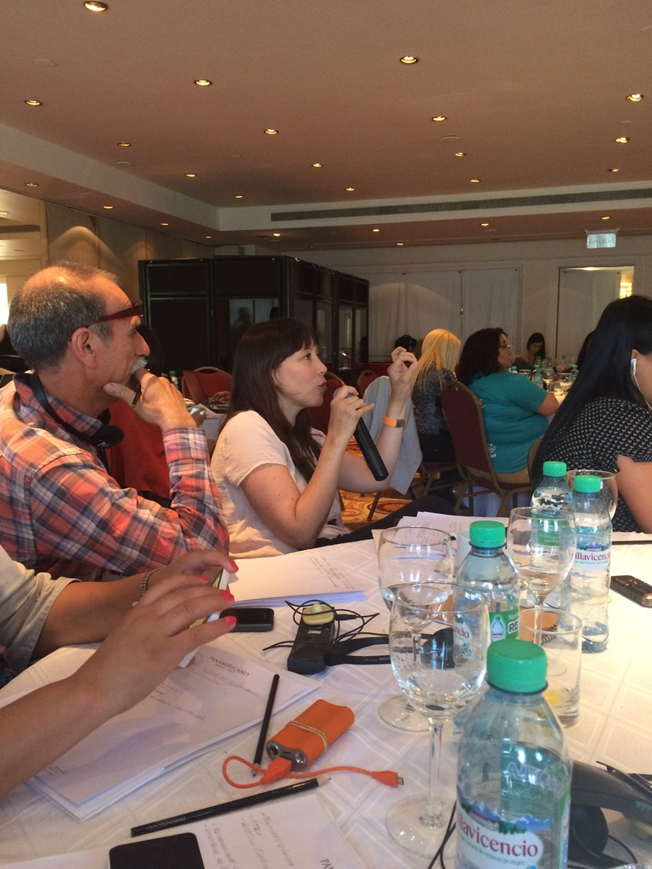
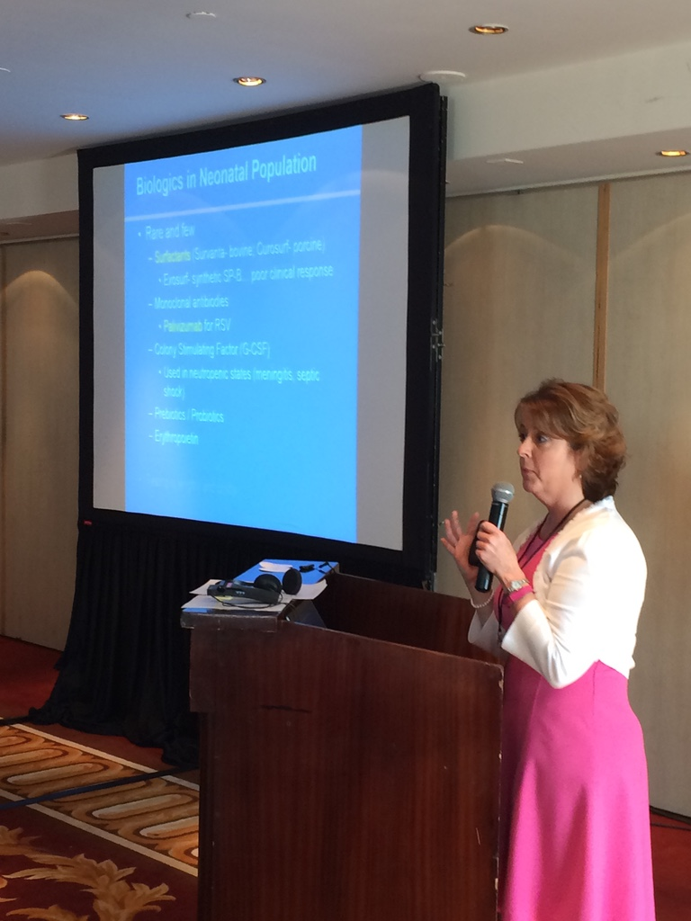
Symposiums, Summits & and Workshops

Slide 18
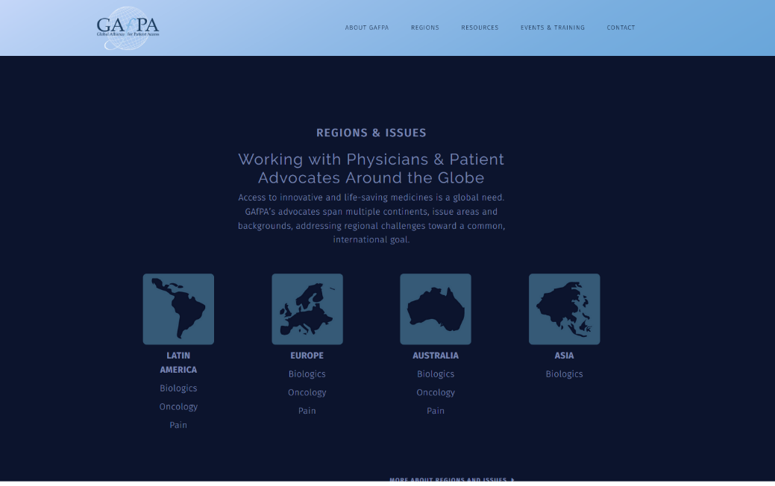
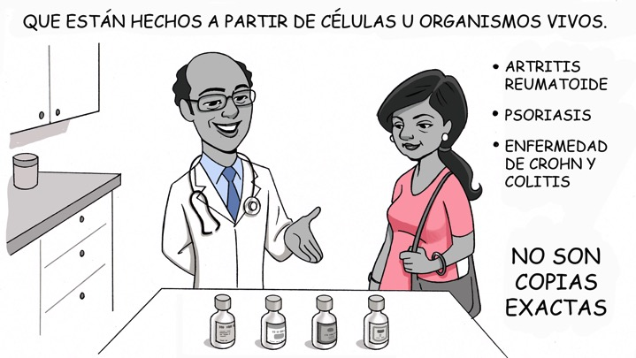
Educational Materials

Slide 19
Naming Poster Presentations

Slide 20
GAfPA’s Upcoming Programs
Global Alliance for Patient Access Policy Workshop
Budapest, January 13-14
Global Alliance for Patient Access Policy Workshop
Munich, May 5-6
Patient Advocacy Conference
Rome, May 24
Societal Impact of Pain
Malta, June 8-9
Latin America, Advocacy Summit
Rio de Janeiro, August 25-26
Global Alliance for Patient Access Policy Workshop
Warsaw, September 15-16
Global Alliance for Patient Access Policy Workshop
Rome, November 10-11
2017 Medical Society Meetings
ECCO, EFIC, EULAR, MDS, ESMO, UEG Week, ACR, EADV
www.GAfPA.org/Events

Slide 21
Website

Slide 22
Protecting Patient Access to Pain Medicine: The Role of Doctors and Patients
Brian Kennedy
Executive Director

