Slide 1
Eventuale sottotitolo o orario/data o spiegazione
Project Web page

Slide 2
Framework
Our commitment, as a European network,
is to engage citizens and citizens’ associations and health stakeholders across Europe to better know and implement vaccination policies.
The current pandemic is placing a huge strain on health systems worldwide, forcing them to adapt and sometimes innovate in care management:
what are the lessons learned for the VACCINATION systems?
Problems & Proposals

Slide 4
TOPICS
From the
EU Commission’s key steps for effective vaccination strategies and vaccines deployment
- RESOURCES
have sufficient resources to assure the capacity of vaccination services to deliver vaccines
- ACCESS
easy access to vaccines for target populations, both in terms of affordability and physical proximity and information.
- MONITORING
ensure that Immunisation Information Systems and other vaccination registries are updated and ready to process vaccination data.
- COMMUNICATION
ensure clear communication on the benefits, risks and importance of vaccines,
thus promoting public trust; tackling the misinformation and disinformation.
+ GENERAL INFO on Disruption & ENGAGEMENT of stakeholders

Slide 5
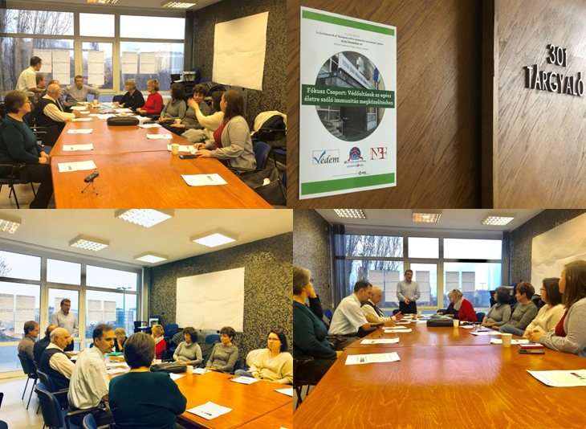
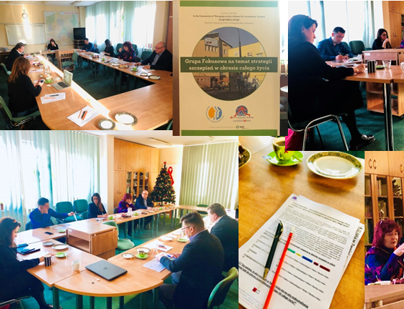
From December 2020 to May 2021
Survey as an“online focus group” about both covid-19 and ROUTINE VACCINATION
in particular on Flu (Influenza) - MMR (measles, mumps, and rubella) and HPV (Human Papilloma Virus)

Slide 6
I EU online survey (June 2021)
RECEIVED: 65 answers in 21 countries, most of them from Belgium, France, Hungary, Ireland, Italy, Malta, Portugal, Romania, Spain, etc..
18 national PAGs (Patients Advocacy Groups) and citizens’ organizations
24 national healthcare professionals
21 National health institutions dealing with vaccination
+ 2 Pharmaceutical companies
by

Slide 7
Routine Vaccinations Disruption

Slide 8
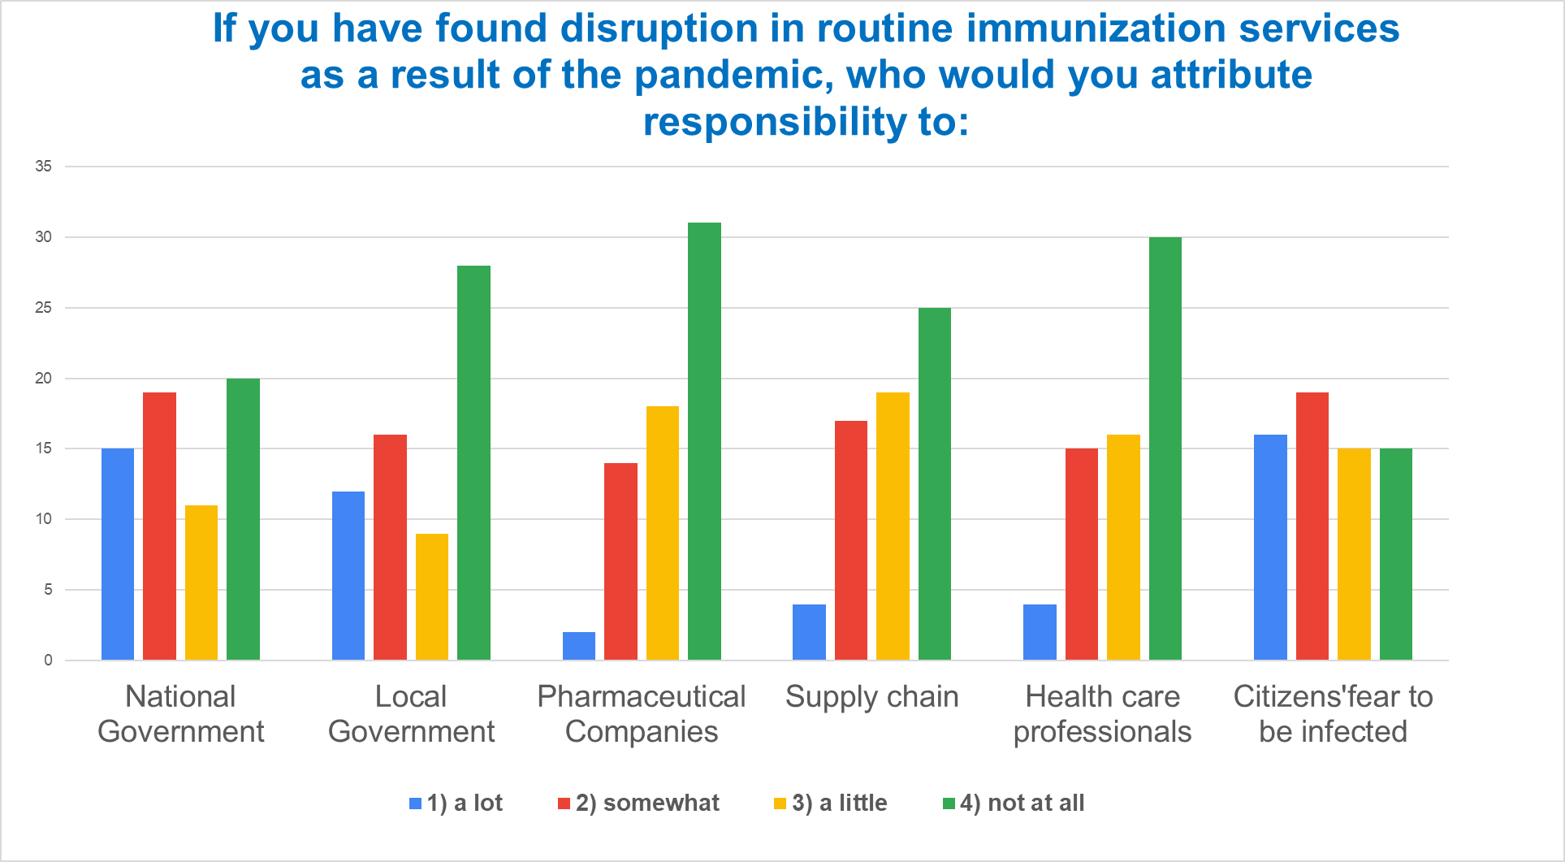

Slide 9
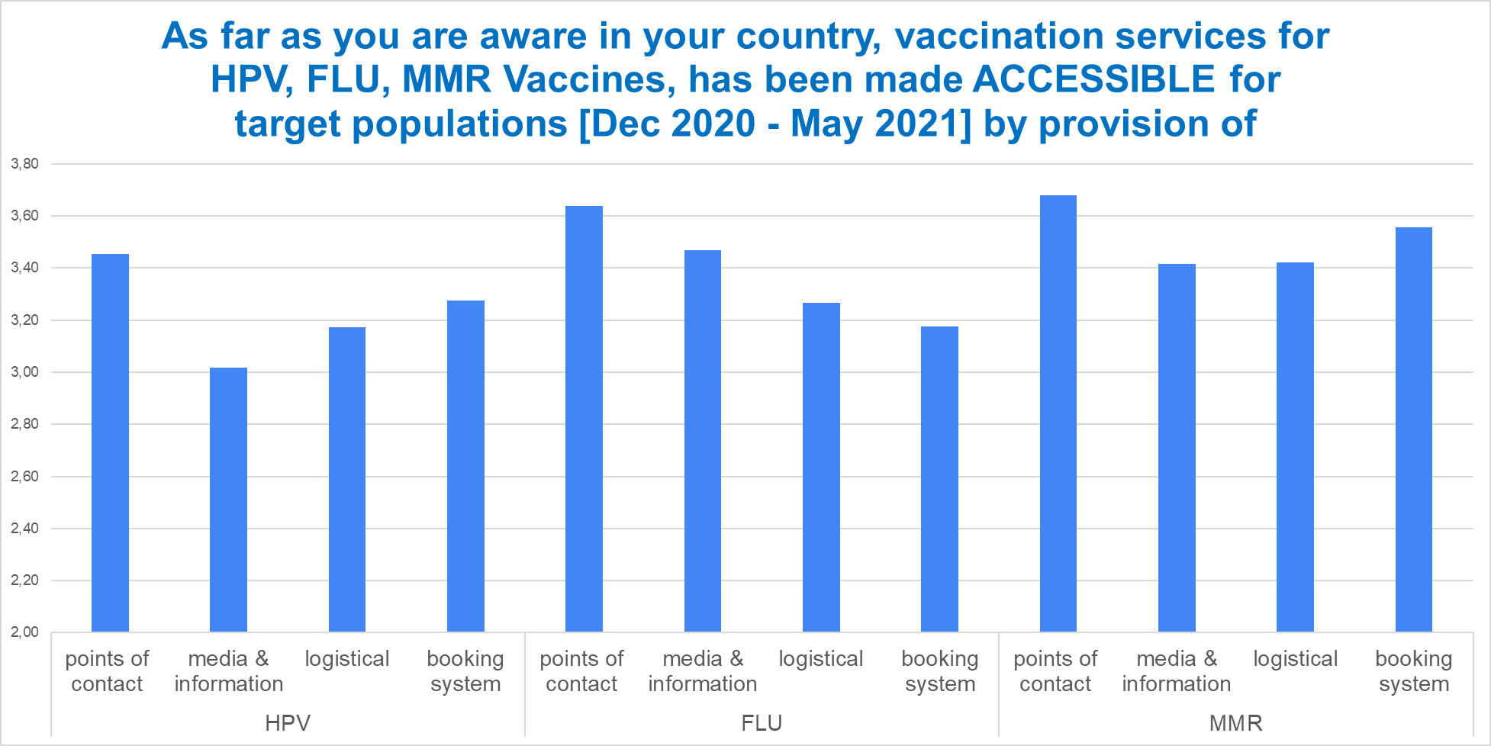
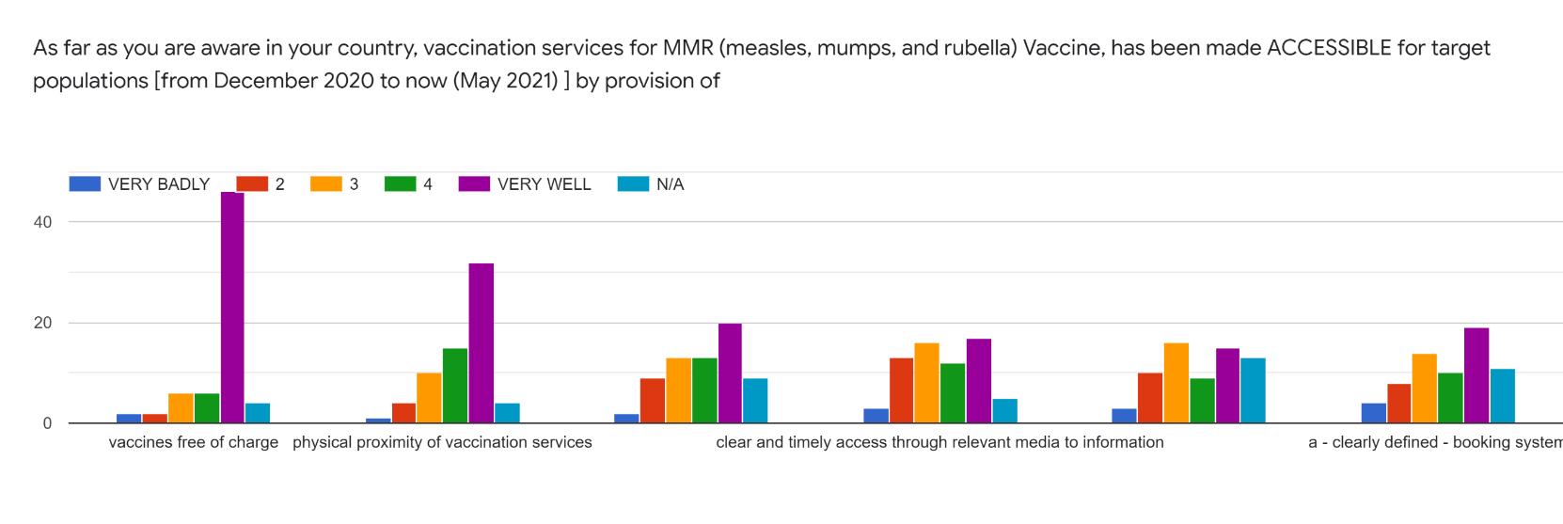
ACCESS
Average
Vaccines free of charge
Physical proximity of vaccination services
Central point of contact clearly communicate to citizens
Clear and timely access through relevant media to information
Increasing logistical and transport capabilities
a - clearly defined - booking system
NO SLIDE
NO nella SLIDE
Notes:
COMPLETE ANWERS: central points of contact clearly communicated to citizens - clear and timely access through relevant media to information - increasing logistical and transport capabilities - a - clearly defined - booking system

Slide 10
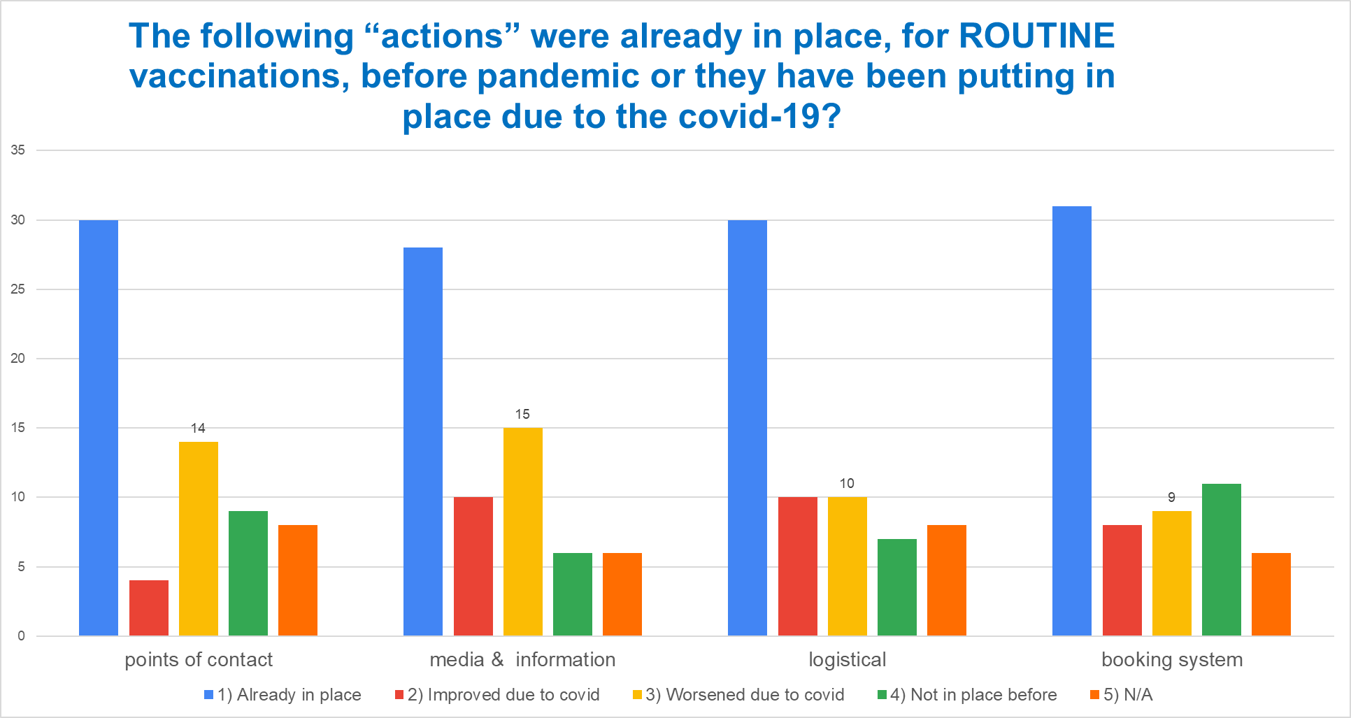
ACCESS
Notes:
COMPLETE ANWERS: central points of contact clearly communicated to citizens - clear and timely access through relevant media to information - increasing logistical and transport capabilities - a - clearly defined - booking system

Slide 11
“Establish that adulthood protection against all vaccine-preventable diseases and the need to avoid unnecessary hospitalizations should remain a priority for the years to come”

Slide 12
Monitoring
Notes:
COMPLETE ANWERS: having up-to-date registries - having registries fully compliant with data protection legislation - data appropriately collected to enable the subsequent post-marketing surveillance - data appropriately collected to enable ‘real time’ monitoring activities - having effective recall system for 2 doses vaccines

Slide 13
Proposals to overcome MONITORING problems related to ROUTINE vaccinations
Digitalization - Create digital systems where all the data for the individual is listed – generate an electronic patient record and a unique patient ID number - Safe data storage - digital vaccination database. More Interoperability - hire case manager and staff to encode data - dedicated workforce. Introduce EU-wide digital vaccination pass for everyone and every vaccination, not only COVID-19. Take example from the monitoring system in place for the COVID-19 vaccination.
One National Immunization register - National database access to data to all healthcare professionals - Centralized and efficient IT system, user friendly and free of charge - good compliance by sharing data from local governments - provide feedback to the end-user (the GP), including benchmarking with his/her peers within the country and between the countries. Active process of monitorization of those unvaccinated or with incomplete schemes.
Education for healthcare workers - more proactive primary care - Ensure accurate data entering by professionals - train healthcare professionals - access to patients’ vaccination records and reminding patients when vaccines are required.
Communicating with defaulters - personal calls and communicative talks about vaccination to the elderly
- not only letter at home.

Slide 14
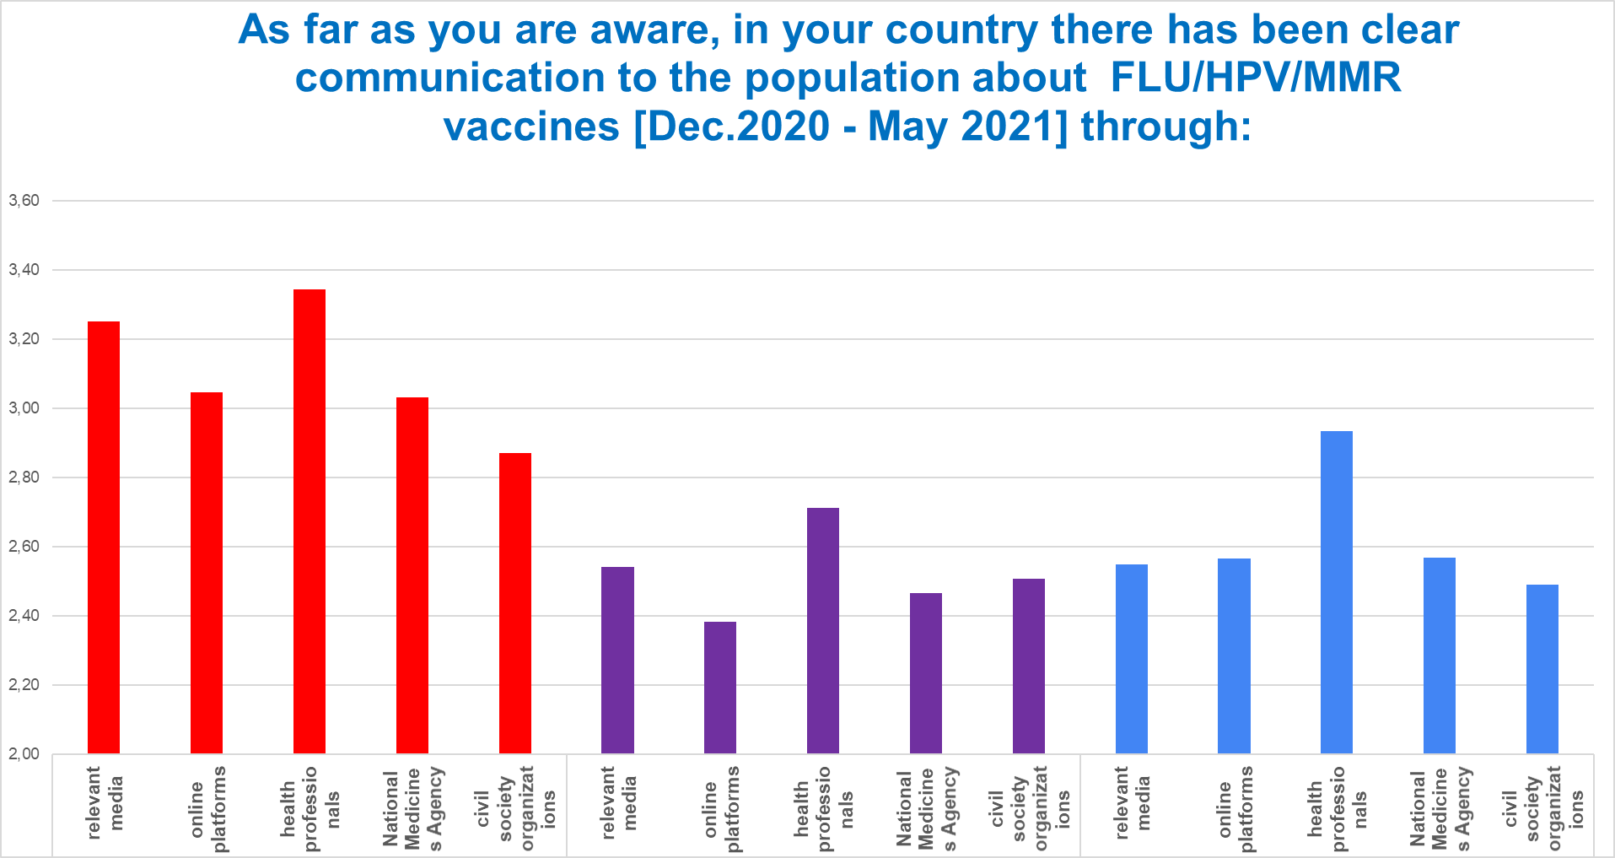
Communication
Average
FLU
HPV
MMR
Notes:
COMPLETE ANWERS: relevant media - popular communication channels (online platforms) - working with health professionals as trusted sources on vaccination matters - the National Medicines Agency - civil society organizations/patients advocy groups

Slide 15
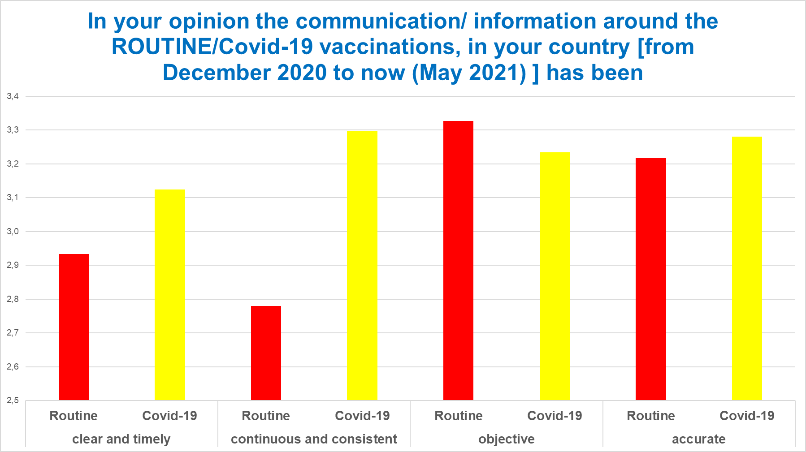
Communication
Average

Slide 16
Proposals to improve the COMMUNICATION of the ROUTINE vaccinations strategies
Information/communication campaigns - trustful - coordinated – with scientific evidence – vs social media disinformation - coming from only one source with no different interpretations by any other body.
Equip health professionals with the tools, time and money to provide information about the vaccines - to increase primary care activity - respecting the scientists and their scientific recommendations - be more proactive - training on communication and vaccinology - fully utilising the public health doctors
Increase community engagement and multi-stakeholders’ collaboration involving citizen/patients' advocacy groups scientific societies, and HCPs – with health education - and increase health literacy in schools.

