Slide 1
Project Web page
Eventuale sottotitolo o orario/data o spiegazione

Slide 2
Framework
Our commitment, as a European network,
is to engage citizens and citizens’ associations and health stakeholders across Europe to better know and implement vaccination policies.
The current pandemic is placing a huge strain on health systems worldwide, forcing them to adapt and sometimes innovate in care management:
what are the lessons learned for the VACCINATION systems?
Problems & Proposals

Slide 4
TOPICS
From the
EU Commission’s key steps for effective vaccination strategies and vaccines deployment
- RESOURCES
have sufficient resources to assure the capacity of vaccination services to deliver vaccines
- ACCESS
easy access to vaccines for target populations, both in terms of affordability and physical proximity and information.
- MONITORING
ensure that Immunisation Information Systems and other vaccination registries are updated and ready to process vaccination data.
- COMMUNICATION
ensure clear communication on the benefits, risks and importance of vaccines,
thus promoting public trust; tackling the misinformation and disinformation.
+ GENERAL INFO on Concomitant deployment & ENGAGEMENT of stakeholders

Slide 5
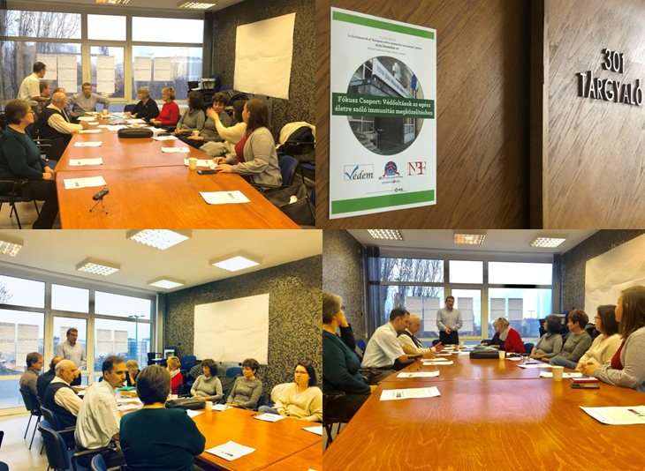
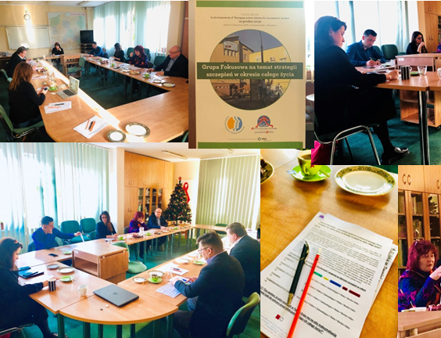
From
October 2021
to November 2021
II Survey as
an “online focus group” about FLU VACCINATION in times of Covid-19 vaccination

Slide 6
II EU online survey (Oct/Nov 2021)
RECEIVED: 82 answers from 23 countries, most of them from Belgium, France, Ireland, Italy, Malta, Portugal, Romania, Spain, UK...
33 national PAGs (Patients Advocacy Groups) and citizens’ organizations
35 national healthcare professionals
13 national health institutions dealing with vaccination
+ 1 Pharmaceutical company
by

Slide 7
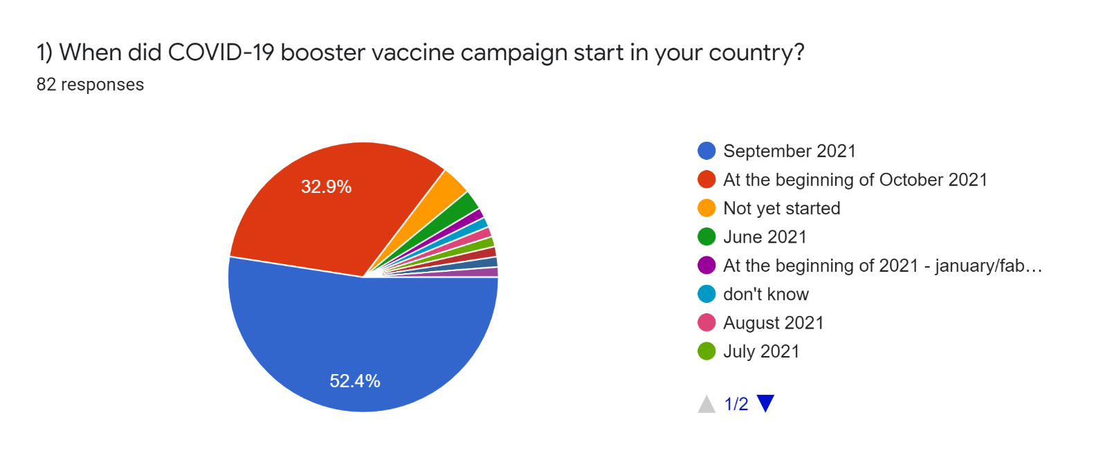
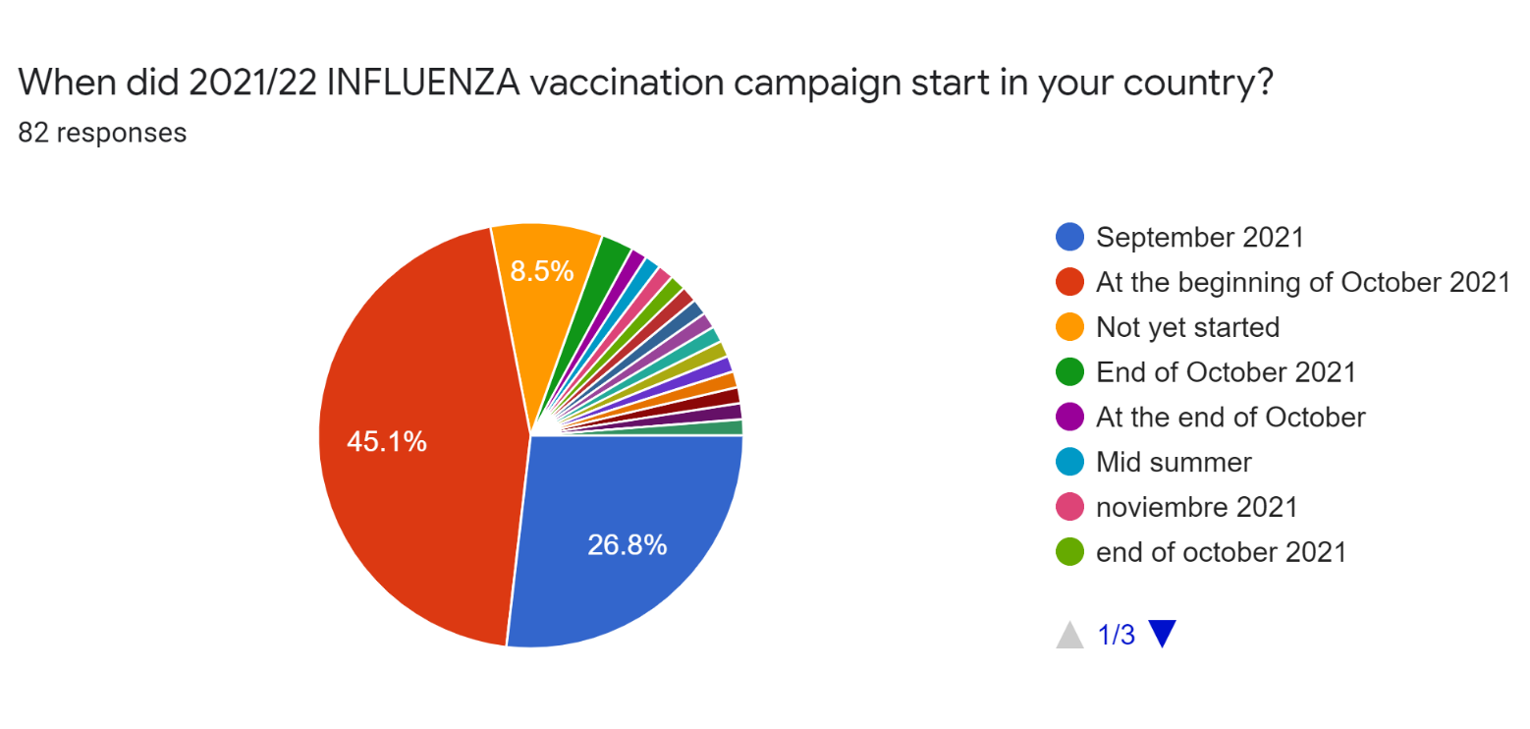
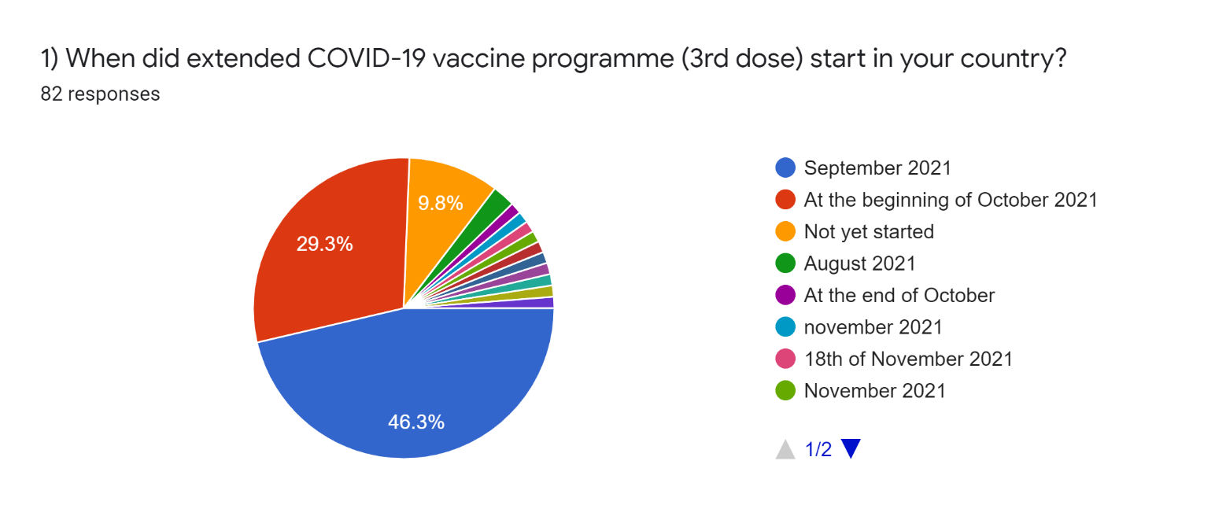
When did the campaigns start?
= confusion and differences among dates, 3rd dose, booster, also within the same country

Slide 8
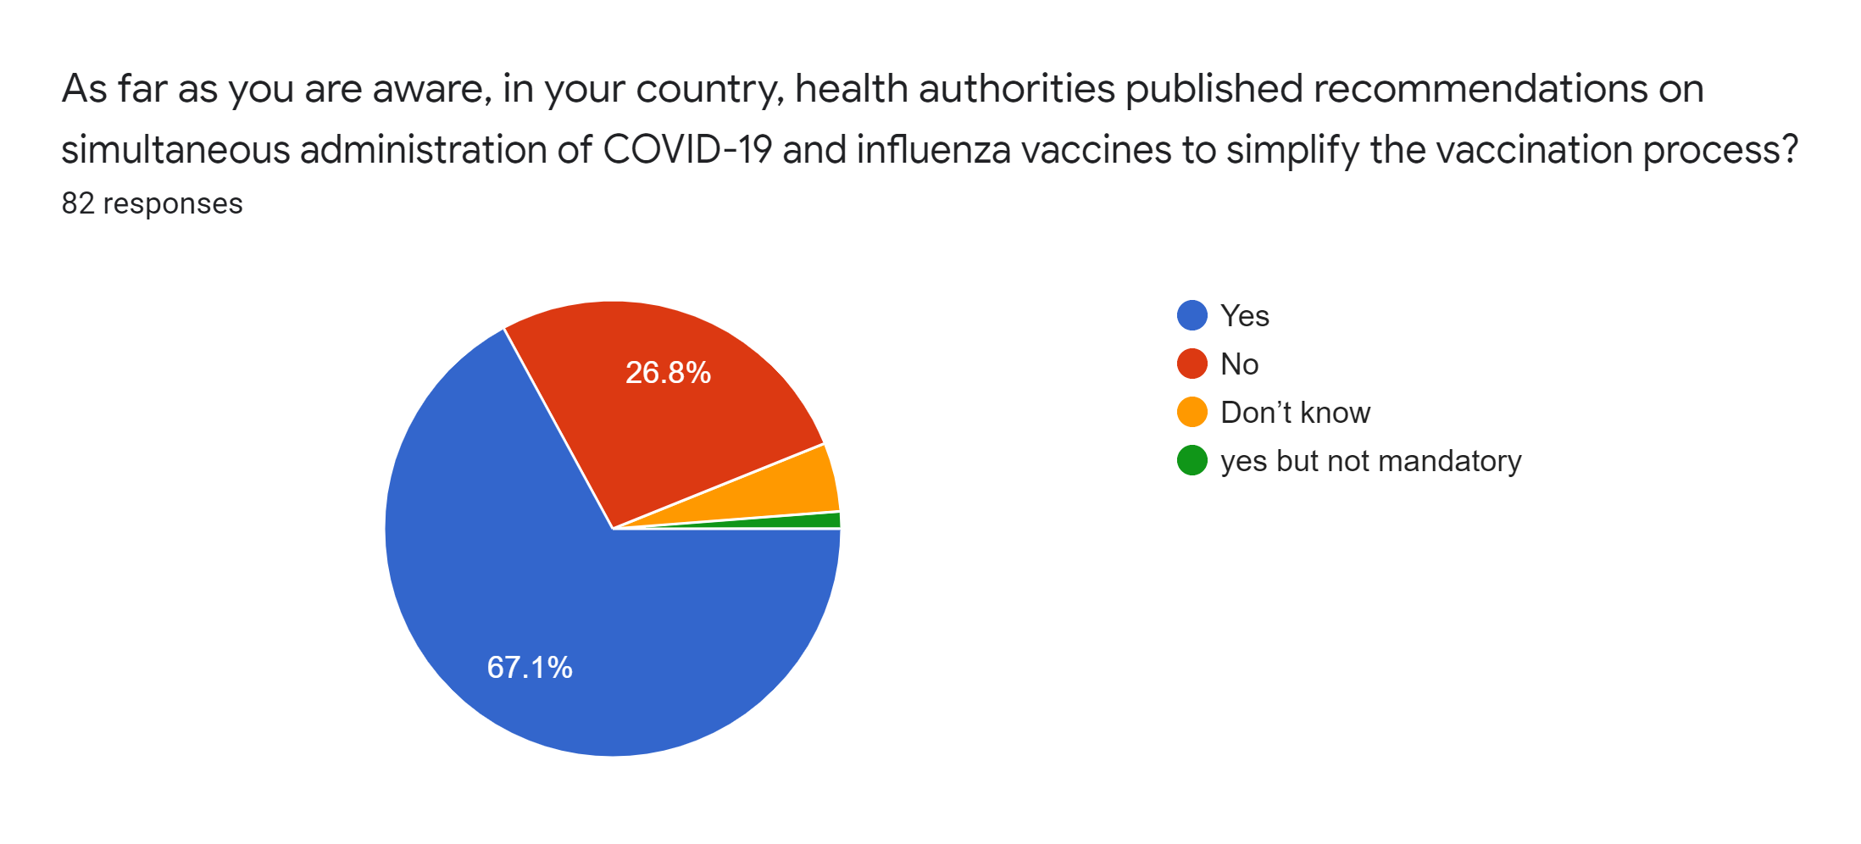
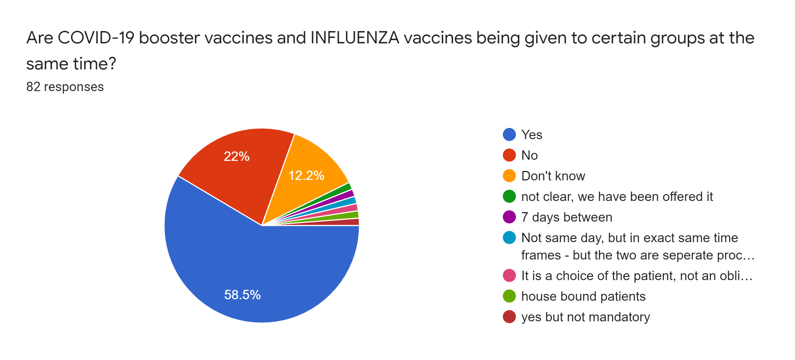
Co-administration Covid-flu

Slide 9
Any delay for the FLU campaign?...NO

Slide 10
Prioritization of at-risk groups for FLU
In your country, in the early phase of the FLU vaccination campaign [OCT 2021-NOV 2021], prioritization of at-risk groups was handled for
Medium Pregnant women & Young children (<6years old)
Very badly (or they don't know) Marginalised groups ( migrants, refugees etc..)
Marginalised groups

Slide 11
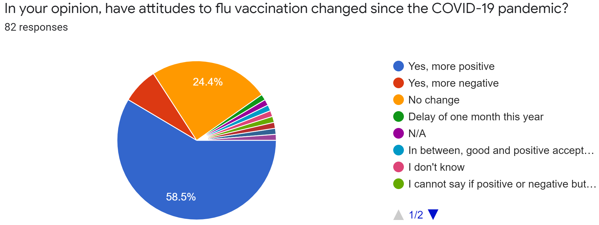
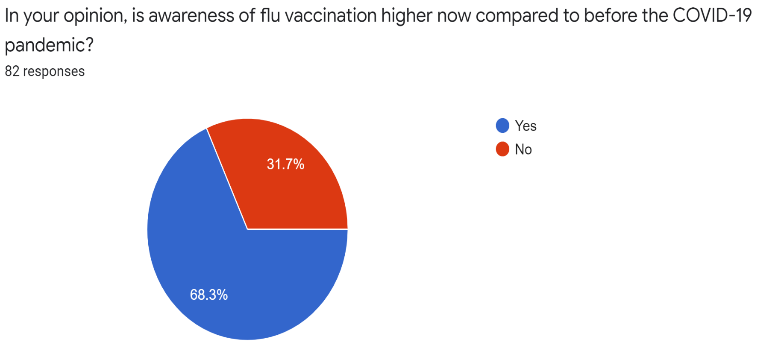
ATTITUDES and AWARENESS
of FLU vaccination

Slide 12
PNEUMOCOCCAL – SHINGLES – PERTUSSIS recommended to be administered with FLU
above all, it is recommended
the pneumococcal vaccine
Differences

Slide 13
SUPPLY

Slide 14
- very well for funded vaccines - enough for investing in HCPs training and communication on vaccination - quite bad for new workforce (for the administration of vaccines) recruitments -quite bad for investment in healthcare infrastructure - bad for planning to progressively invest in life-course immunization (but many answers are I don't know!)
RESOURCES

Slide 15
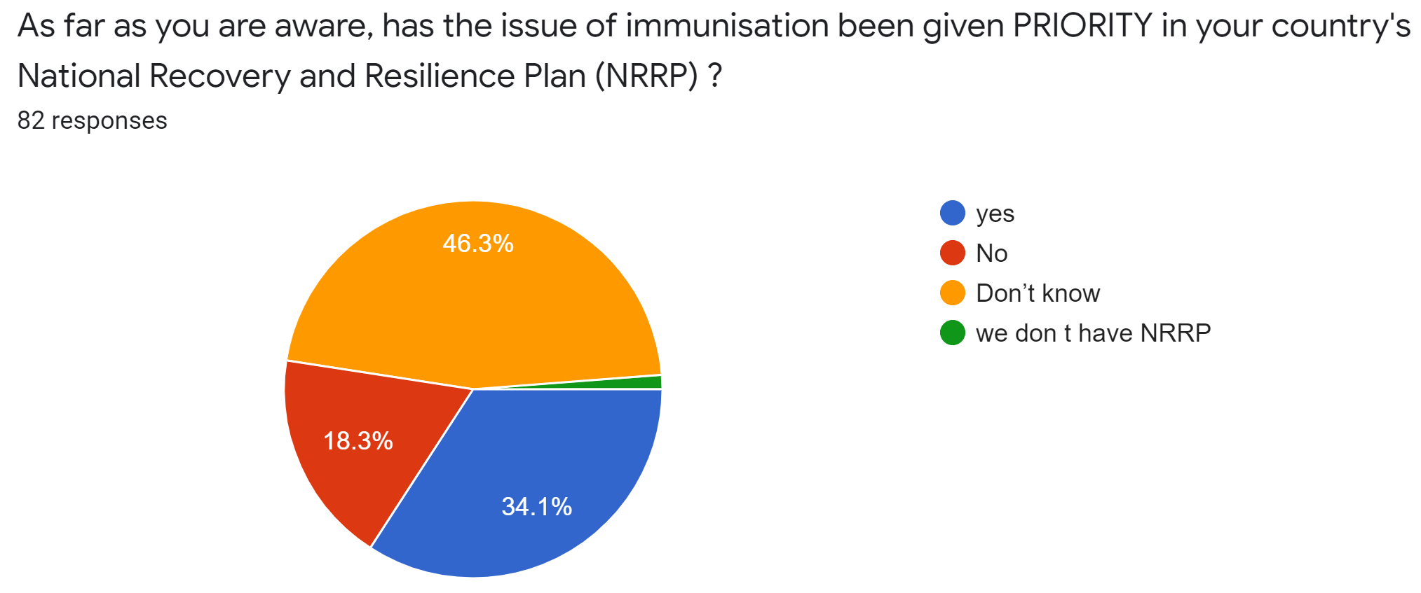
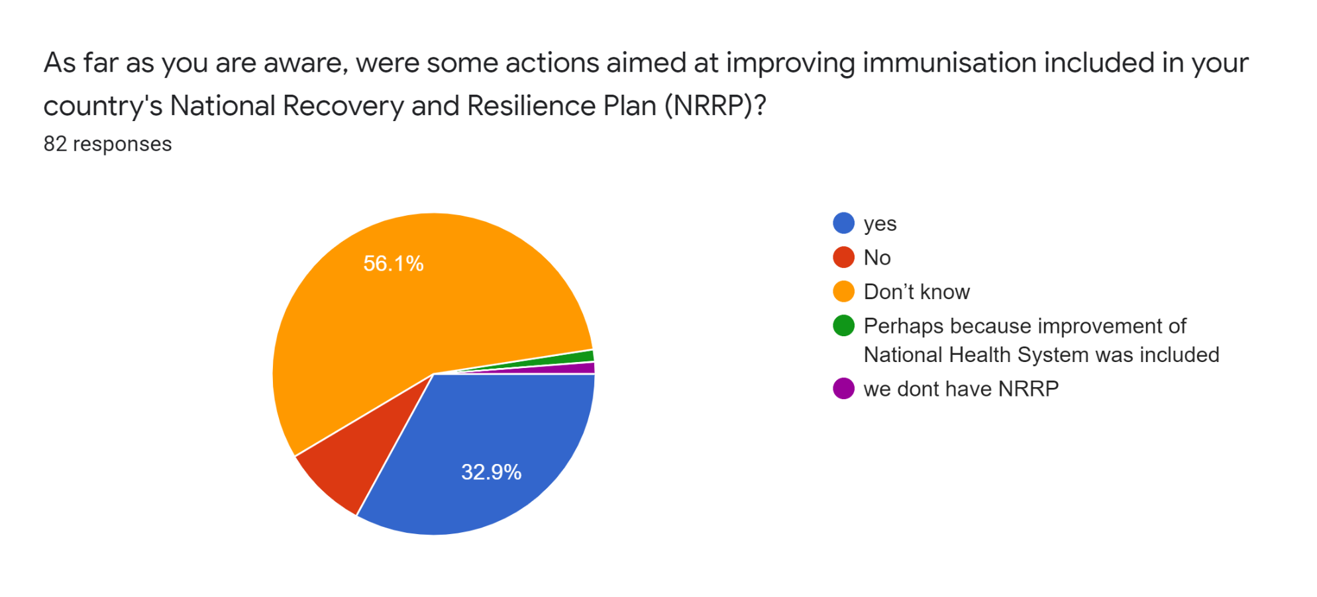
NRRP
and immunization

Slide 16
What are your main proposals to facilitate overcoming RESOURCES problems related to FLU Vaccination?
Extend the categories of
HCPs allowed to vaccinate against Flu
and places
Communication
and Education
Greater investment and greater organization

Slide 17
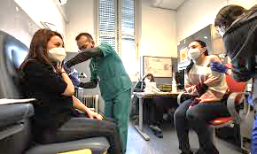
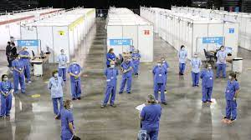
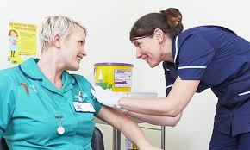
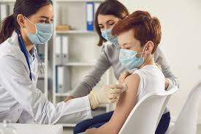
ACCESS
70% GPs 51% Vaccination centers 40% Nurses 39% Pediatricians 32% Pharmacies 13% Employers

Slide 18
ACCESS
As far as you are aware in your country, the following actions have been implemented to support and facilitate access to FLU vaccination for target populations?
Pretty good: Expanding vaccination administering channels
Pretty good: Campaign duration
Bad enough: Improving communication activities for target populations
Bad enough: guidance to HCPs
Pretty bad: booking systems
Pretty bad: central contact points
Bad: collaboration with key stakeholders

Slide 19
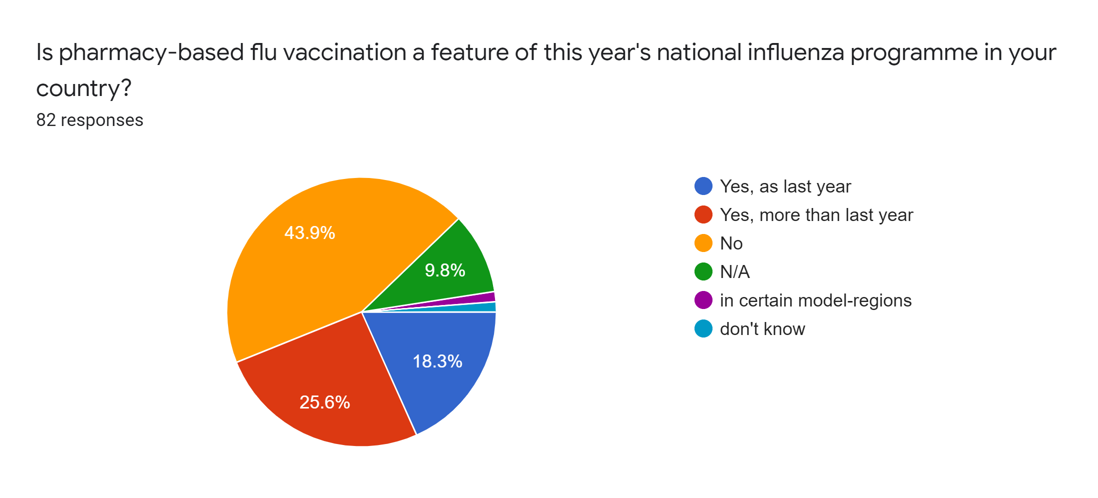
ACCESS
“If so, how is it working in your opinion?”
- Very well in Ireland
- Well in France
- Well in Italy but inequalities
- Quite well in Portugal and UK
YES «more than in 2020» (France, Ireland, Italy, Portugal, UK)
NO (Austria, Belgium, Malta, Poland, Romania, Hungary, Spain)

Slide 20
ACCESS
39% yes
31% don't know!
29% no

Slide 21
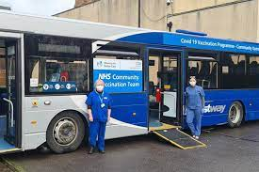
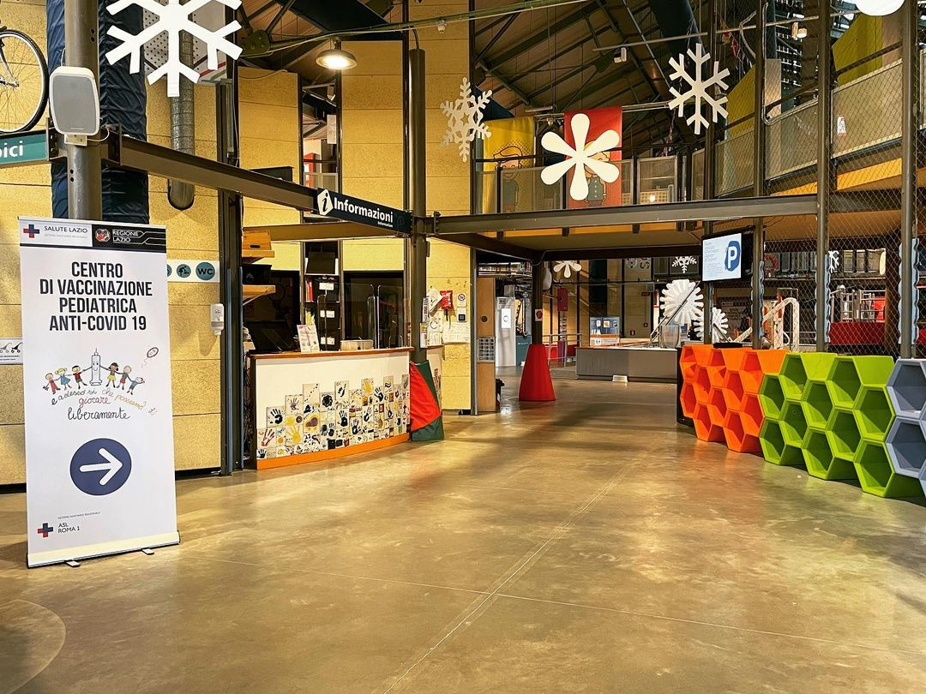
Which are your proposals - ACCESS
“Vaccination with low obstacles”:
extend the possibilities
improve communication
improve supply of vaccines

Slide 22
MONITORING
Quite bad:
-Data appropriately collected and communicated to enable ‘real time’
monitoring activities
-Collecting the necessary data to remind and track those that fail to receive the dose
-Unique national immunization information system (as proposed in the I survey)
-Empowering and training healthcare workers
Very bad: - Facilitating ways to communicate with defaulters
- Assess the vaccination status of all persons at each contact with the healthcare system

Slide 23
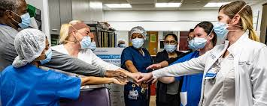
Proposals to overcome MONITORING problems
Unique national immunization information system + coordination in the EU!
Digitalization
Improving the role
of healthcare workers
Correct and clear information about the data collected

Slide 24
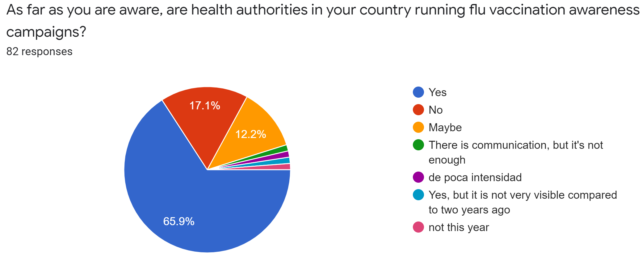
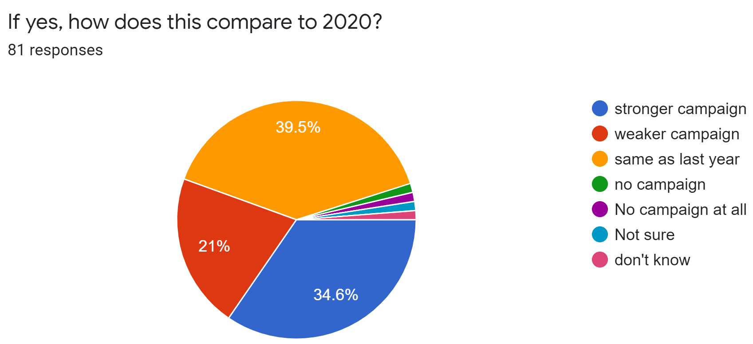
COMMUNICATION
Who is communicating about flu vaccination to the public?
74% Health professionals 73% Health authorities 29% Patients groups 25% Politicians

Slide 25
COMMUNICATION
working with health professionals as trusted sources on vaccination matters
civil society organizations/
Patients Advocacy Groups

Slide 26
COMMUNICATION
For the majority
Yes BUT more or less the same as last year

Slide 27
Proposals to improve the COMMUNICATION about FLU
Information/communication
campaigns through all media channels
Reinforce the communication made by HCPs
Increase community engagement and multi-stakeholders’ collaboration
(bottom-up)

Slide 28
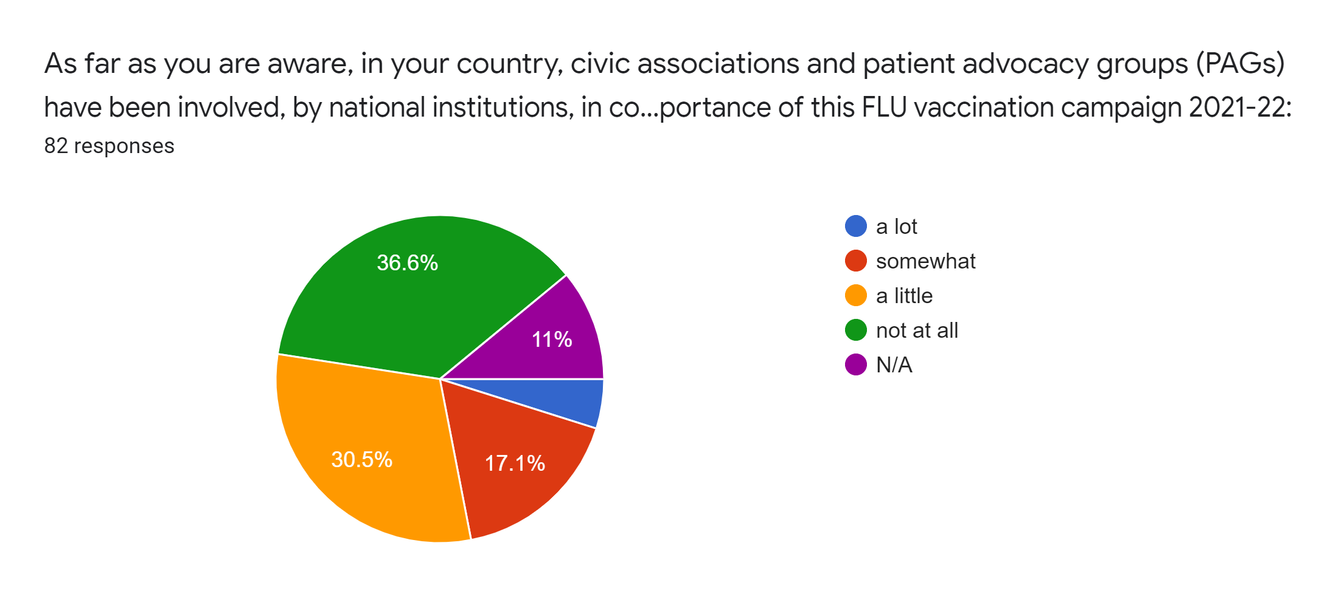
ENGAGEMENT
There has not been a big involvement of citizens' and patients' advocacy groups on this topic!

