Slide 1
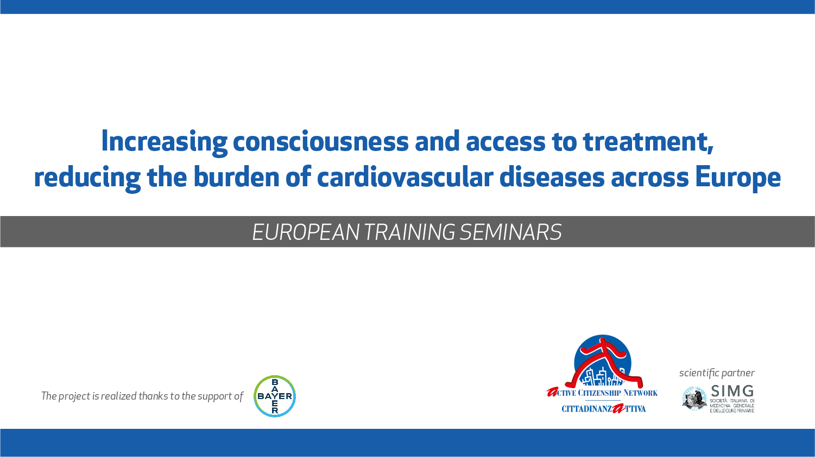

Slide 2
Prevention and management of seasonal infectious diseases and COVID-19
Role of the doctors and the citizens

Slide 3
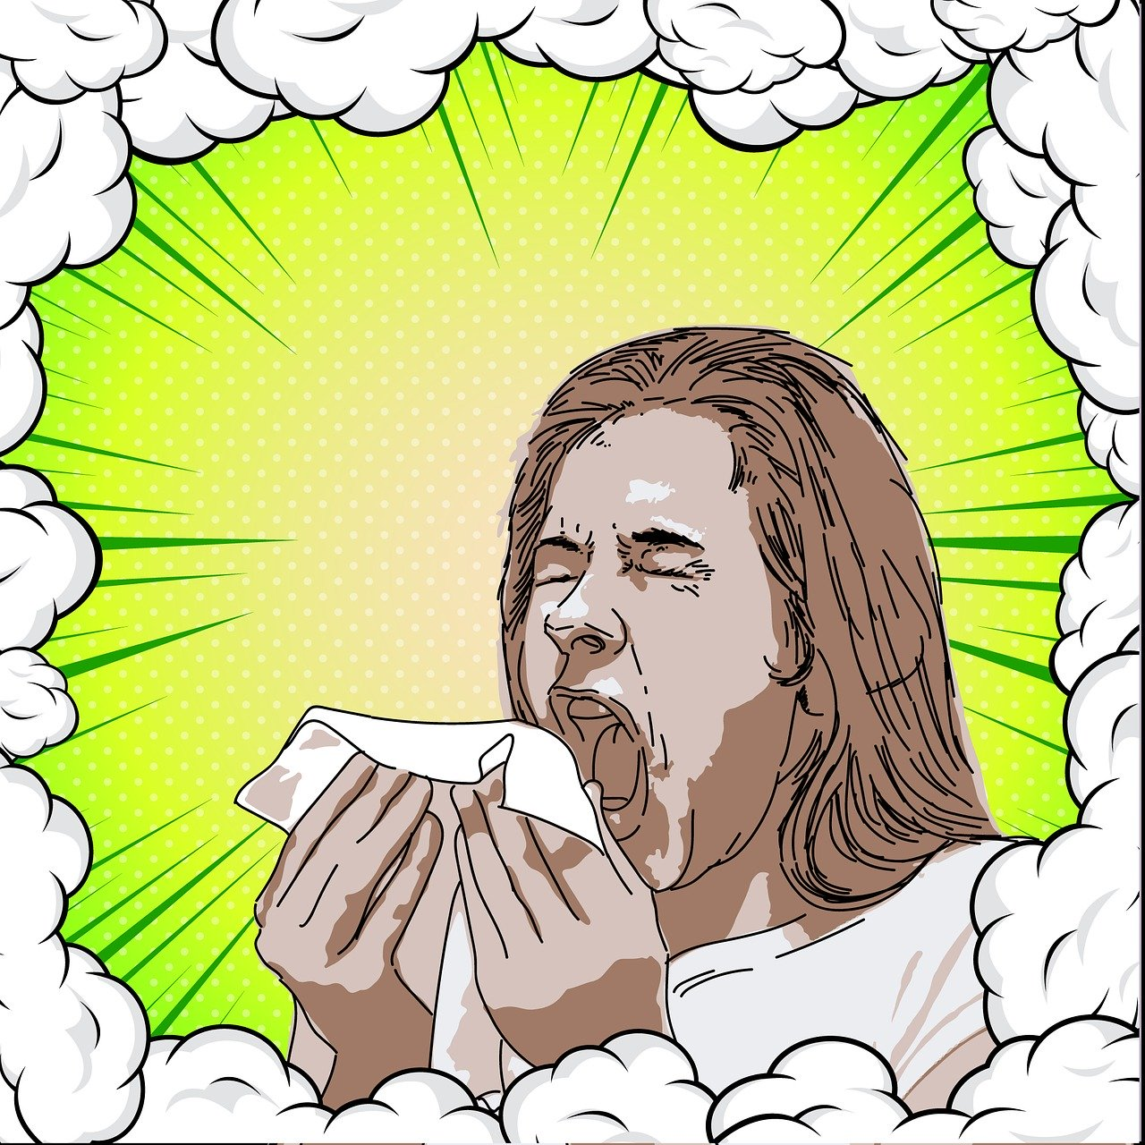
Seasonal diseases
Seasonal diseases have common symptoms:
Fever
Muscle aches
Shivering
Weakness
Sneezing
Cough
Nasal congestion
Sore throat
Headache

Slide 4
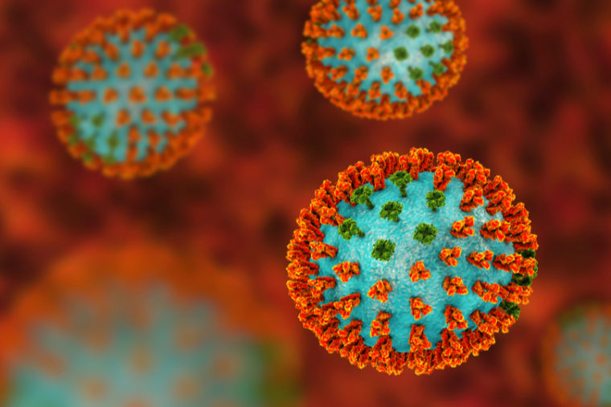
What is a flu-like illness?
An ILI (influenza-like illness) has a specific definition:
Any subject having an abrupt and quick presentation with:
  At least one of the following general symptoms:
    Fever
    Malaise/weakness
    Headache
    Muscle aches
  And at least one of the following respiratory symptoms:
    Cough
    Sore throat
    Shortness of breath

Slide 5
Which diseases present as an ILI?
COVID-19 (SARS-CoV-2)
Seasonal flu
Parainfluenza syndromes:
  Common cold
  Diseases caused by paramyxoviridae and respiratory syncytial virus

Slide 6
Characteristics of the diseases
Onset and transmission
Symptoms
Duration of the disease
Prognosis

Slide 7

Characteristics of flu
Onset and transmission:
  Time from exposure to symptoms is 1-4 days, mean 2 days
  Transmission is through droplets, but there’s a chance of transmission by air; less frequent is transmission by contact

Slide 8
Characteristics of flu
Sudden onset with:
  Fever (range 37,8-40,0°C)
  Headache
  Muscle pain
  Malaise
  Dry cough
  Sore throat
  Nasal dripping
Less frequently, expecially in children, there’s nausea and diarrhea

Slide 9
Characteristics of flu
Duration and prognosis:
  Duration depends on the strain: usually uncomplicated flu lasts 2-5 days
  Most frequent complications are superinfections (bacterial otitis, pharyngitis, pneumonia), but also viral pneumonia may occur
  Mortality is around 1-1,5/100000

Slide 10
Characteristics of flu
Therapy:
  Support and symptoms therapy
  Neuraminidasis inhibitors:
    Oseltamivir
    Zanamivir
    Baloxavir marboxil
Prevention:
  Vaccines

Slide 11

RSV and paramyxoviridae syndromes
Onset and transmission:
  Time from exposure to symptoms is 1-8 days depending on the pathogen involved
  Transmission is through direct contact and through droplets

Slide 12
RSV and paramyxoviridae syndromes
Symptoms depend on the pathogen involved:
  Nasal drip
  Cough
  Sore throat
  Headache
  Mild fever
In children RSV is associated with bronchiolitis
For immunocompromised patients they may cause pneumonia and BPCO esacerbations

Slide 13
RSV and paramyxoviridae syndromes
Duration and prognosis:
  Duration is variable
  Usually it’s self-limiting in 10 days
  Death rate may raise in immunocompromised patients or with chronic diseases, reaching 2 to 18%
Notes:
Occhio al denominatore della mortalità

Slide 14
RSV and paramyxoviridae syndromes
Therapy:
  Support and symptomatic therapy
  Ribavirin vs RSV
  Reduction of immunosuppression (if available)
  Monitoring of superinfections

Slide 15
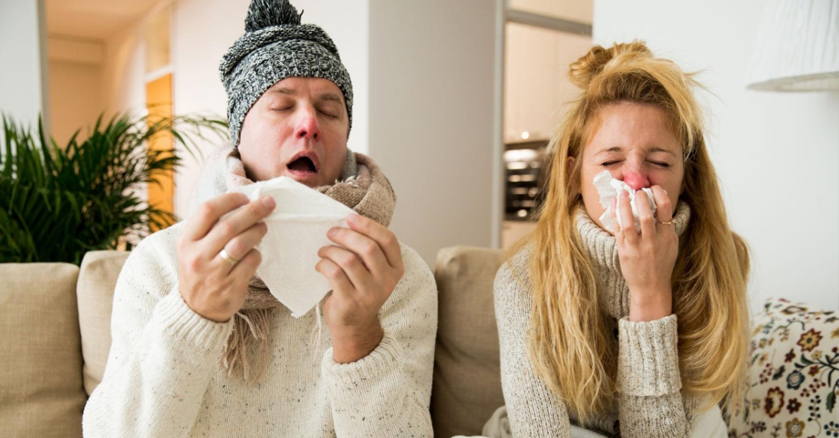
Common cold
Time from exposure and transmission:
  Time from exposure to symptoms is 2-3 days
  Transmission is through contact and droplets

Slide 16
Common cold
Symptoms are most commonly linked to an immune response than to the pathogen itself:
  Running nose
  Nasal congestion
  Sore throat
  Cough
  Malaise
  Headache

Slide 17
Common cold
Duration and prognosis:
  Prognosis is benign
  Most common complications are bacterial superinfections causing otitis or sinusitis
  Duration is 3-10 days but may last longer in smokers
    Cough can persist for weeks after resolution of other symptoms

Slide 18

Characteristics of COVID-19
Onset and transmission:
  The time from exposure to COVID-19 to the moment when symptoms begin is, on average, 5-6 days and can range from 1-14 days
  Transmission in through droplets and by contact

Slide 19
Characteristics of COVID-19
Symptoms:
  Fever: 88,7%
  Cough (dry): 67,8%
  Weakness: 38,1%
  Mucus expectoration: 33,7%
  Shortness of breath: 18,7%
  Muscle aches: 14,9%
  Sore throat: 13,9%
  Headache: 13,6%
  Shivering: 11,5%
  Nausea/vomit: 5%
  Nasal congestion: 4,8%
Initially some symptoms (now typical) weren’t considered: diarrhea, anosmia, dysgeusia, syncope
Notes:
Sincopi + anosmia/disgeusia

Slide 20
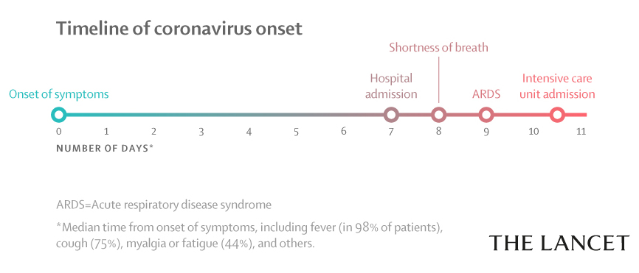
Characteristics of COVID-19
Duration and prognosis
  Worsening of the disease occur around the 10th day
  Around 90% the disease is mild, severe in around 8% and critical in 2% of the cases
  Duration of the disease has a span from 7-10 days for mild disease and 3-6 weeks for severe diseases
  People aged 60 years and over, and those with underlying medical problems are at higher risk of developing a severe illness

Slide 21
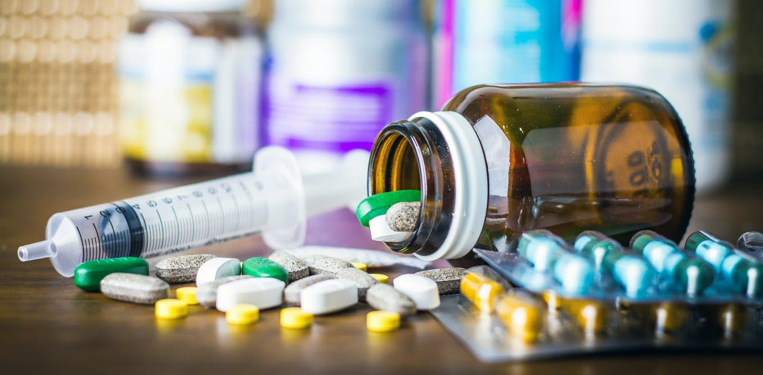
Characteristics of COVID-19
Therapy:
  Support in mild diseases
  Support therapy when in need of oxygen and if the patient can’t move (heparin)
  Drugs:
    Remdesivir
    Steroids (when oxygen is needed and only after at least 3 days of severe disease)
    Antibiotics if bacterial infection is suspected
    Others?
    Vaccines?

Slide 22
Comparison
Symptoms | COVID-19 | Common cold | Flu
Fever | Frequent | Rare | Frequent
Weakness | Possible | Possible | Frequent
Cough | Frequent, dry | Possible, mild | Frequent, dry
Sneezing | No | Frequent | No
Muscle aches | Possible | Frequent | Frequent
Running nose | Rare | Frequent | Possible
Sore throat | Possible | Frequent | Possible
Diarrhea | Rare | No | Possible, in children
Headache | Possible | Possible | Frequent
Breathlessness | Possible | No | Rare

Slide 23
Clinical case
52 year old, male, manager
Wife (teacher) and 2 kids (5 and 3 years old)
No contacts with people suffering from COVID-19
Dry cough and mild fever from 3 days
No shortness of breath, sore throat, nasal congestion, weakness, muscle aches or any other symptom

Slide 24
Comparison
Symptoms | COVID-19 | Common cold | Flu
Fever | Frequent | Rare | Frequent
Weakness | Possible | Possible | Frequent
Cough | Frequent, dry | Possible, mild | Frequent, dry
Sneezing | No | Frequent | No
Muscle aches | Possible | Frequent | Frequent
Running nose | Rare | Frequent | Possible
Sore throat | Possible | Frequent | Possible
Diarrhea | Rare | No | Possible, in children
Headache | Possible | Possible | Frequent
Breathlessness | Possible | No | Rare

Slide 25
What to do?
The patient should contact the GP as soon as symptoms start, so that the GP can do the following:
  Triage:
    Urgency
    Social criteria
    Instructions for isolation
  Visit from remote:
    Skype/Facetime
    Instruction to use common auto-measurment instruments (Blood pressure, oxymeter, if available) and monitoring
  Offering instructions for follow up

Slide 26
What should the patient do?
The most important thing is to avoid the spreading of the disease:
  Isolation
  Rapid testing
  Contact tracing
Paracetamol can be used as a symptom reliever, but other drugs can be prescribed by the GPs; avoid self-administration of drugs (i.e. antibiotics) if not shared with the GP
Alert the GP as soon as there are new symptoms or a worsening of the symptoms
Alert the GP as soon as the results of a test are ready

Slide 27
What should the patient do?
Isolation:
  Not going to public places
  Keep at least 1 mt distance from everyone, even family members
  Stay in a room different from others
  Use a different bathroom than other in your family
  Wear a mask any time you need to contact others (for food or clinical checkup)
  Keep the house well ventilated
  Stay positive by keeping in touch with loved ones by phone or online, and by exercising at home.

Slide 28
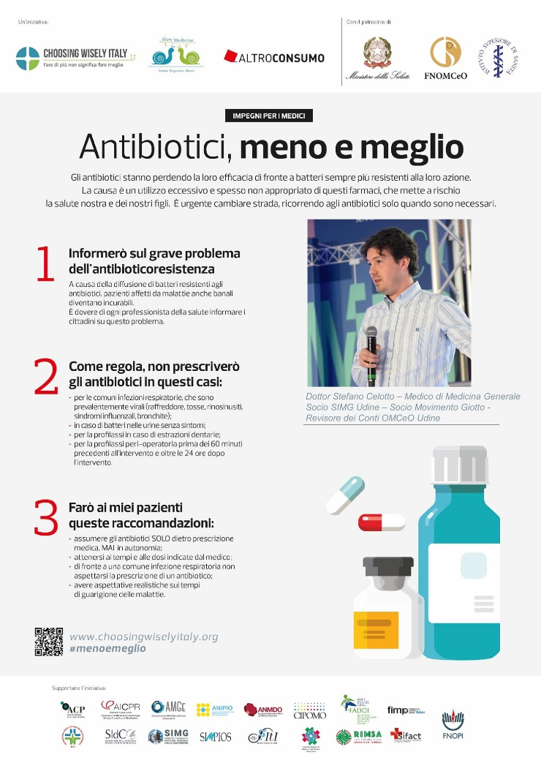
What can we do as a community?
Spread information about seasonal diseases
Spread correct information about COVID-19 and contrast fake news
Be aware that the disease is just a part of the illness, so consider the need for social programs (people will be alone when on isolation)
Participate in giving materials to people in need to face the disease (face masks, oxymeters…)

Slide 29

Thank you

