Slide 2
Patient advocacy and peer to peer support
in congenital heart disease
Dr. Edward Callus
President of the ECHDO European Congenital Heart Disease Organisation
Fixed-term Research Fellow A in Clinical Psychology in the department of Biomedical Sciences for Health at the Università degli Studi di Milano
Head of the Clinical Psychology Service at the IRCCS Policlinico San Donato Research and University Hospital

Slide 3
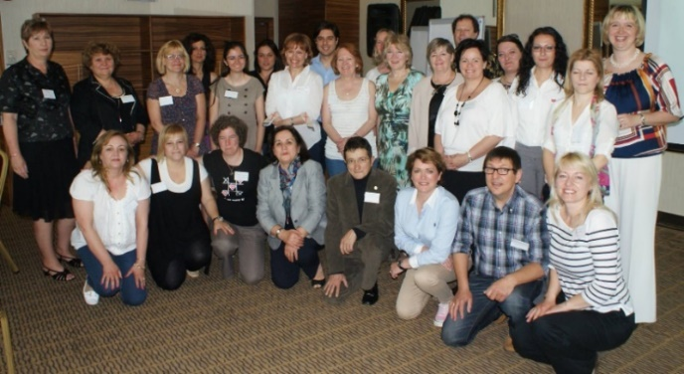
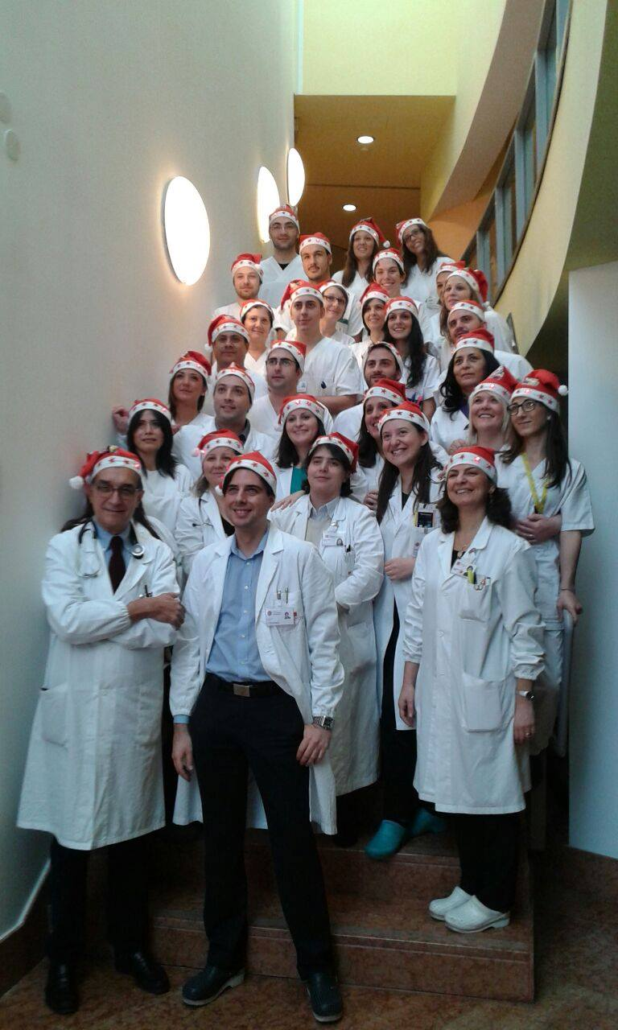
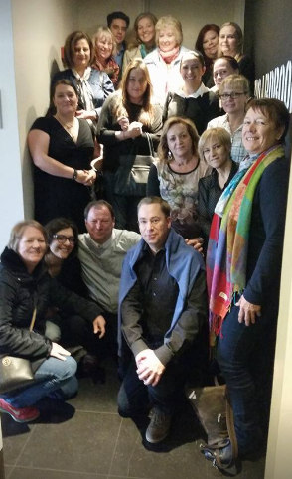
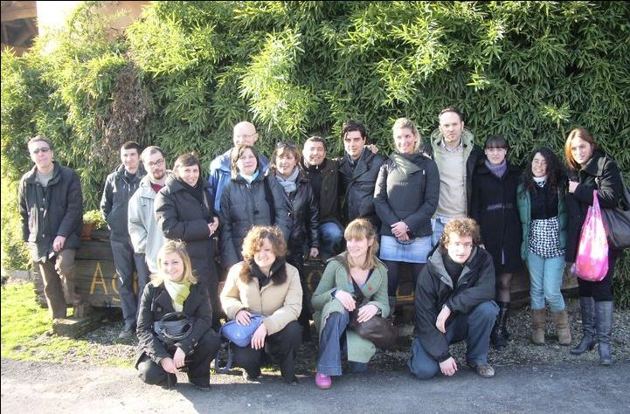
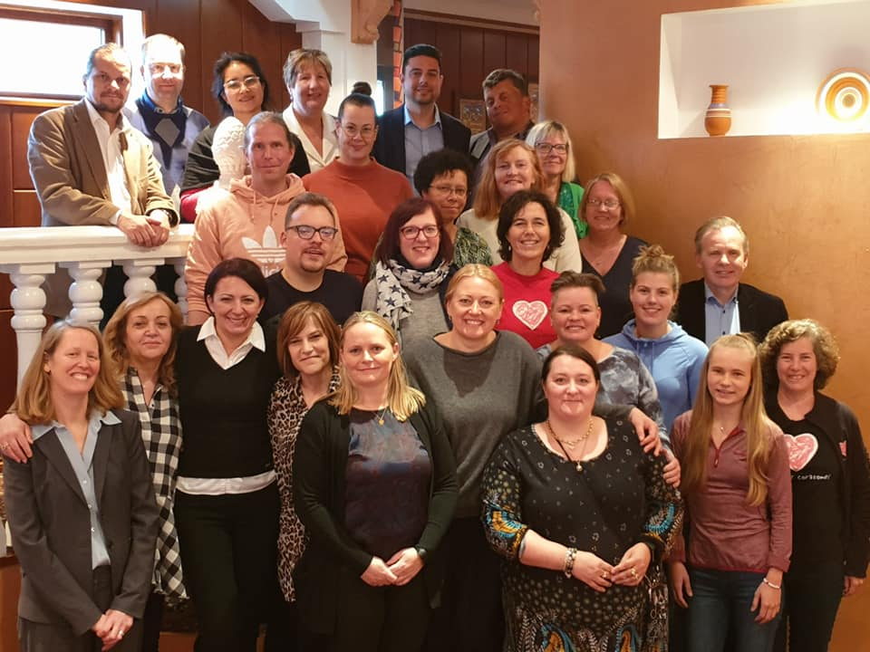

Slide 4
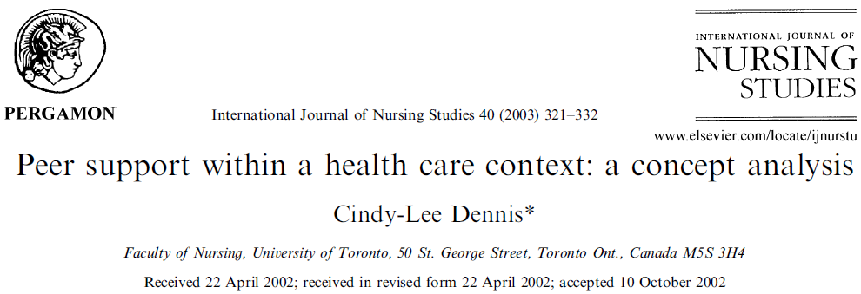

Slide 5
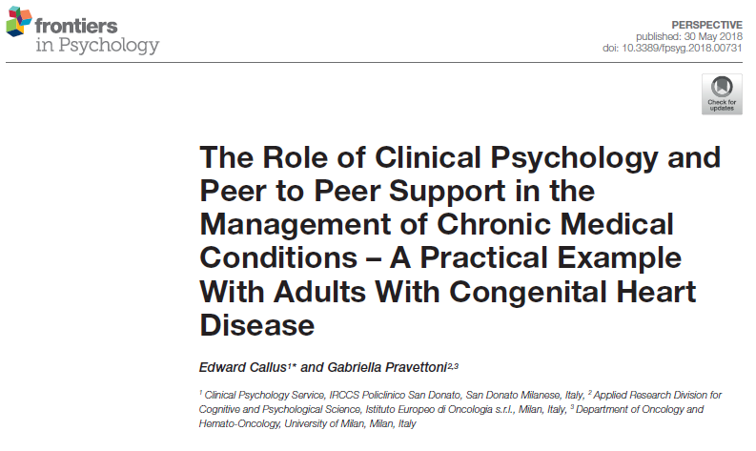
Integration of Clinical Psychology Service and Peer to peer support
Operative instruction Clinical Psychology Service
Presence of the psychologist during daily meetings of medical staff
Psychosocial evaluation of all ACHD patients prior intervention
Psychological interventions are provided according to the results of the evaluation and the indications of the medical, paramedical and psychosocial staff and also patient requests
Non-profit association activity (Associazione Italiana Cardiopatici Congeniti Adulti – AICCA)
Presence during the weekly multidisciplinary psychosocial meeting and the daily patient admission, to verify if there are any psychosocial issues.
Provision of assistance when it comes to logistic, economic and bureaucracy issues, in relation to the condition.
Social activities and outings are organized for the patients, their families, and their friends approximately once every 2/3 months.

Slide 6
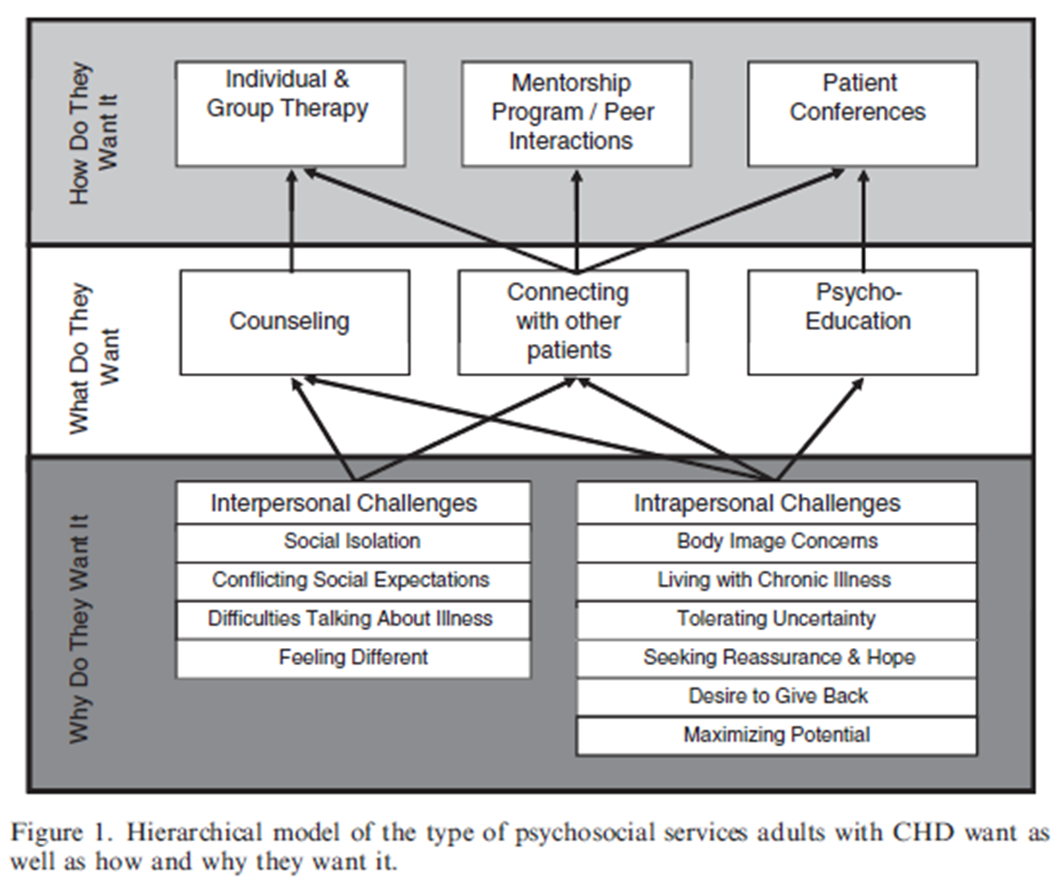
ACHD Treatment/Intervention Preferences (Kovacs 2009, Page 2012)

Slide 7
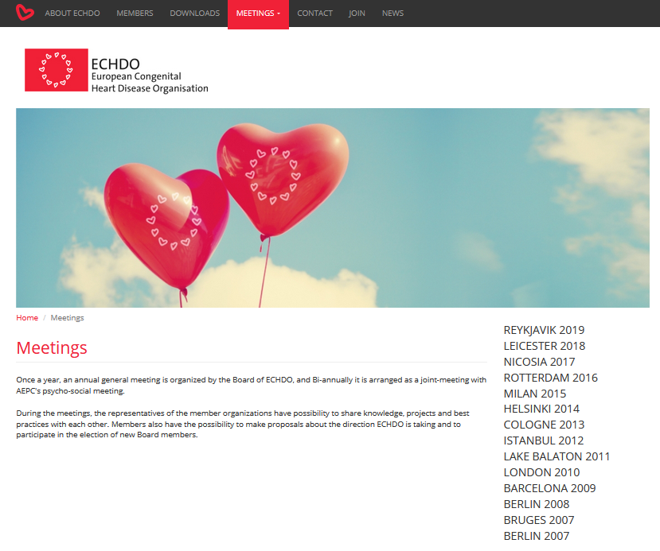

Slide 8
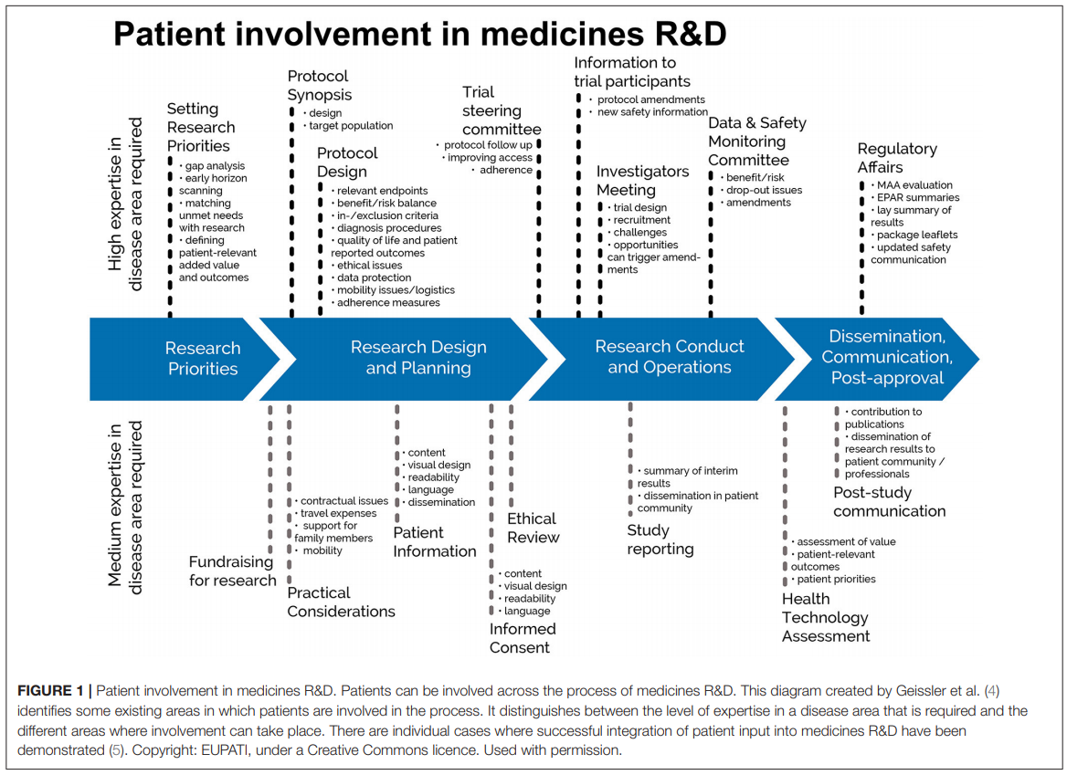

Slide 9
ECHDO participation in drafting and endorsement of European Society of Cardiology Recommendations
“Recommendations for transition to adulthood and transfer to adult care of young persons with congenital heart disease: A consensus statement of the ESC Association of Cardiovascular Nursing and Allied Professions (ACNAP), the ESC Working Group of Adult Congenital Heart Disease (WG ACHD), the Association for European Paediatric Cardiologists (AEPC), the Pan African Cardiac Society (PASCAR), the Asia-Pacific Pediatric Cardiac Society (APPCS), the Inter American Society of Cardiology (IASC), the Cardiac Society of Australia and New Zealand (CSANZ), the International Society for Adult Congenital Heart Disease (ISACHD), the World Heart Federation (WHF), the European Congenital Heart Disease Organisation (ECHDO), and the Global Alliance for Rheumatic and Congenital Hearts (Global ARCH).

Slide 10
Conclusions
Creation of formalized entities to enable effective peer to peer support and advocacy
Collaboration with both medical and psychosocial services to avoid excessive burden
Integration of patient representatives/advocates in all phases of research programs and the drafting of recommendations and guidelines

Slide 11
Thank you for your attention e.callus@echdo.eu

